Slide 1
Erasmus 2020
Life Expectancy
Sweden

Slide 2
Life expectancy

Slide 3
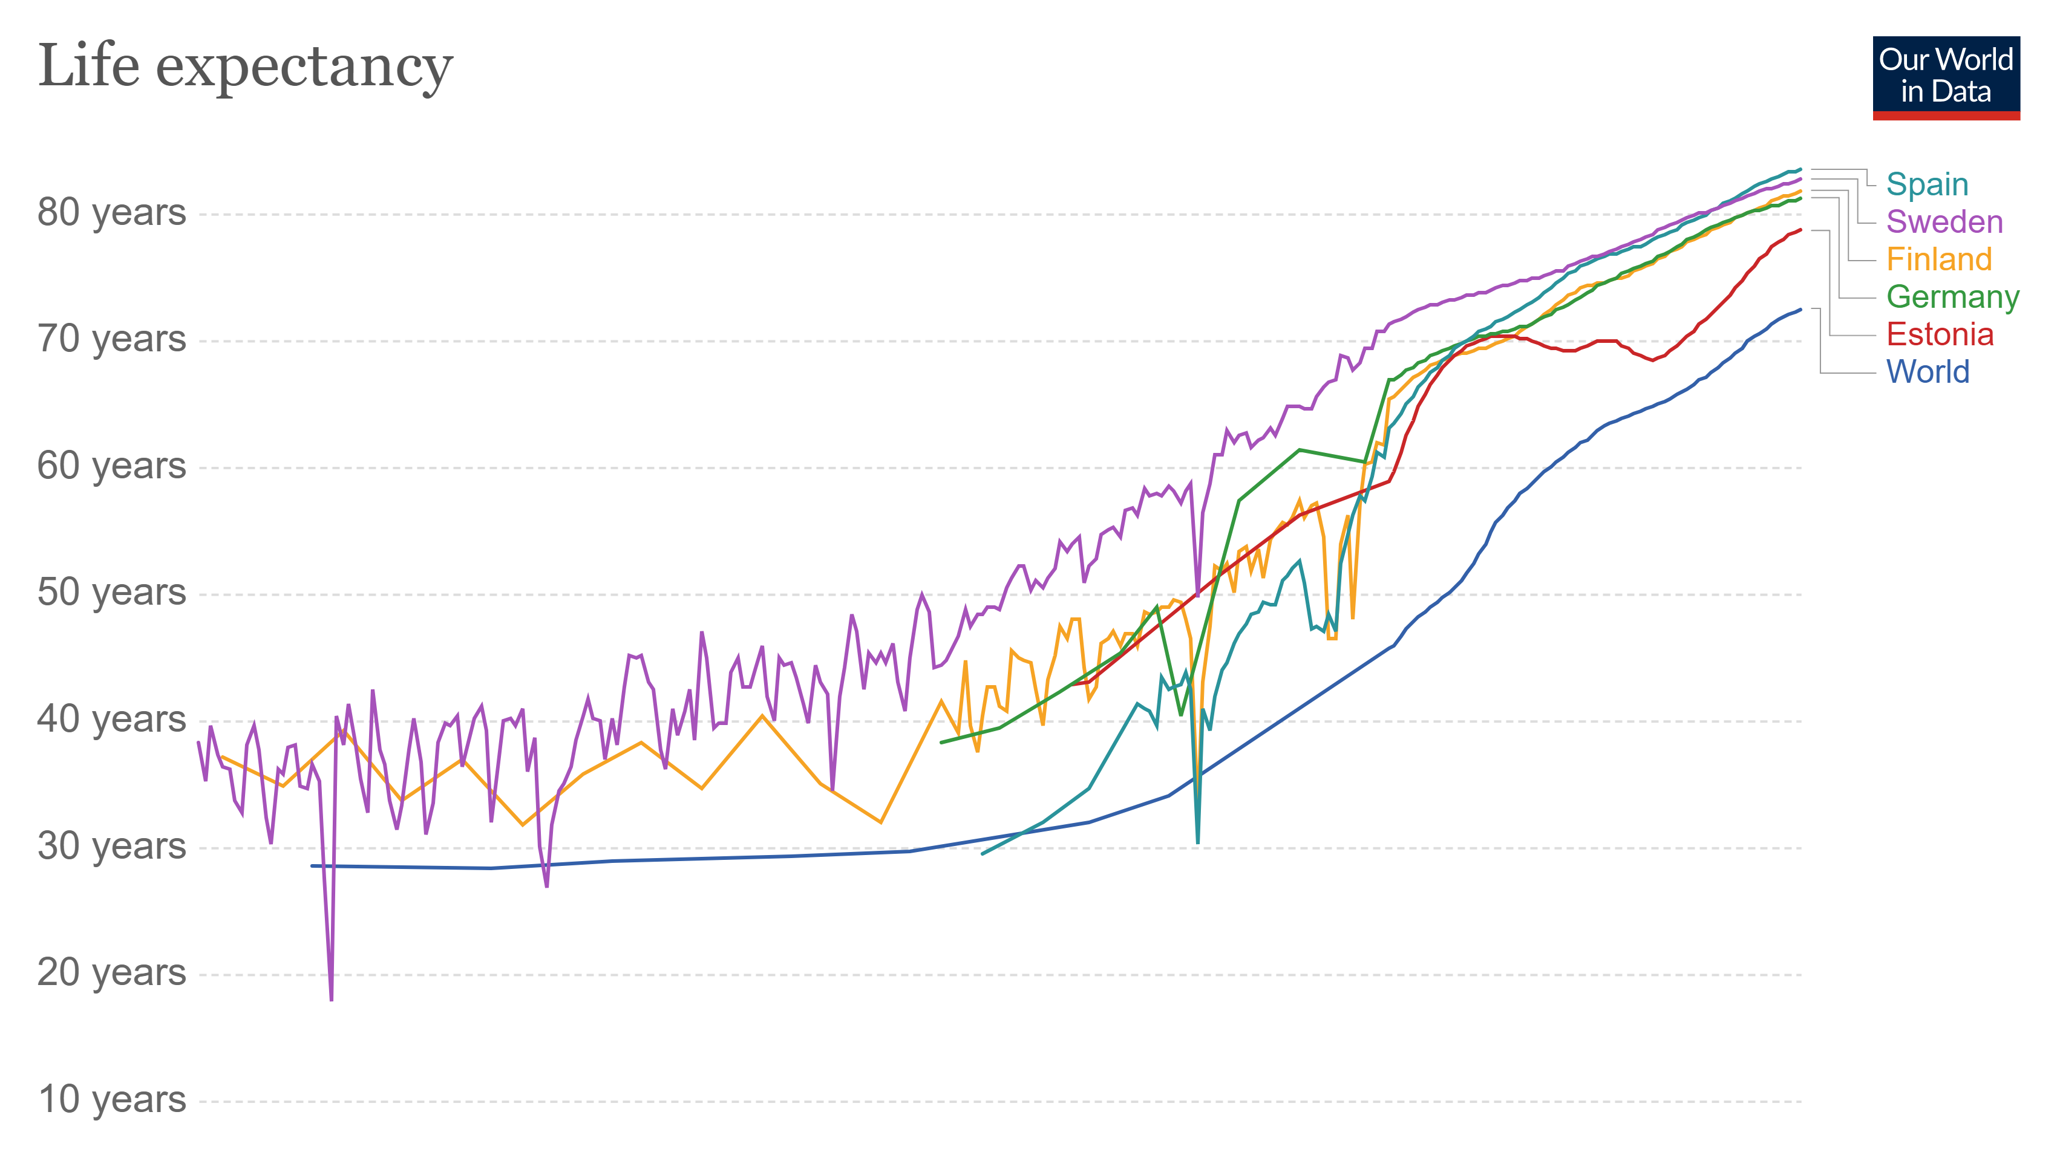

Slide 4
Why do you think we live longer now then in the past?
5 minutes

Slide 5
Video:
"How Long Will People Live For In 2050?"- The Infographics Show

Slide 6
Discussion
Do you think a longer life is beneficial or damaging for society?
What life span would be the ideal?
If you replace all your body parts with artificial ones, are you still alive?
10 minutes

Slide 8
https://en.wikipedia.org/wiki/Life_expectancy www.un.org/.../wpp2017-global-life-expectancy
https://en.wikipedia.org/wiki/Maximum_life_span
https://en.wikipedia.org/wiki/Life_extension
https://www.historylearningsite.co.uk/a-history-of-medicine/history-hygiene-timeline/

