Slide 1
SUMMER TIME
HAVE FUN IN ENGLISH!

Slide 2
Refreshing activities for a hot summer!

Slide 3
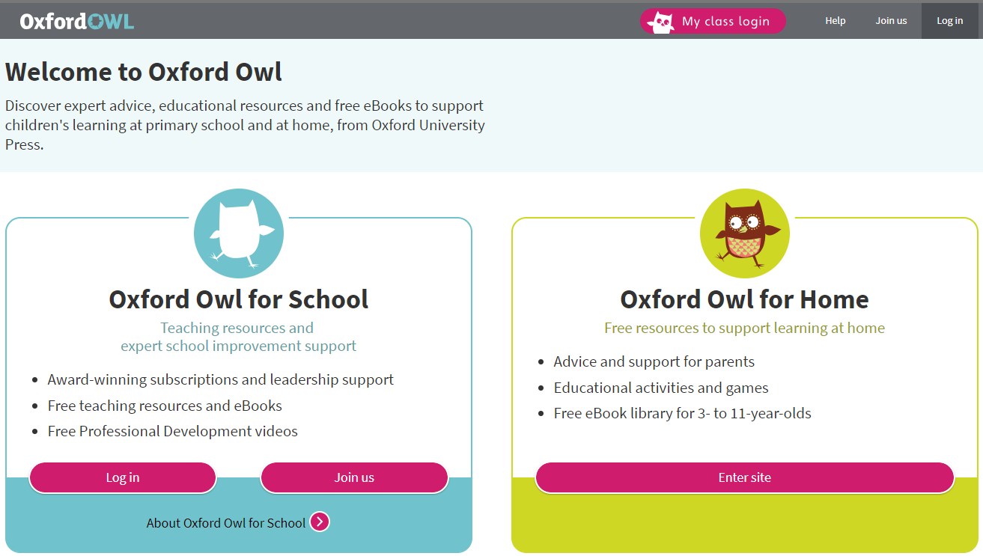
OWL https://www.oxfordowl.co.uk/

Slide 4
EDU365 http://www.edu365.cat/primaria/muds/angles/index.htm

Slide 5
ANGLÈS365 https://www.angles365.com/

Slide 6
LEARNING ENGLISH http://learnenglishkids.britishcouncil.org/en

Slide 7
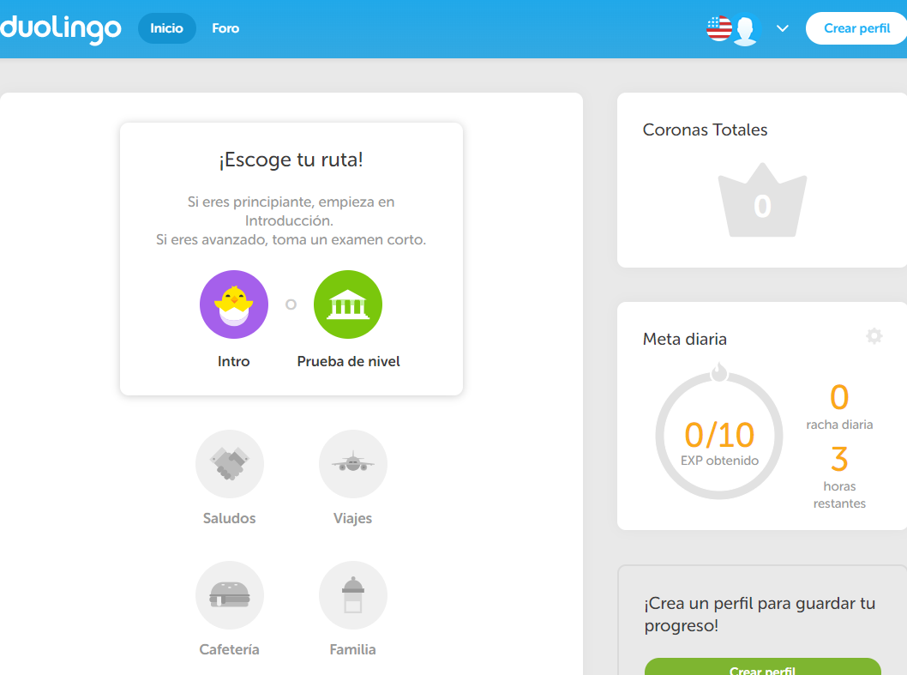
DUOLINGO https://es.duolingo.com/welcome

Slide 8
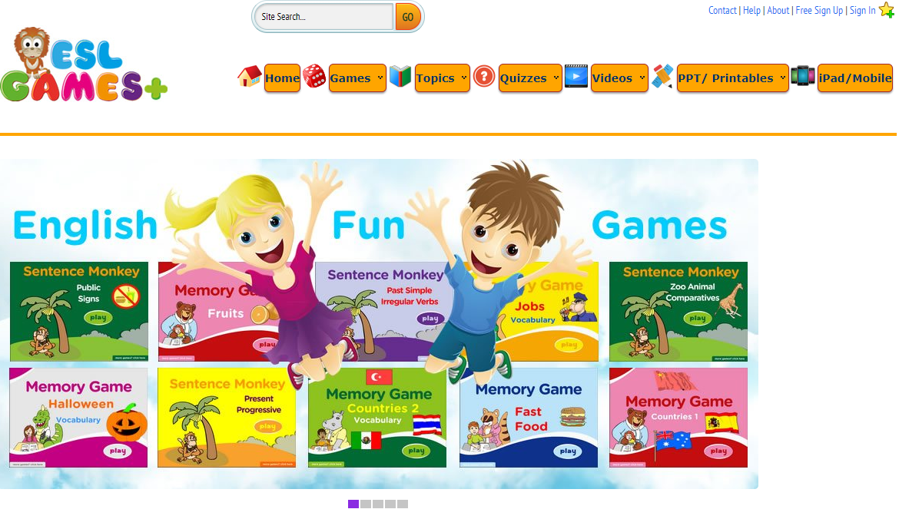
ESL GAMES https://www.eslgamesplus.com/

Slide 9
PICASSO’S WORD SEARCH

