Slide 1
PHYSICAL DESCRIPTION

Slide 2
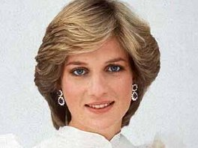

Slide 3
____ ____ ____ ____ ____ ____ ____ ____

Slide 4
FAIR HAIR

Slide 5
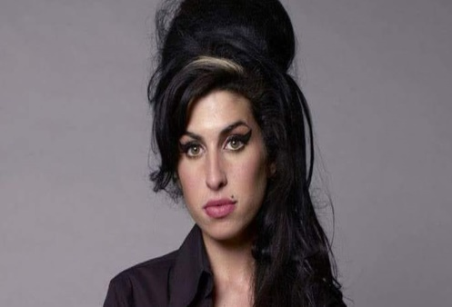

Slide 6
____ ____ ____ ____ ____ ____ ____ ____

Slide 7
DARK HAIR

Slide 8
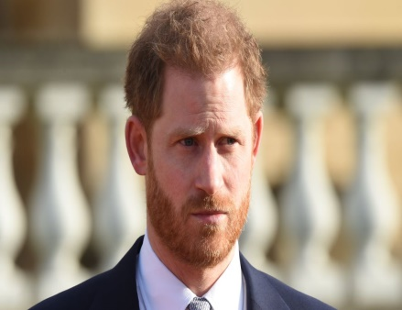

Slide 9
____ ____ ____ ____ ____ ____ ____

Slide 10
RED HAIR

Slide 11
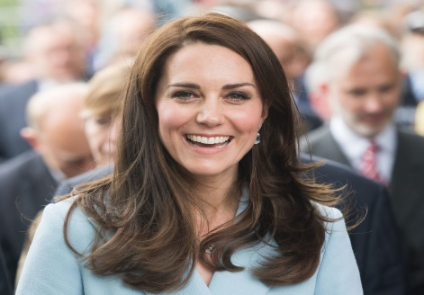

Slide 12
_ _ _ _ _ _ _ _ _ _ _ _

Slide 13
STRAIGHT HAIR

Slide 14
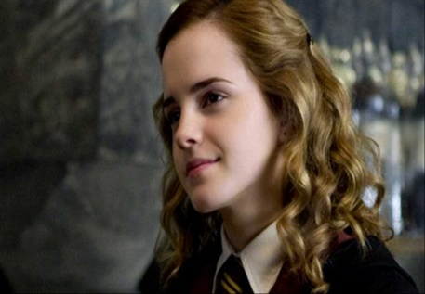

Slide 15
_ _ _ _ _ _ _ _ _

Slide 16
CURLY HAIR

Slide 17
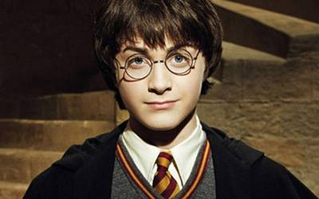

Slide 18
_ _ _ _ _ _ _

Slide 19
GLASSES

Slide 20
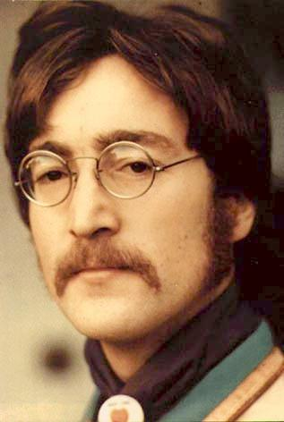

Slide 21
_ _ _ _ _ _ _ _ _

Slide 22
MOUSTACHE

Slide 23
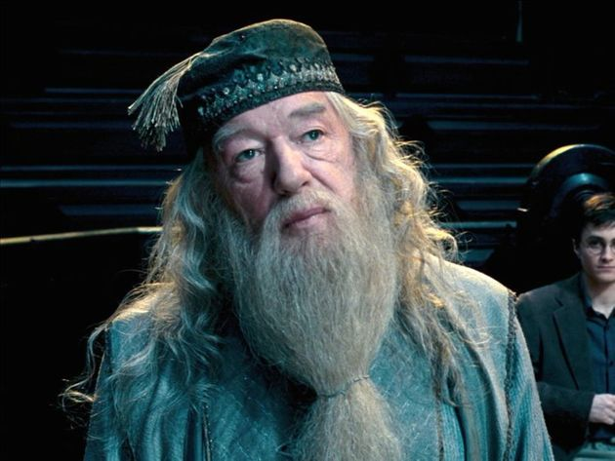

Slide 24
_ _ _ _ _

Slide 25
BEARD

Slide 26
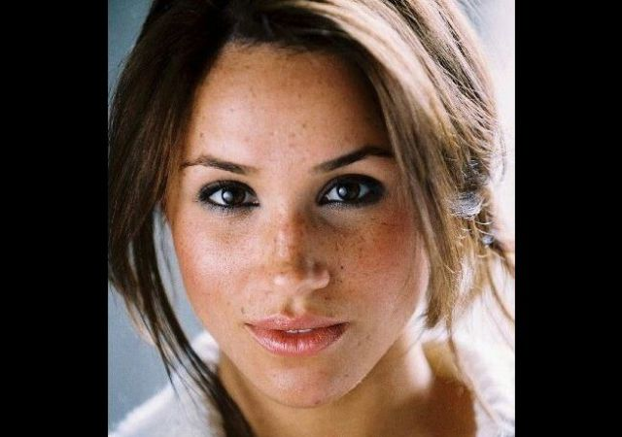

Slide 27
_ _ _ _ _ _ _ _

Slide 28
FRECKLES

Slide 29
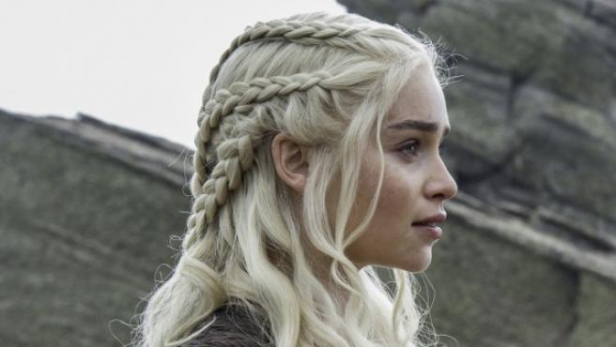

Slide 30
_ _ _ _ _ _

Slide 31
BRAIDS

Slide 32


Slide 33
_ _ _ _ _ _ _ _

Slide 34
LONG HAIR

Slide 35
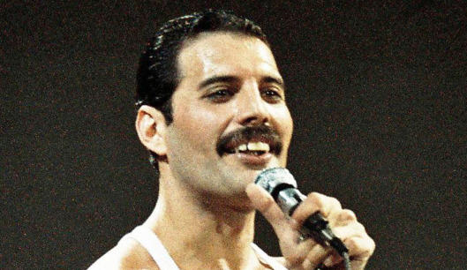

Slide 36
_ _ _ _ _ _ _ _ _

Slide 37
SHORT HAIR

