Slide 1
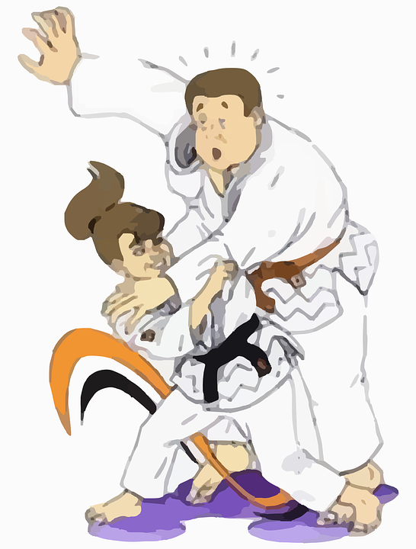
JUDO
By Nàdia

Slide 2
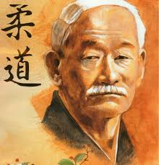
HISTORY
Judo is a Japanese martial art founded by Jigoro Kano at the end of nineteenth century after Jujutsu, escaping from dangerous or useless techniques, thus allowing his free practice in randori.

Slide 3
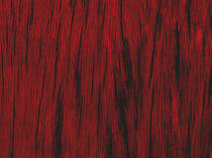
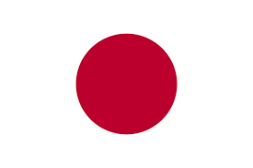
PLACE:
Judo is very popular in Japan, because it was created there. People play Judo in the Olympic games in Tokyo.

Slide 4
EQUIPMENT:
The equipment of Judo is a specific dress, the keikogi, that in Judo takes the name of judogi, a jacket and pants made of resistant and generally with fabric and belt (obi);
All in all in the West it is Known as Kimono although it is the suit with which judo is practiced.

Slide 5
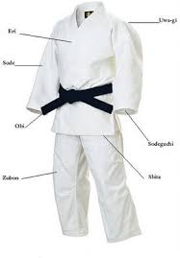
FRI
UWA-GI
SODE
OBI
SODEGUCHI
ZUBON
SHITA

Slide 6
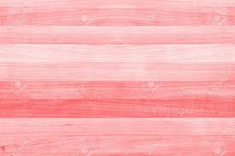
RULES:
All competitions will be developed through leagues from three to five competitors, and only the first of each league will be classified if there is one, three, four or more.
-They will play the quarterfinals, semifinals or finals according to the number of leagues that exist.
-If there are only three leagues, the first three will be playing one final league.
-In the event that there are six leagues, the first six classifieds will play one eliminatory, remaining three classified to play a final league.
- In the event that there are four or eight leagues, the four or eight first

Slide 7
THE END
BY NÀDIA

