Slide 1
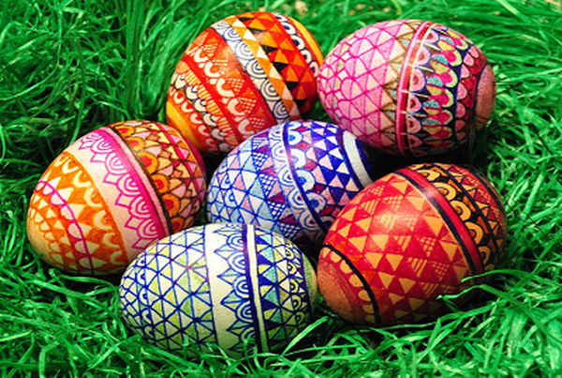

Easter in our region- Kazanlak,Bulgaria

Slide 2
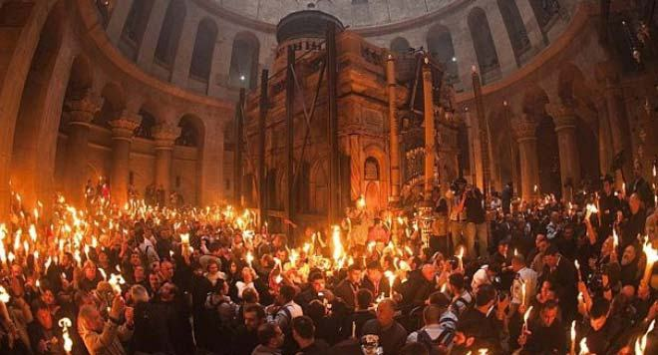
Great Day
Easter or Velik den (Great Day) is one of the most important holidays in Bulgaria.It is a celebration of life, of Christ’s victory over sin and death.
The Bulgarian Easter is celebrated according to the Bulgarian Orthodox church’ s calendar.This year Easter will be on 19th of April.

Slide 3
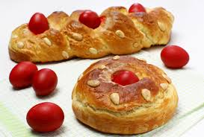
Good Friday
Good Friday is a great holiday. There is a ban on any work and related activity, and people believed that if the ban was broken, the harvest would be ruined by hails. A legend tells us the story of how Christ, carrying the huge cross on Good Friday, passed by a woman who was washing clothes. He asked for some water to moisten His cracked lips. She scooped up some slops and gave Him. He drank it, and said nothing. Later, there was a house where people baked bread, and they gave Him a crisp piece from it. When He climbed Golgotha, Christ uttered, “Damned be the woman who washes on this day, and blessed be the one who bakes bread.” So, there is a ban on washing on Good Friday, and it is also the day to prepare the Easter loaves.

Slide 4
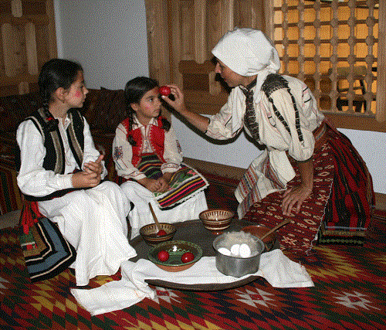
Coloring the eggs
According to the Bible, Jesus was captured on Thursday during prayer and this is traditionally the day to color the eggs.
Before coloring the eggs you need to hard boil them first. Then take the egg paint and dissolve it in as much water as the packaging says before putting the eggs inside. Some Bulgarians add a tablespoon of vinegar, so the shell absorbs the color better.
The first egg you take out of the paint should be the red one. Before it dries up you make small cross signs with it, first on the forehead, and then on the cheeks of the children in the family, and then on each family member. The first egg should be kept next to the icon of St.Mary in the house until next year.

Slide 5
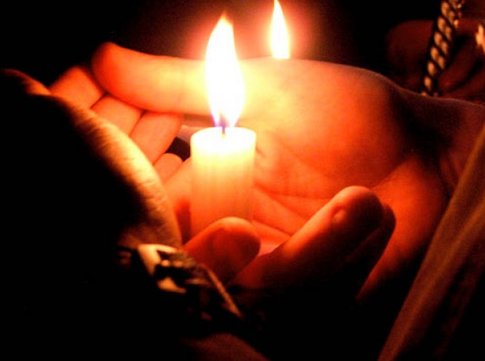
Round and round the church
On Saturday evening at 12 o’clock every church in Bulgaria serves an Easter Mass. Have a candle with you and go to the church of your choice at midnight. At 12 o’clock exactly the priest announces the resurrection of Jesus Christ. Then he goes out of the church carrying a lit candle. You should wait for your turn and light your candle from this fire. Then the priest leads the people who go around the church 3 times. During this walk you are supposed to make sure your candle is lit at all times and then take the candle safely home (keeping it lit).

Slide 6
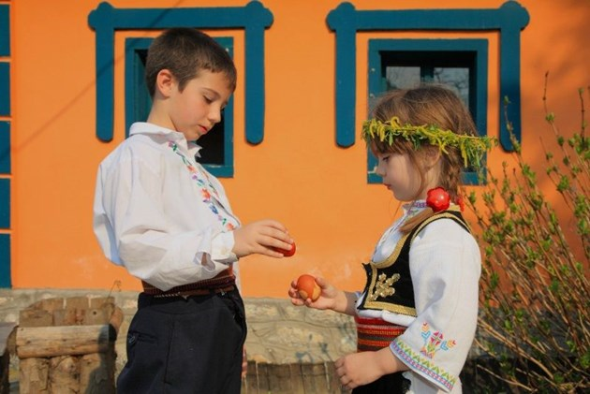
The egg fight
The most interesting part of Easter are the egg fights that occur on Sunday morning. People take turns in smashing their eggs against the eggs of other people. The person who has managed to keep his/her egg unbroken is the Easter egg fight winner. He/she is then considered the wealthiest, healthiest and happiest person for the rest of the year.

Slide 7
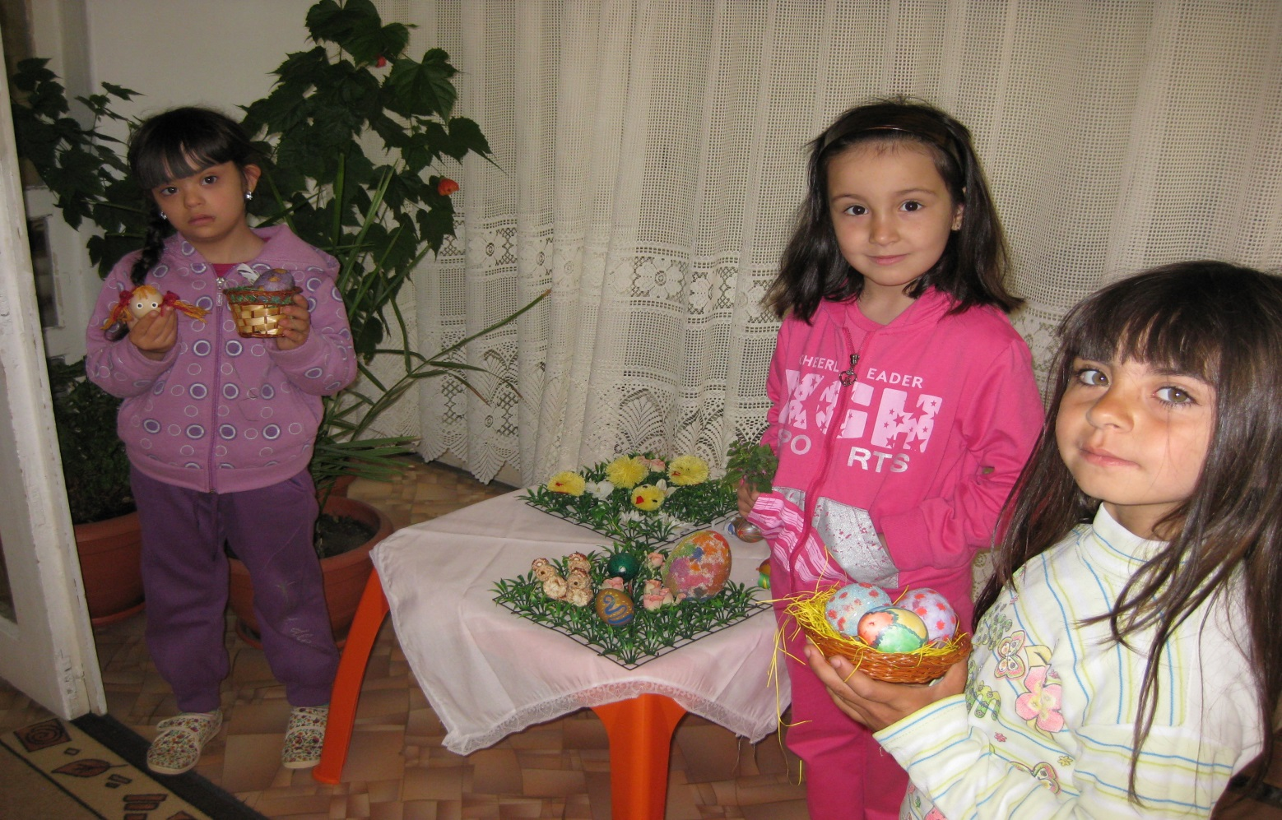
Easter in the kindergarden
Every year the teachers and the children boil eggs, make presents for the parents which are traditionally for the Easter and have a lot of fun together!

Slide 8
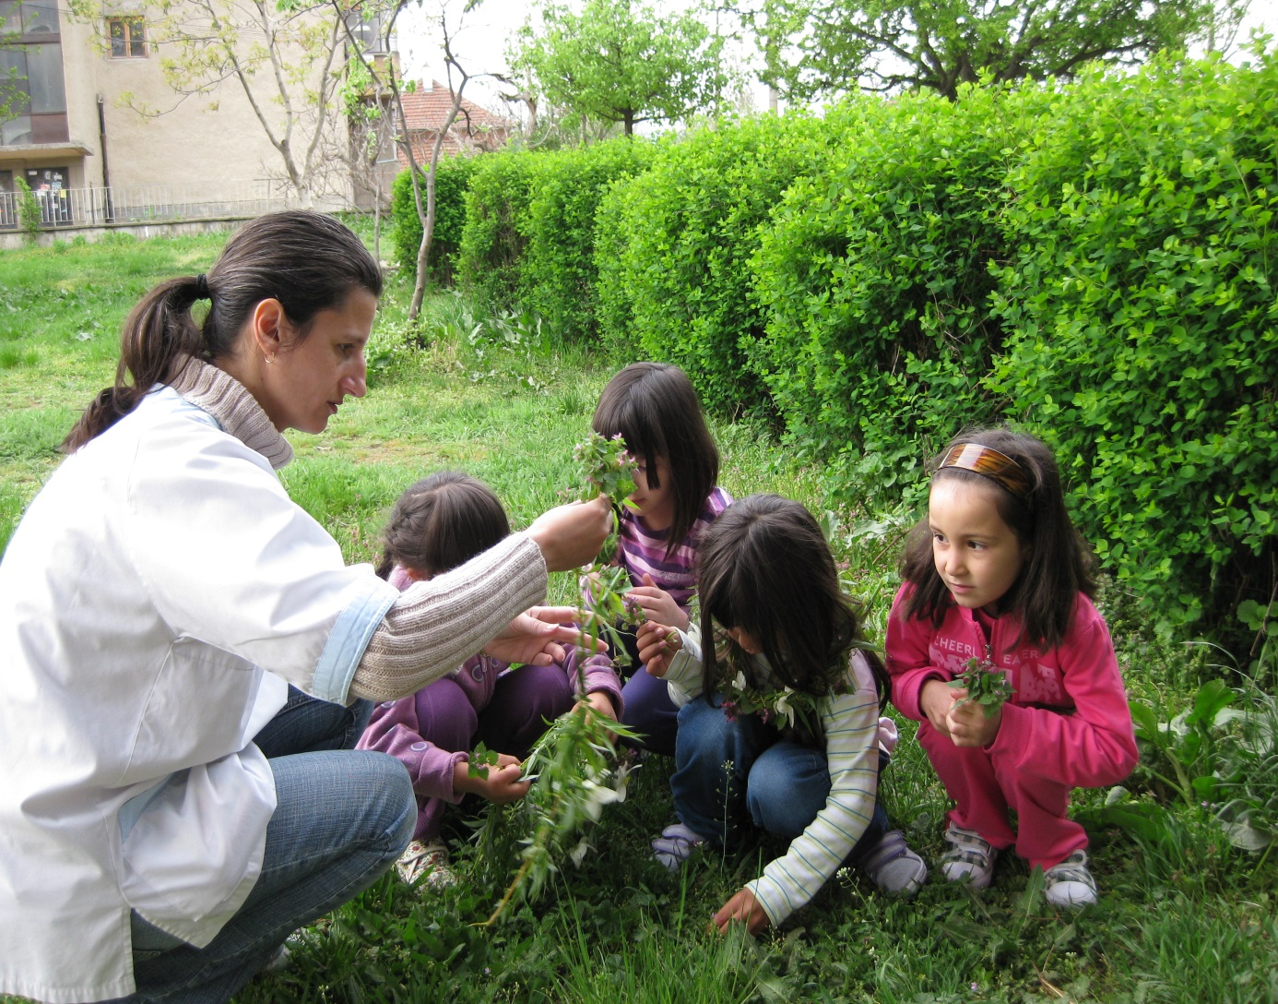

Slide 9
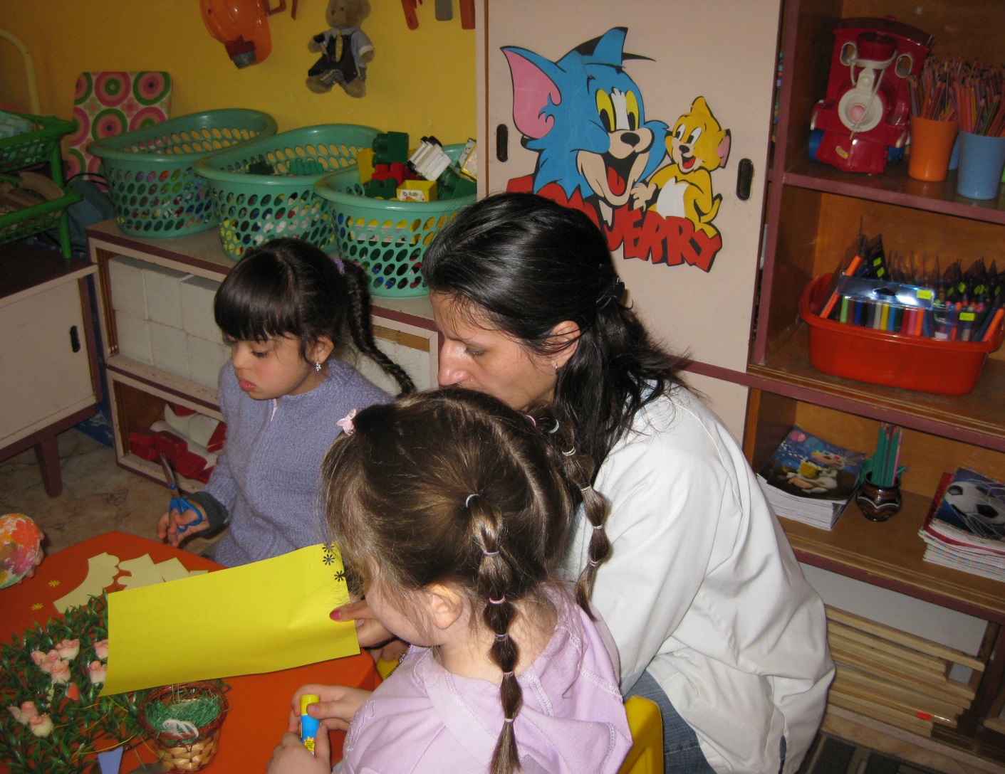

Slide 10
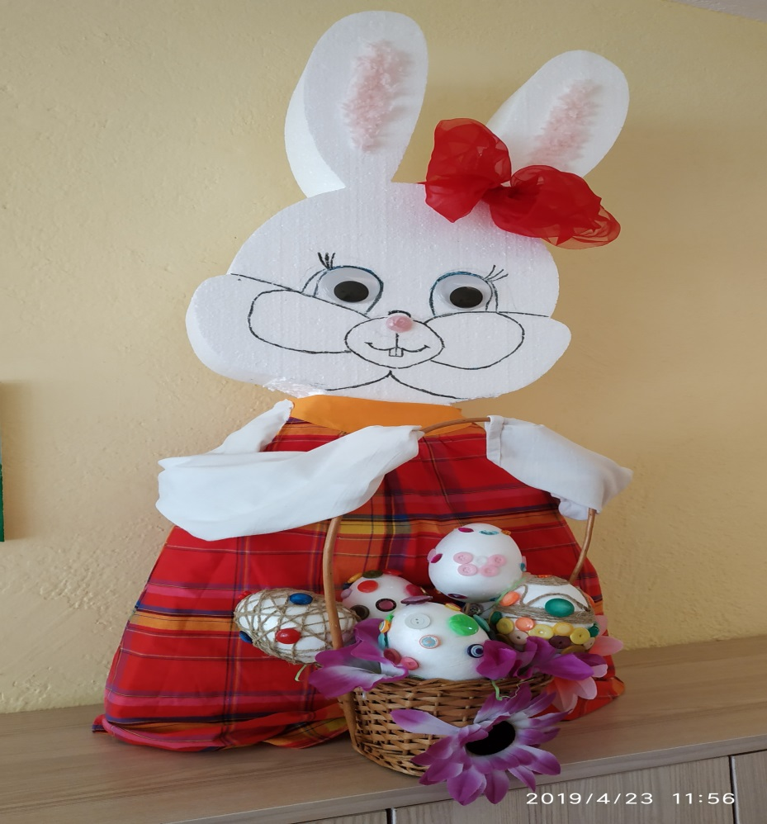
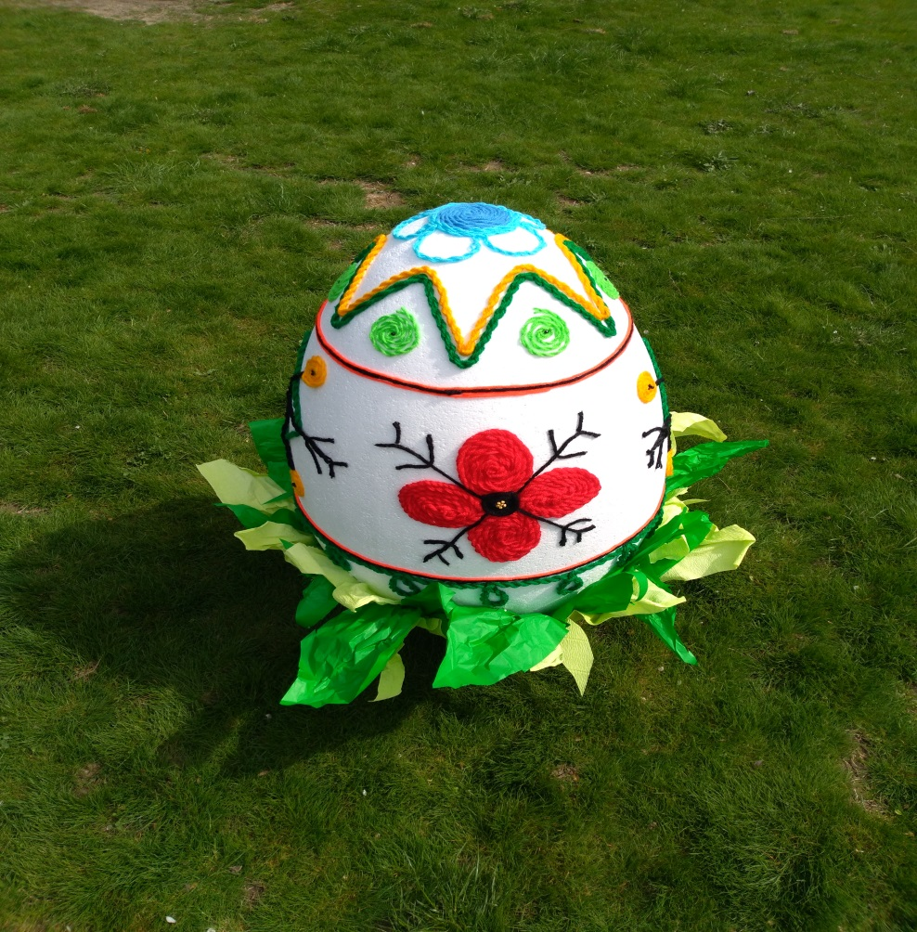
The kindergarden bazaar
From few years it’s also tradition for us to make a bazaar.The items which we sell are made only by the children with help from the teachers.In the end of it the children show the bazaar to their parents and together they can choose and buy something for their home.The money for the bazaar we use for toys or necessary books for the kids.

