Slide 1
Valencian Country
Capitle :Valencia

Slide 2
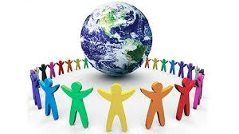
Population
790.201 populoation

Slide 3
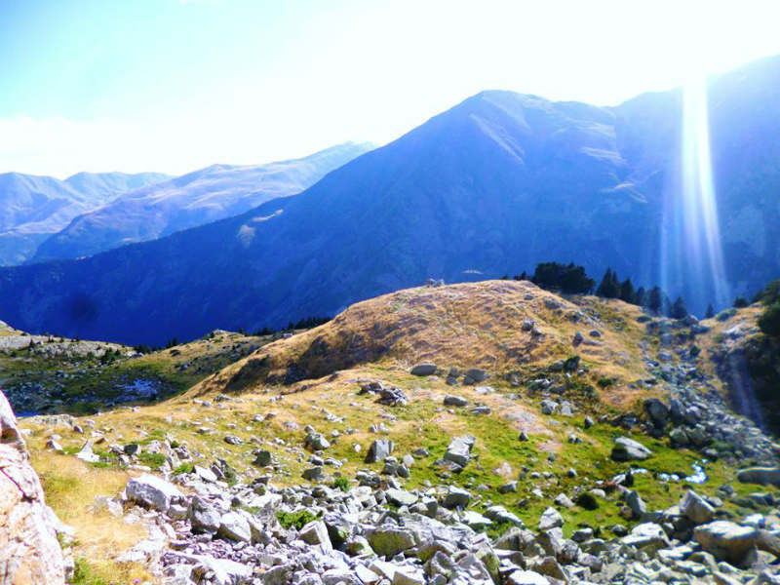
Mountains
Puig campana and Peñaglosa

Slide 4
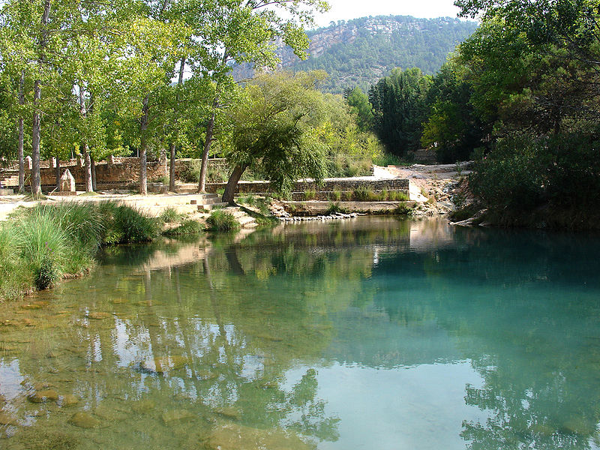
Rivers
Júcar and Turia

Slide 5
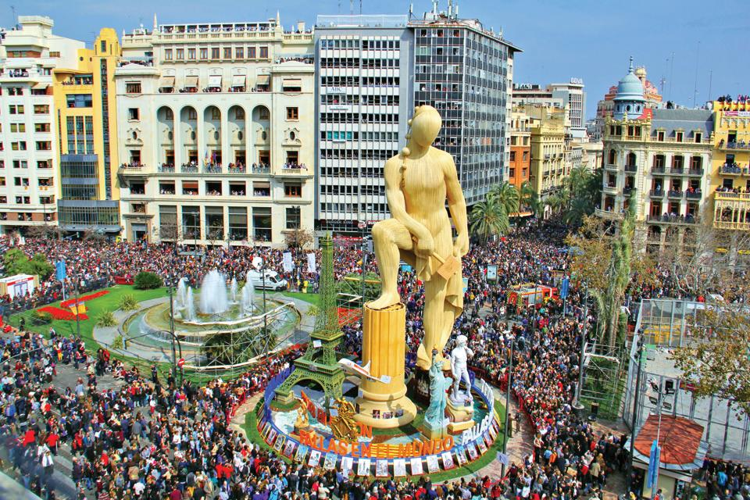
Typical party
(Fallas)

Slide 6
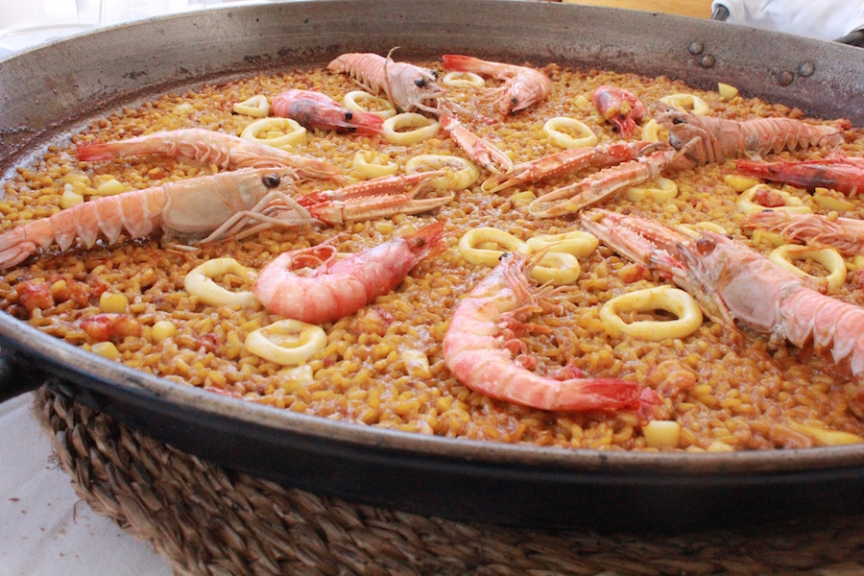
Typical food
Paella Birthplace

Slide 7

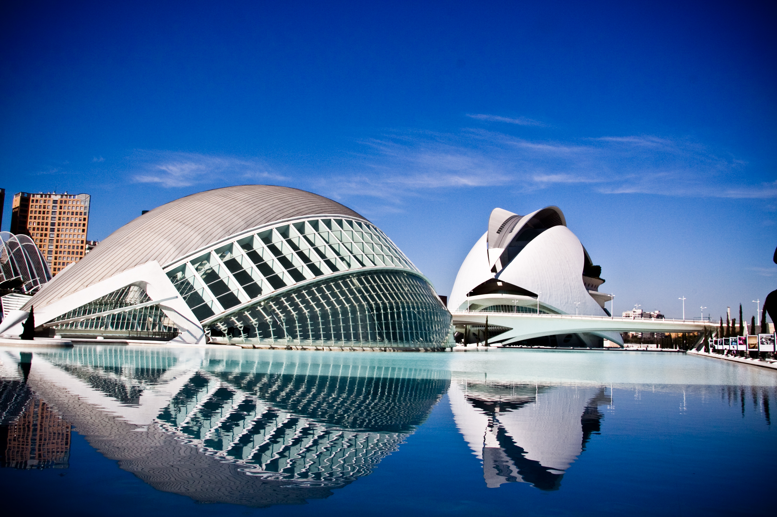
Drink
Horchata

Slide 8
Acuarium
Ciudad de las artes y las ciencias

Slide 9
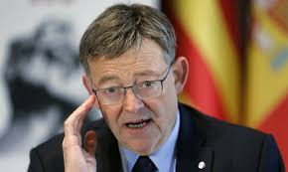
President of Valencia
Ximo Puig Ferrer

Slide 10
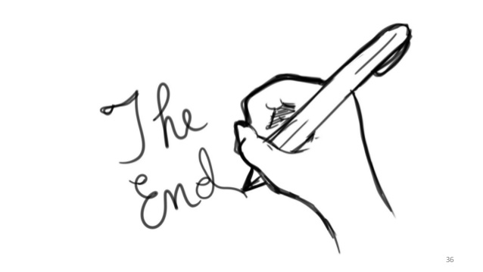
End….

