Slide 1
The excretory system
Team 3

Slide 2
The Excretory System
The excretory system is the system of your body that eliminates waste bacteria\food from your body.
The organs in the excretory system are:
The kidneys
The renal arteries
Bladder
Urethra
ureter

Slide 3
The kidneys
The kidneys, are bean-sized organs, on either sides of your spine, below your ribs and behind your belly.
The kidneys job is to filter the bad waste out of your blood. All of the blood in your body goes throught them at least a couple times a day.
Blood comes into the kidney, waste gets removed, and salt, water, and minerals are adjusted (if needed). The filtered blood goes back into the body, And waste gets turned into urine.

Slide 4
Renal arteries
Renal refers to anything related to the kidneys.
The renal arteries carry blood from the kidneys. They branch directly from the aorta (the main artery comming off the heart) on either side and extend to the kidney. These arteries take a very large volume of blood to the kidneys to be filtered.

Slide 5
Bladder
The urinary bladder is a muscular sac in the pelvis, just above and behind the pubic bone. When empty, the bladder is about the size and shape of a pear.
The bladder stores urine, allowing urination to be infrequent and voluntary. The bladder is lined by layers of muscle tissue that stretch to accommodate urine. The normal capacity of the bladder is 400 to 600 mL

Slide 6
Urethra
The urethra is a tube that empties the bladder.
The males urethra is quite bigger than the female urethra. A males urethra is about 18-20 cm long
A females urethra, is 5.1 cm long

Slide 7
Ureter
A tube on each side of the body that takes urine from the kidney to the bladder.

Slide 8
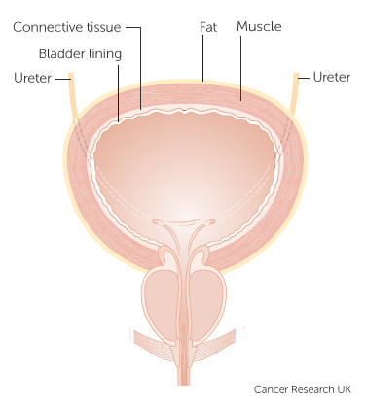

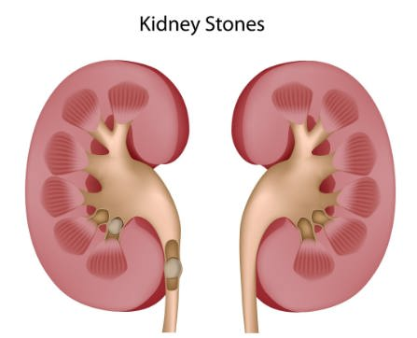
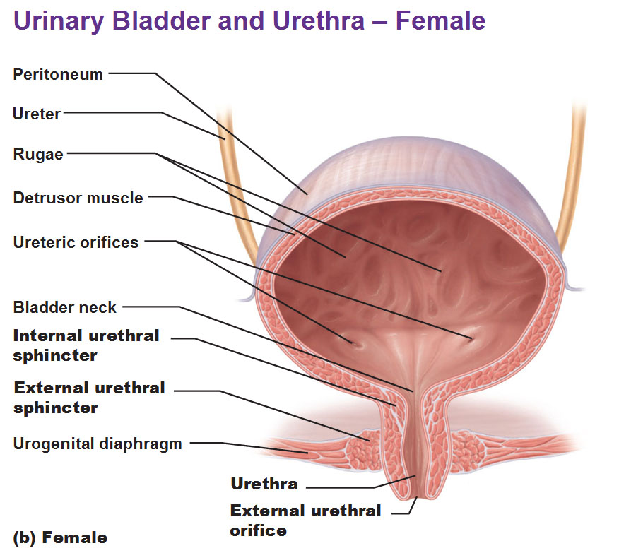
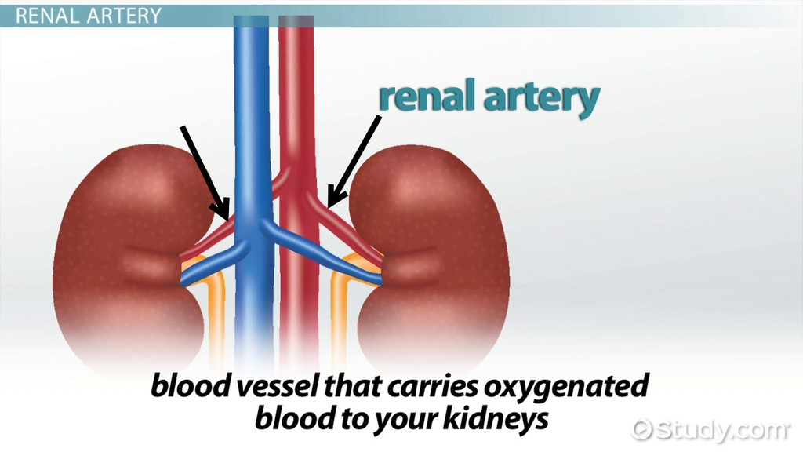
Excretory system

Slide 9
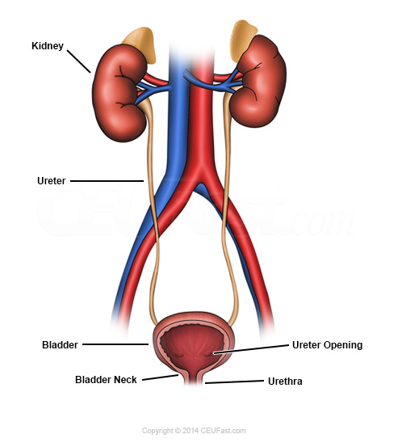
THANKS FOR WATHING OUR EXCRETORY SYSTEM PROJECT! ☺

