Slide 1
The Circulatory System
How it works.

Slide 2
How does it works.
Veins carry the blue blood to our hearrtafter circulating the body. In here the right side of our heart collects and pumps the blod to the lungs through the pulmonary arteries. The lungs what they do is they refresh the blue blood with oxygen making it red. That’s why our blod is red, because if it wouldn’t pass through the lungs it would be still blue not red. After this red blood enters the left part of our heart and pumps through the aorta to the body to suply tissues with our oxygen. Four vels which in your heart keep your blood moving the right way.
TRICUSPID VALVE
MITRAL VALVE
PULMONARY VALVE
AORTIC VALVE
Open and close only one way and only pushed on.

Slide 3
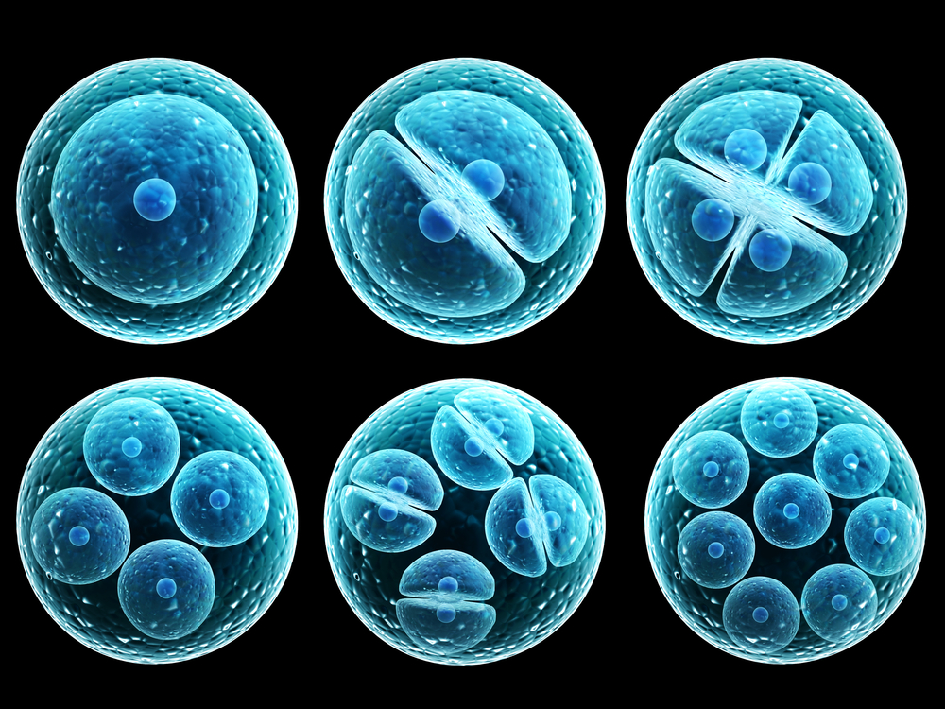
The main work of the Circulatory system.
The circulatory system delivers nutrients and oxygen to our cells in the body. This main things consist of:
Heart
Blood cells
Arteries: carry blood away from the heart.
Veins: carry it back to the heart.
Coronary vessels
Capillaries
Portal veins
Lungs
Systemic circulation
Brain
Kidneys
Physiology
This travels through all our body.

Slide 4
The Circulatory System.
A presentation of how to keep our body healthy.

Slide 5


Stop smoking and tabaco use.
When you smoke and use tobacco, there’s more risk of heart disease. This can damage your heart and circulation by all the chemical compounds. This chemical pounds in tobacco cause ARTHEROSCLEROSIS, which may can produce a heart attack. Once you quit smoking, your heart disease extremely decreases over the next year.
There’re different benefits:
If you stop having tobacco use before, it would have different reactions of your body. But if is not like this, you would have grate problems/reactions of all your body systems including your five senses.

Slide 6

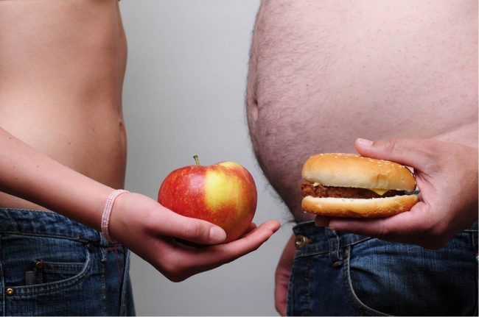

Healthy weight
Managing a healthy weight is a huge part of how to keep the circulatory system healthy. Being overweight can increase a risk of high blood pressure, diabetes, high cholesterol. All of this please you on a extremely high risk for your heart and its circulation problems. By just losing a 10% of your body weight, you can increase the odds of not advancing in your hole circulation system.

Slide 7



Exercise
To keep a healthy circulatory system healthy you need to do minimum 30 minutes of sport or more. This improve our heart and circulation that goes through which helps to manage weight and reduce risk of developing other conditions that make our circulation system work harder. Like: blood pressure, diabetes and high cholesterol. Your food can produce can intake a lot of improvement: on your heart and circulation. Diets contain 5 or 10 servings of fruit and vegetables, whole grains and low. Dairy this are very beneficial to our circulatory system.
Fast food, (processed food)that are high in saturated, trans fats, and excessive in alcohol consume, can also improve in your circulatory system health.

Slide 8



Interesting facts
Did you know that?:
In the 20th century for the English people smoking was a healthy habit.
More than 443,000 English people died for this reason.
There’re more than 600 toxic ingredients in cigarettes and more than 7,000 chemicals treated burn when you open the cigarette .
At least 69 chemical compounds produce cancer.
E-cigarettes are not safe as some people think.
Our heart pumps 5 quart of blood every minute, 100.000beats everyday and 35 million beats every year.
Also called the cardiovascular system and includes the lymphatic system.
Contract, can also be called as systole, and Relax can also be called as diastole.
Did you know that?...

Slide 9
thanks
Thanks,
For all your attention!

