Slide 1
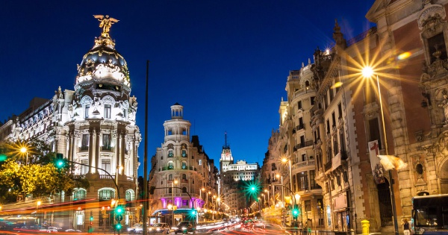
madrid

Slide 2
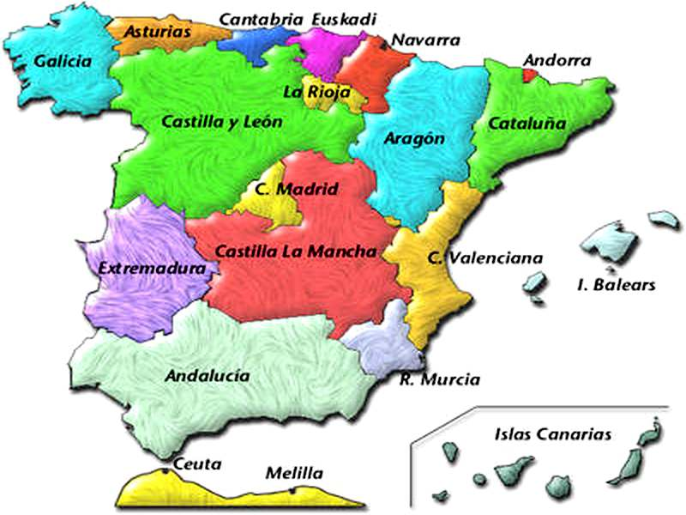
Introduction
Madrid is the capital of spain.
* It is surrounded by:

Slide 3
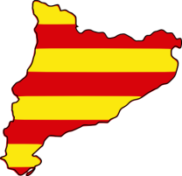

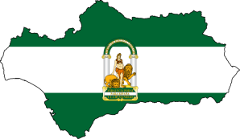
facts
* The community of Madrid is about 8.030 square meters.
* It is the third most populous area in Spain
6.5 millions

Slide 4
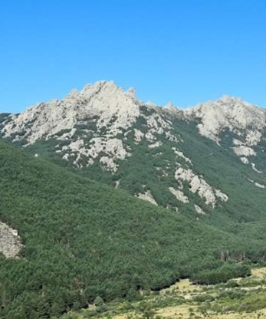
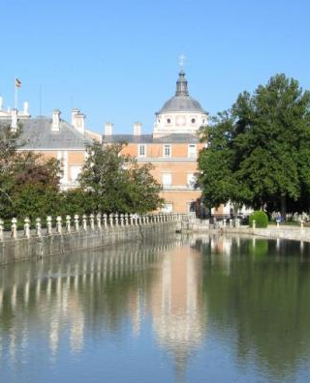
GEOGRAPHY
* The community of Madrid is located between 430 and 2430 meters above the sea.
At 2430 meters is Peñalara.
At 430 meters is Alberche river.
* The community of Madrid has different habitats and landscapes:
- Sierra de Guadarrama
- Sierra de Ayllón
- Gredos
- Tajo
- Alberche
- Guadarrama
- Jarama

Slide 5
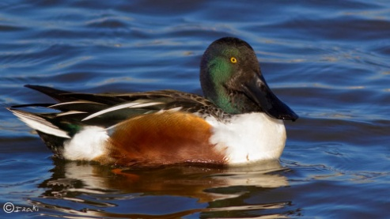
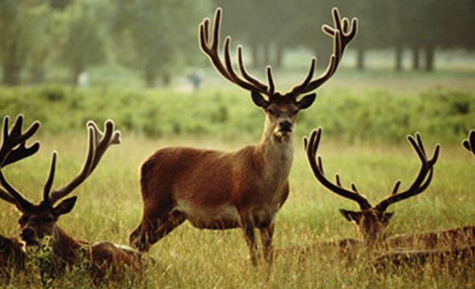
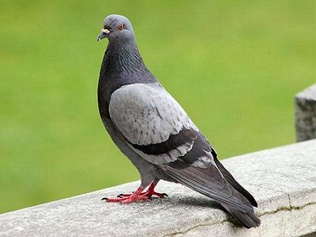
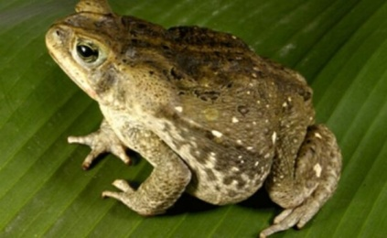
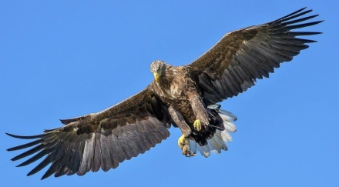
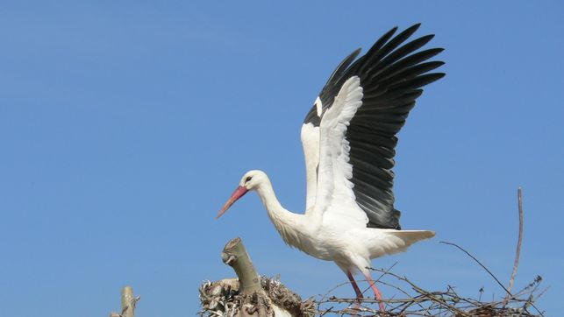
fauna
*South east:
*North:
*Surrounding:
*Center:

Slide 6
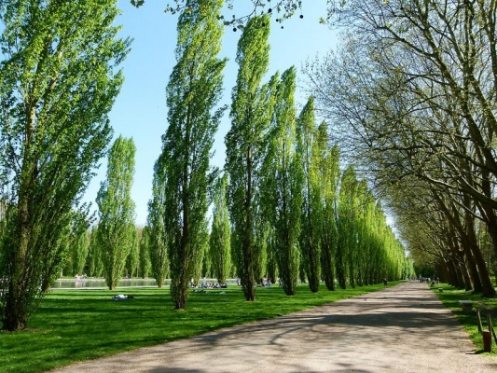
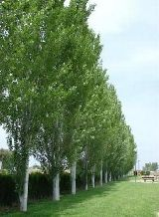
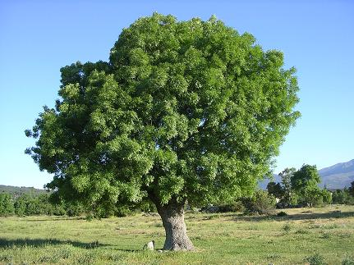
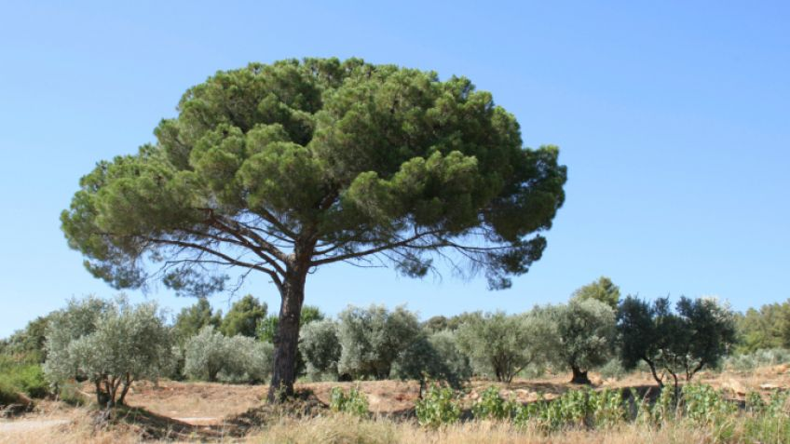
flora
*Álamos:
*Chopos:
*Pine:
*Fresnos:

Slide 7
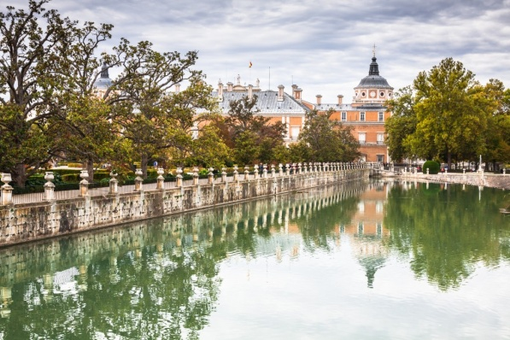
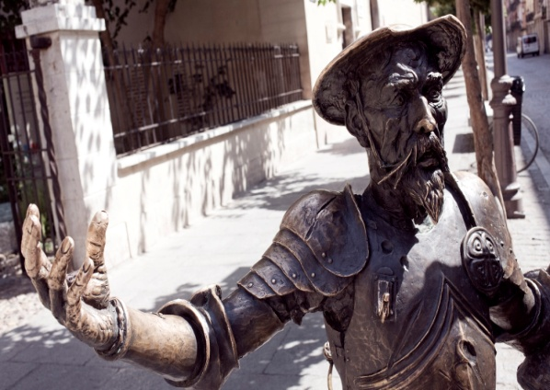
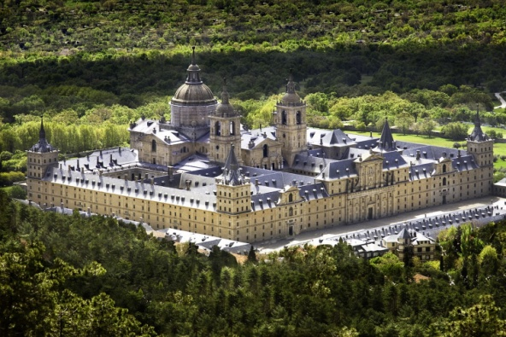
monuments
SURROUNDINGS
Aranjuez Palace → It was the springtime residence of Spanish royalty.
Alcalá de Henares→ It is the city of birth of Cervantes.
El Escorial→ It has functioned as a monastery, royal palace, pantheon, library, museum, university and hospital.

Slide 8
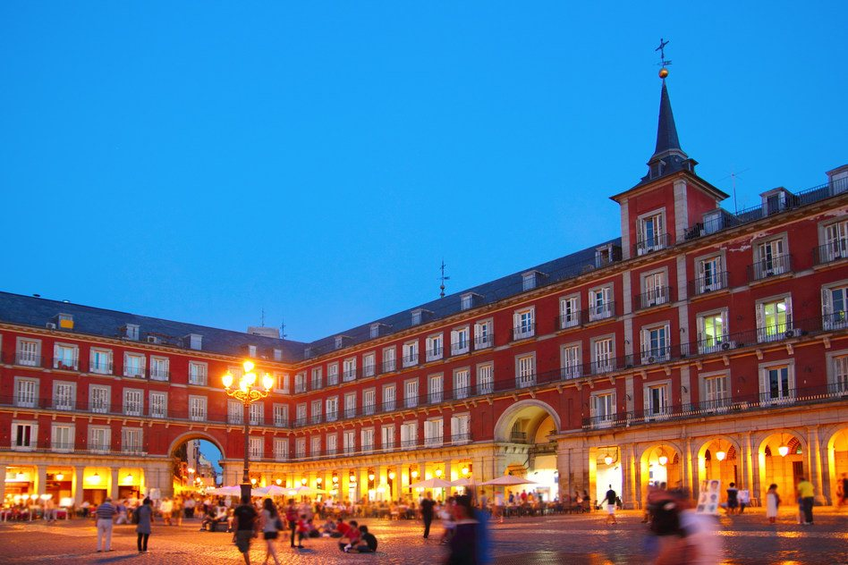
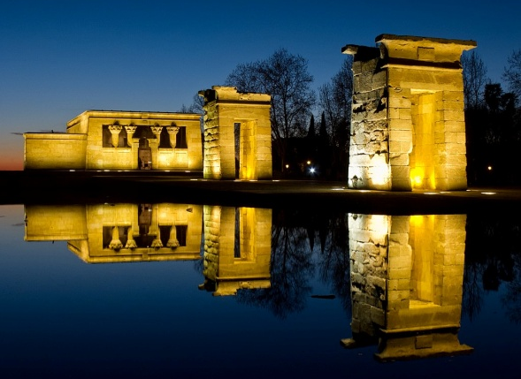
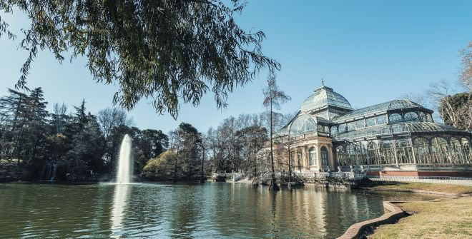
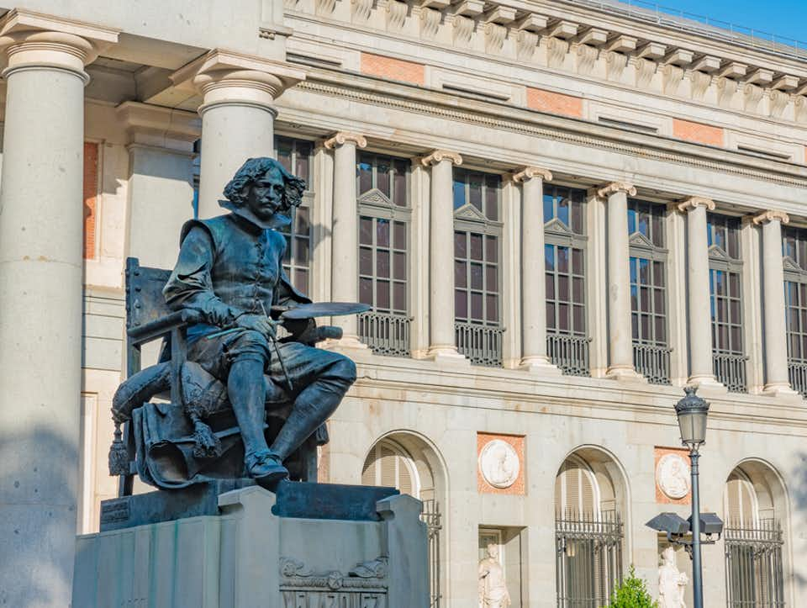
monuments
Debod Temple → It is an Egipcian Temple.
Major Square→ It is one of the most beautiful squares in the world.
CITY OF MADRID
Prado Museum→It is one of the most important museum in the world.
Retiro Park→ It is the wonderful lung of the city of Madrid.

Slide 9
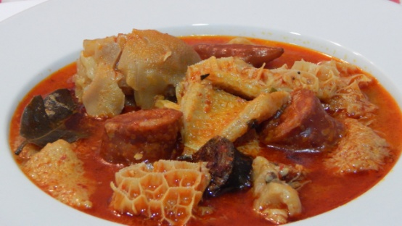
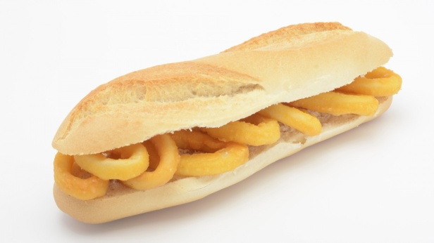
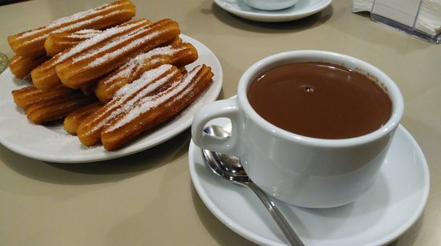
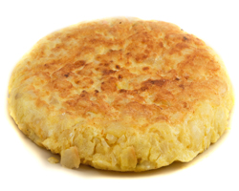
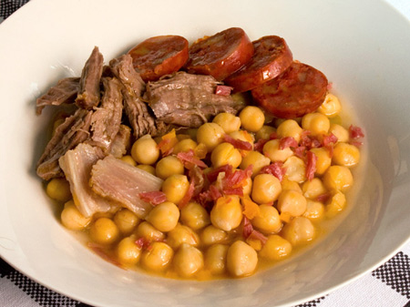
food
* You can find food from all over the world.
* Some traditional plates are:

Slide 10
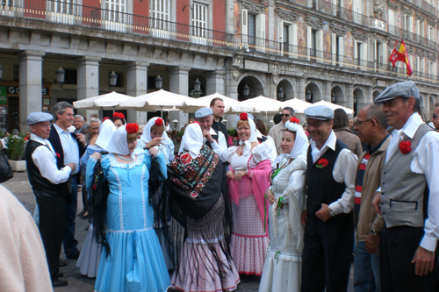
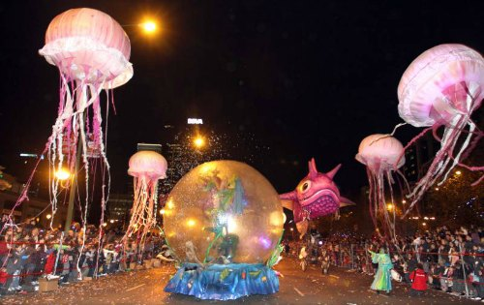
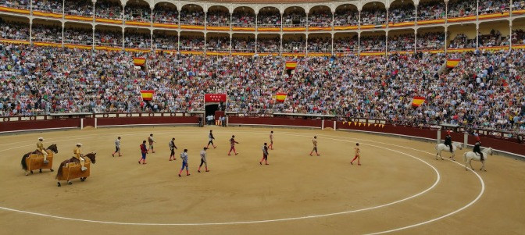
traditions
*San Isidro
*The three kings parade
*Bullfighting

