Slide 1
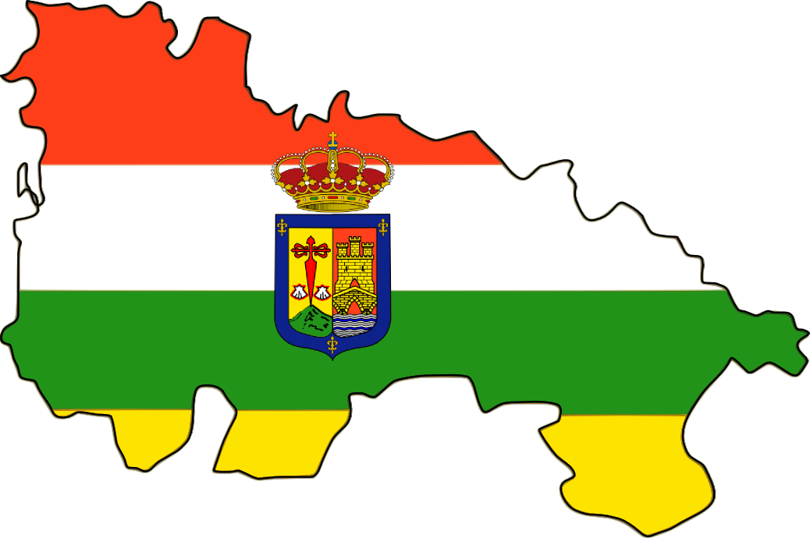
LA RIOJA

Slide 2
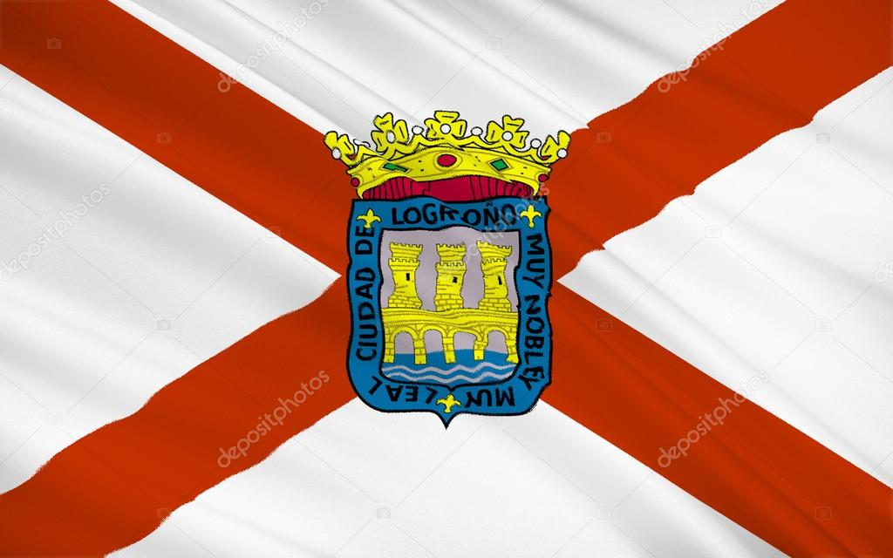
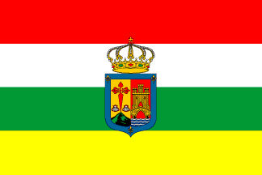
THE FLAGS
Logroño
La Rioja

Slide 3
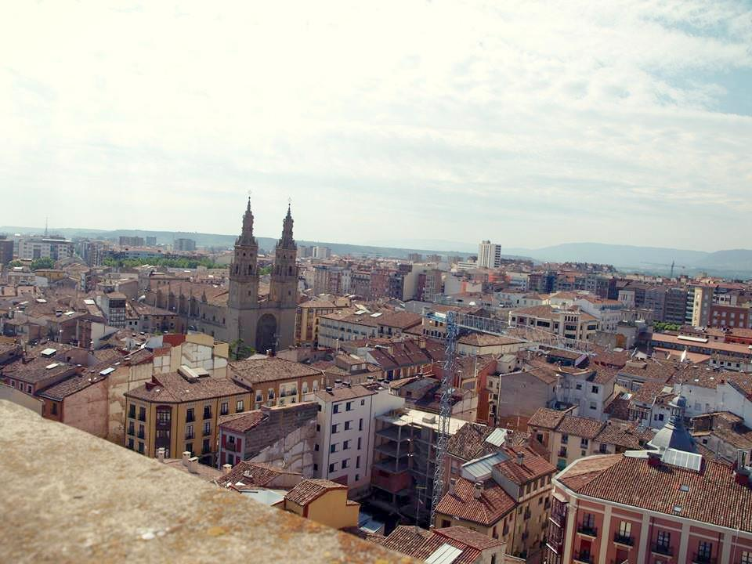
The capital city of La Rioja is Logroño.
CAPITAL CITY
The capital city of La Rioja is Logroño.

Slide 4
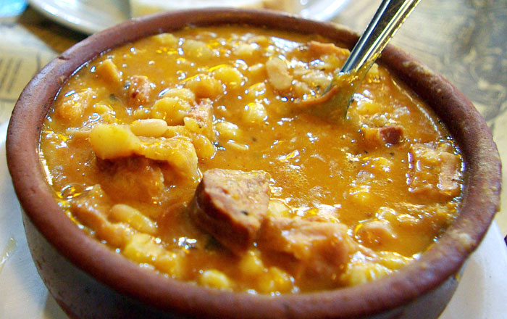
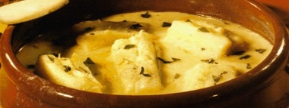
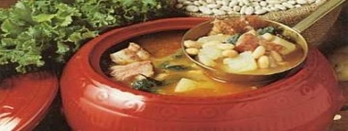
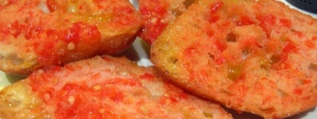
Fabada(Asturias) bacalao al pil pil (País Vasco) caldo gallego (Galicia)
TRADICIONAL FOOD

Slide 5
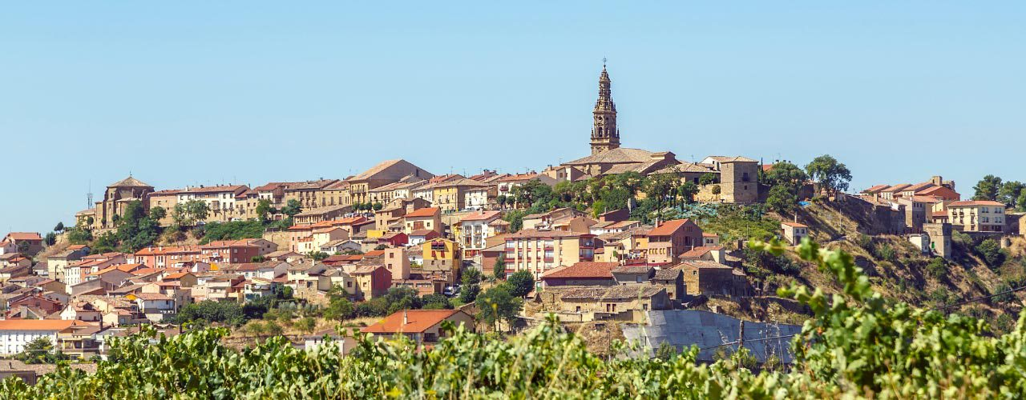
INFORMATION
Poblation: 315.794.
Surface: 5.045 squared km.
Universities and schools: Cooelr (Dentist school), Unir(International university), …

Slide 6
HISTORY
Roman and Muslim periods
In Roman times the territory of La Rioja was inhabited by the tribes of the Berones , Autrigones and the Vascones. It was part of the province of Hispania Tarraconensis.
In medieval times La Rioja was often a disputed territory. The Visigoths created the Duchy of Cantabria that probably included most of La Rioja and were against the Vascones. After the Muslim invasion in AD 711, La Rioja fell into the Muslim domains of Al Andalus.
Medieval period
In 993 most of the territory was reconquered by Sancho I of Pamplona, acting for the Kingdom of Pamplona together with the Kingdom of León and the Counts of Castile.The lower region around Arnedo came under control of his allies. The territory to the east of the Leza River remained under Muslim control.

Slide 7
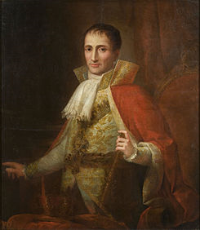
THE WAR OF INDEPENDENCY
In 1808 after Napoleon nominated his brother José king of Spain the War of Independency started.
The war lasted in La Rioja until 1812 when the french troops withdrew the region.

Slide 8
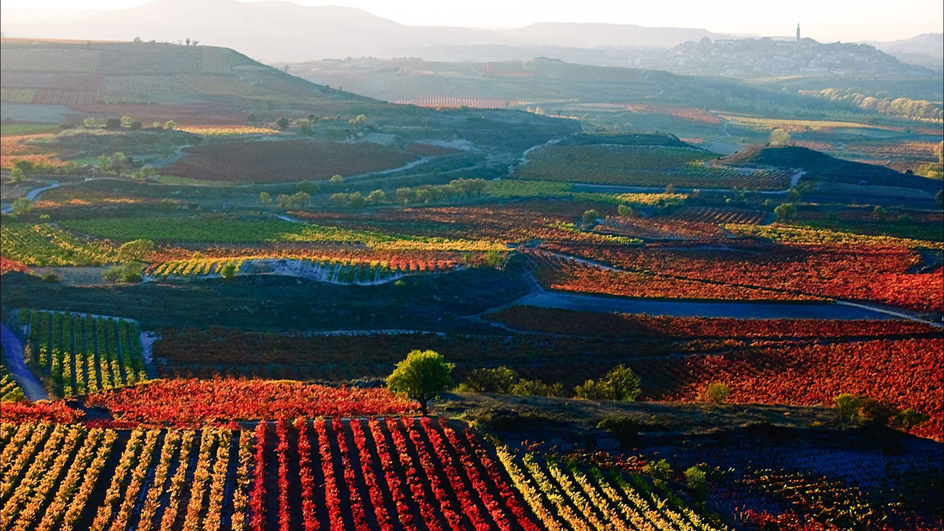
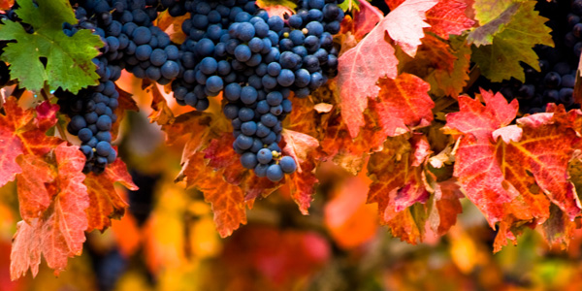
WHY IS LA RIOJA IMPORTANT?
La Rioja is important for its wine and grape.

Slide 9
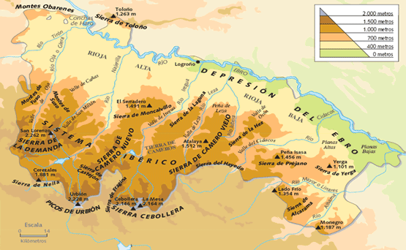
LA RIOJA ALTA,MEDIA AND BAJA
La rioja is divided into three parts:La Rioja alta,media and baja.
The river Ebro flows through all of them.

Slide 10

Thanks for watching

