Slide 1
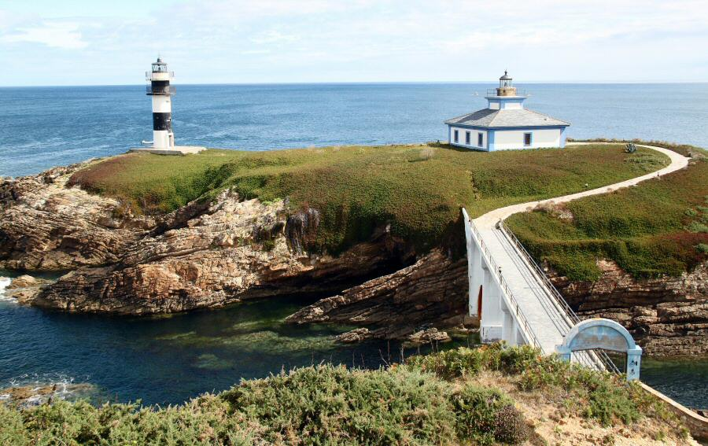
Galicia

Slide 2
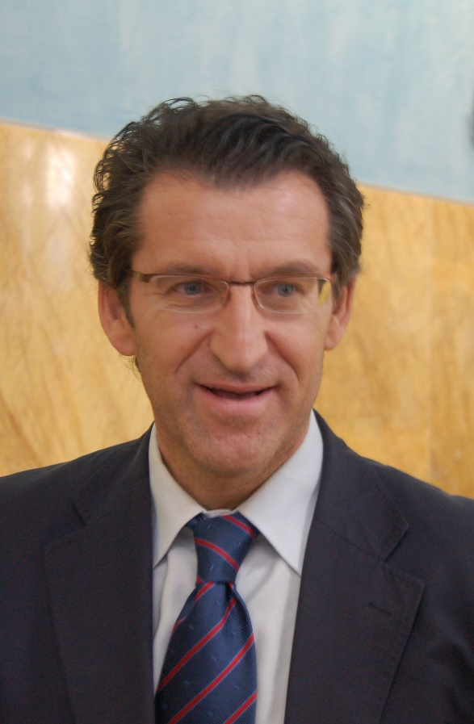
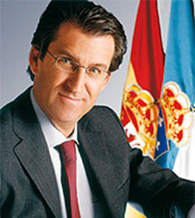
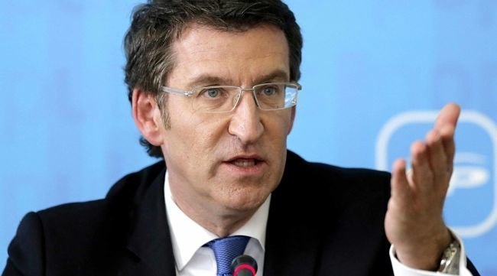
President of Calicia
Alberto Núñez Feijóo

Slide 3
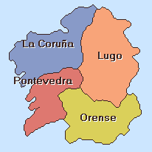
Provinces
Provinces:

Slide 4
seize
29.574 km2

Slide 5
POPULATION
2,719 MILLIONS

Slide 6
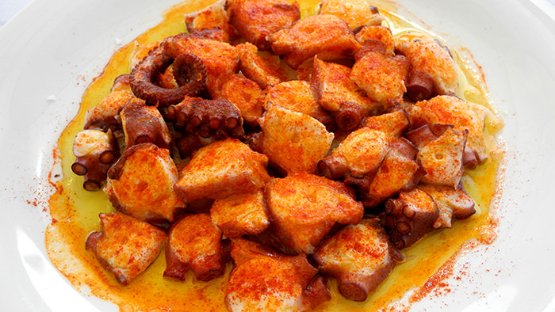
Tradicional
food
Tradicional food
OCTOPUS

Slide 7
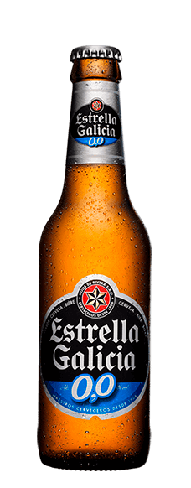
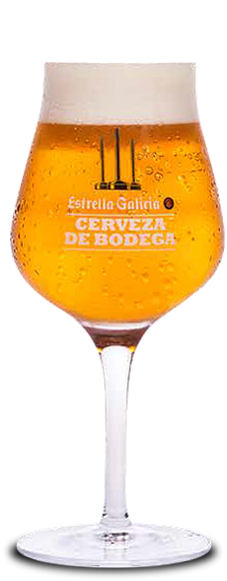
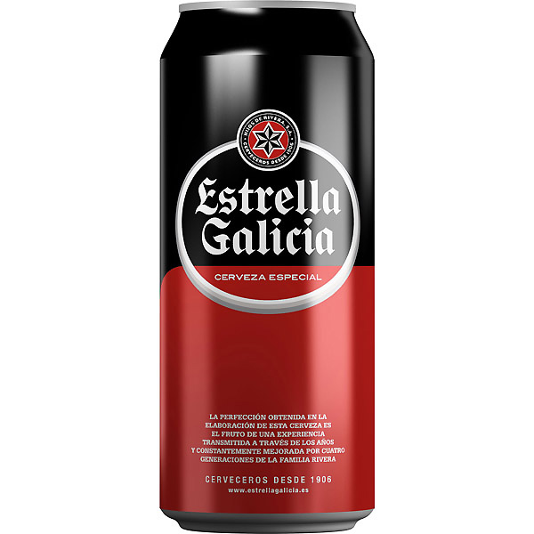
Traditional drink

Slide 8
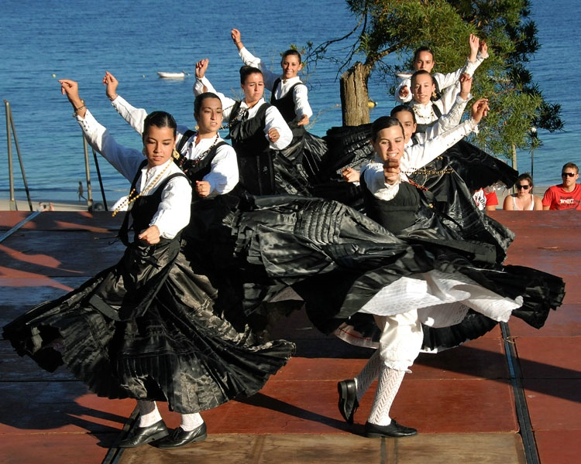
Traditional dance
Traditional Dance
MUIÑERA

Slide 9
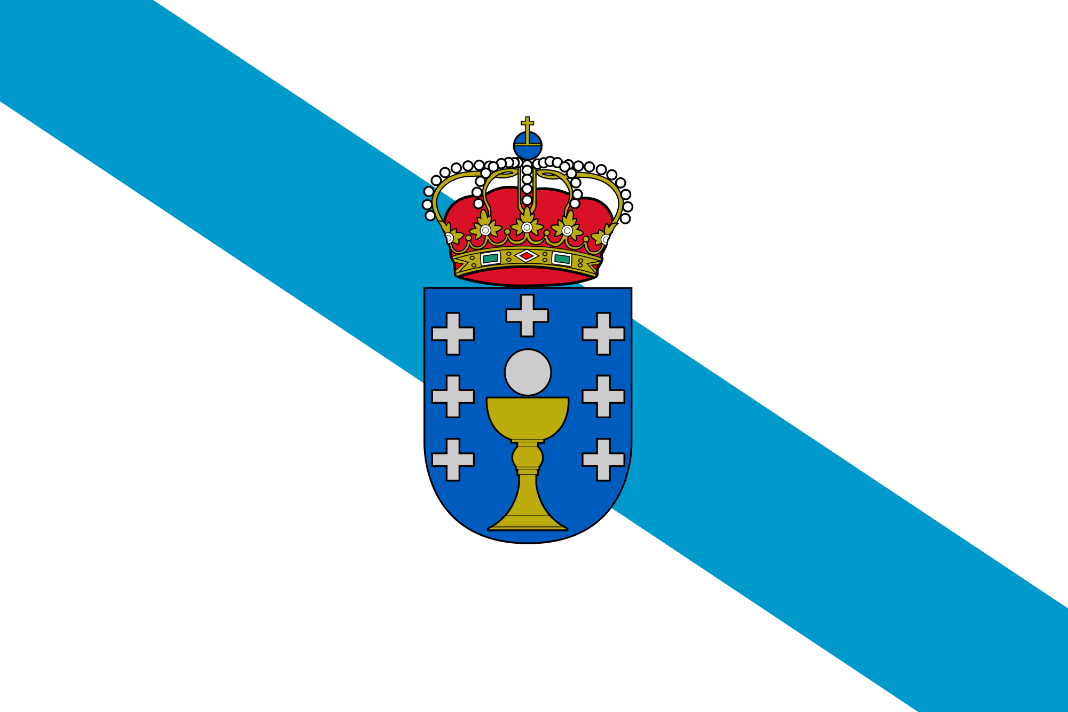
CALICIA
FLAG OF

Slide 10
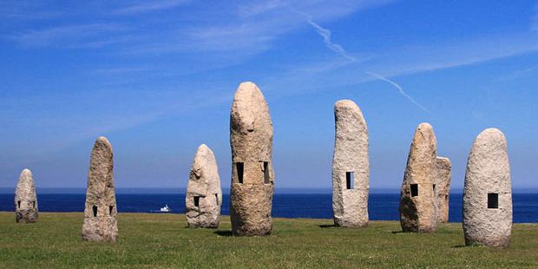
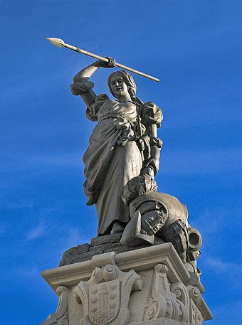
FAMOUS MONUMENTS
TOWERS OF HERCULES
MARIA PITA’S STATUES

Slide 11
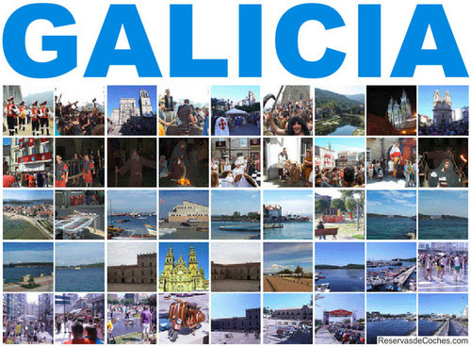

Slide 12
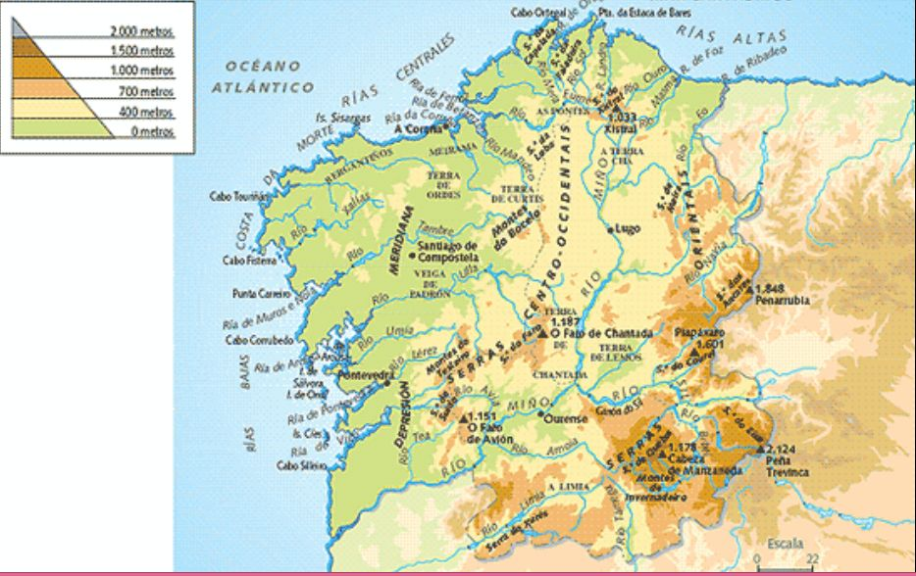

Slide 13


THANK YOU FOR WATCHING

