Slide 1

extremadura
Subtitle

Slide 2
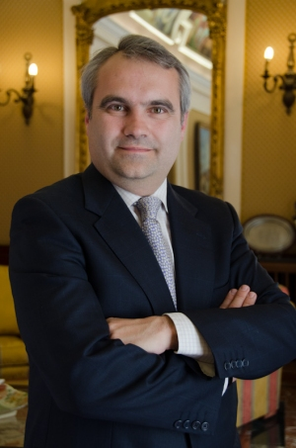
Francisco Javier fragoso
mayor

Slide 3

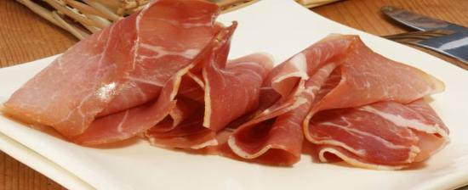
Food and drink

Slide 4
Population size
1,087,778
37° 57′ and 40° 85′ N latitude, and 4° 39′ and 7° 33′ W longitude.

Slide 5
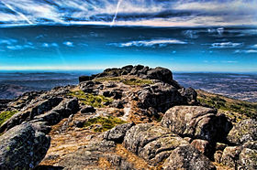
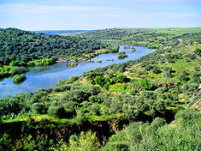
geography
Jálama guadiana

Slide 6
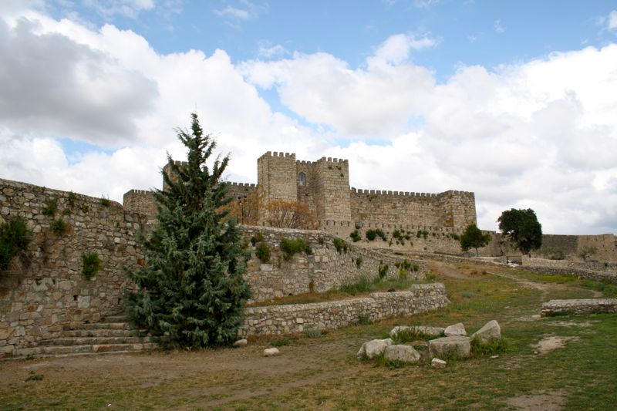
Add a Slide Title - 1
Castle of trujillo

Slide 7
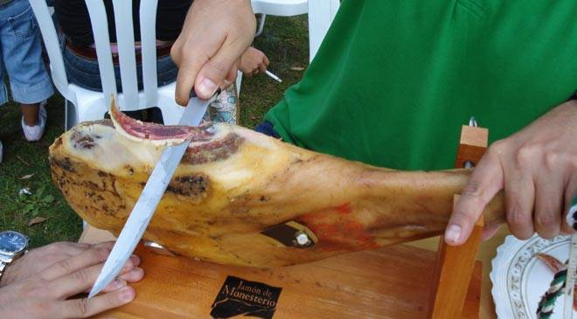
Ham day
traditions
extremadura
Cutting
ham

Slide 8
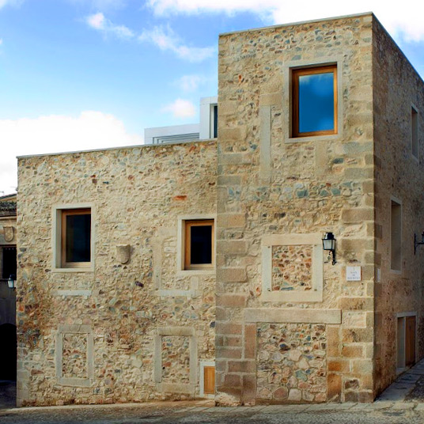
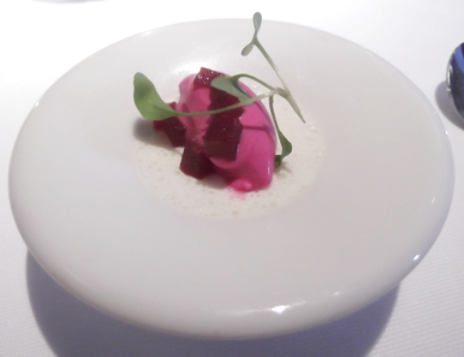
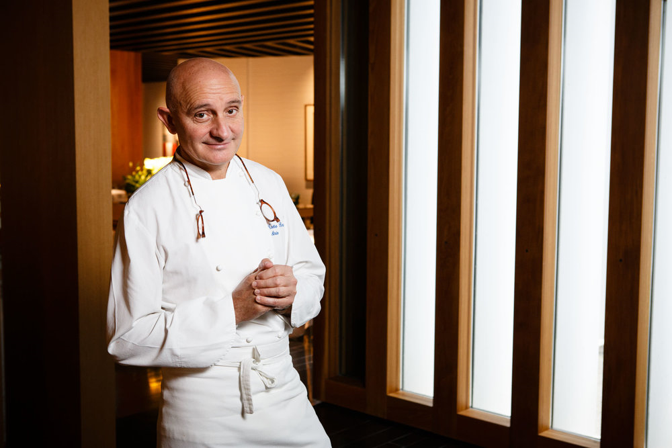
Atrio famous restaurant

Slide 9
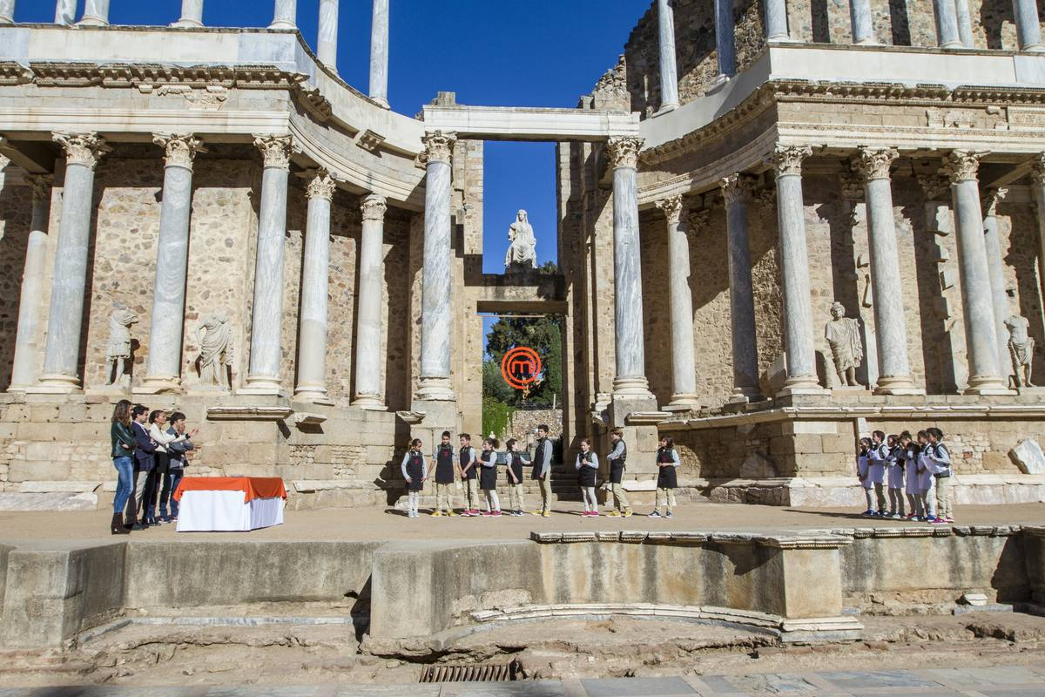
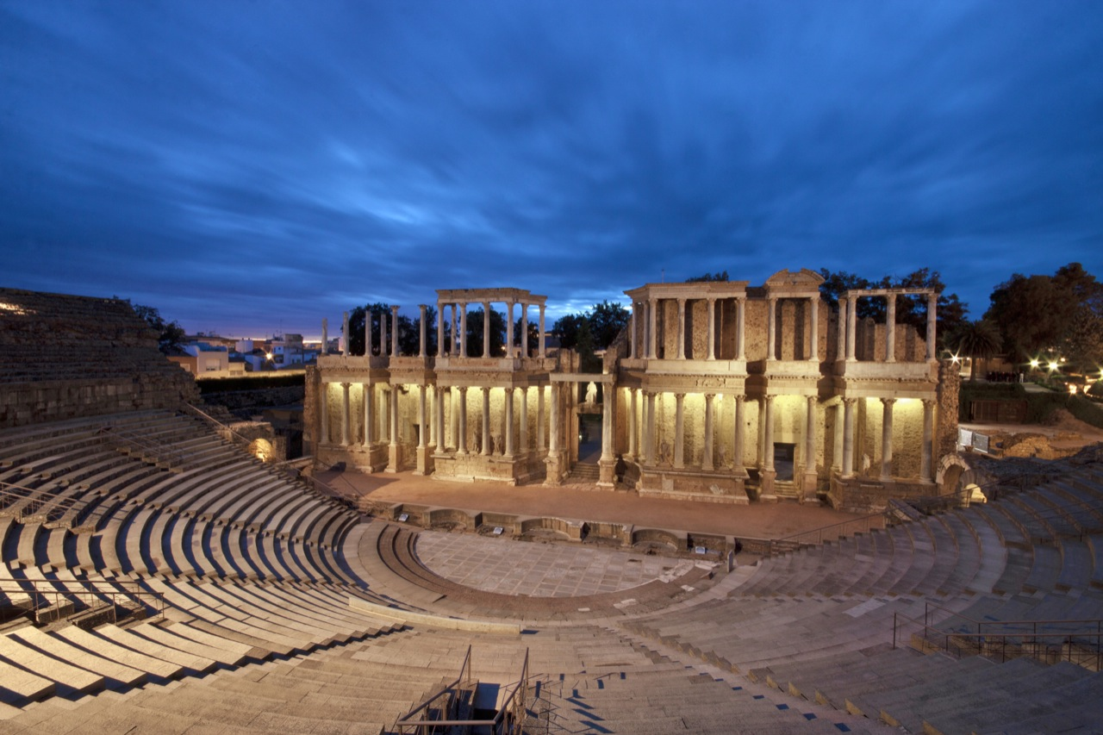
a famous program of tv called masterchef went to:
Teatre romà de Mèrida

Slide 10

f.C extremadura
Famous futbol club in Extremadura.

