Slide 1
DIGESTIVE SYSTEM
By : CRISTINA , PAULA , MARTINA , ERIC , XAVIER , OSCAR .A.

Slide 2

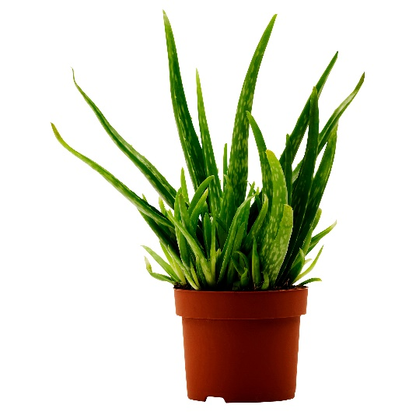
NUTRIENTS IN DIGESTIVE SYSTEM
They are substances that plants and animals need to live and grow.
The digestive system is the group of organs to obtain nutrients from the food and expel undigestive waste.

Slide 3
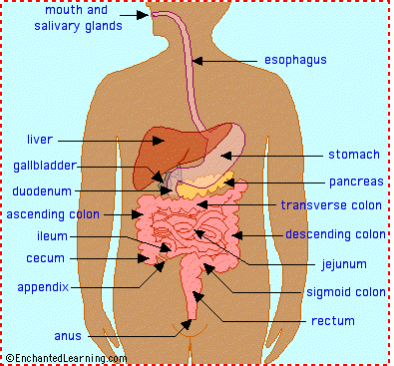
THE PROCESS OF THE DIGESTION
1.THE NOSE AND THE MOUTH
2. THE OESOPHAGUS
3. THE STOMACH
4. THE SMALL INTESTINE
5. THE LARGE INTESTINE

Slide 4
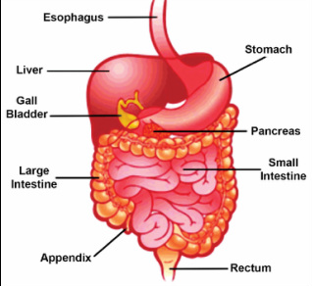
THE DIGESTIVE SYSTEM IS MADE UP OF:
9 ORGANS:
SALIVARY GLANDS
OESOPHAGUS
LIVER
STOMACH
SMALL INTESTINE
PANCREAS
LARGE INTESTINE
RECTUM
ANUS

Slide 5


