Slide 1


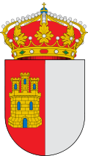
CASTILLA LA MANCHA
By: Sílvia Castro Serra

Slide 2
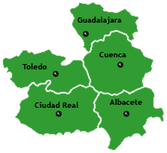
CAPITALS + PROVINCES:
PROVINCES : CAPITAL:
The map:
Albacete -Toledo
Ciudad Real
Cuenca
Guadalajara
Toledo

Slide 3
POPULATION AND SIZE:
SIZE:
POPULATION:
79,463 km²
Population (2016)
• Total: | 2,041,631
• Rank: | 9th (4.3% of Spain)
• Density: | 26km²

Slide 4

FLAG:
CASTILLA LA MANCHAS FLAG:

Slide 5
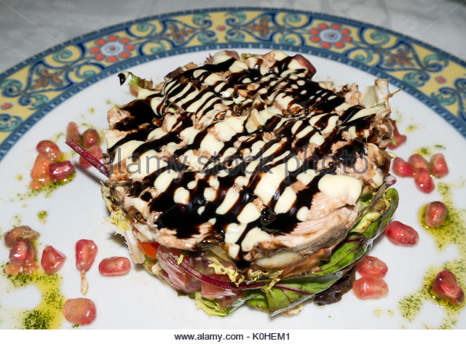
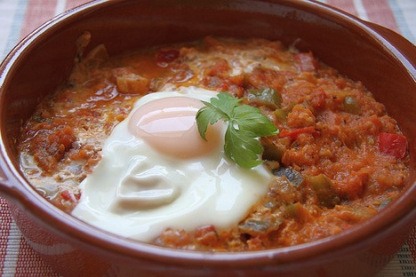
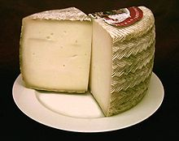
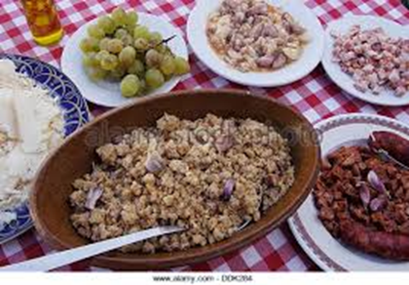
TRADITIONAL FOOD:
TRADITIONAL FOOD:
Pisto manchego
Migas
Partridge salad
Manchego
cheese

Slide 6
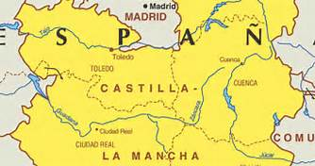
MOUNTAINS AND RIVERS:
MOUNTAINS:(examples)
RIVERS:
Cerro Calderón
Sierra de Pinilla
Cerro San Cristóbal
San Antón
Porrón
Sierra Seca
Sierra de Enmedio
Tajo
Guadiana
Záncara
Júcar

Slide 7
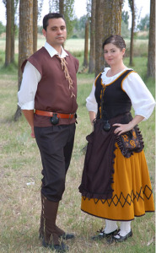
TRADITIONS AND CULTURES:
TRADITIONS:
CULTURES:
Costumes : special occasion
Dance :hymn + other music
Toledo:Corpus Christi
Guadalajara:La Caballada
Cuenca:La Endiablada
Albacete:Romeria del Cristo del Sahuco
The moors:mosques +synagogues
Gothic Heritage:cathedrals,Siguencia…
Reinassance:Palace of the Infantado-Guadalajara,San Juan de los Reyes and Hospital of Sta. Cruz-Toledo
Miguel de Cervantes-lived there
UNESCO-recognised the cultural richness of:Toledo,Cuenca+Caves of Albacete

Slide 8
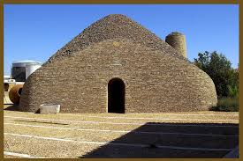
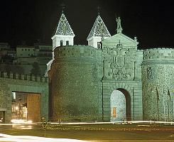
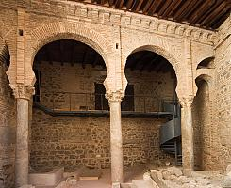
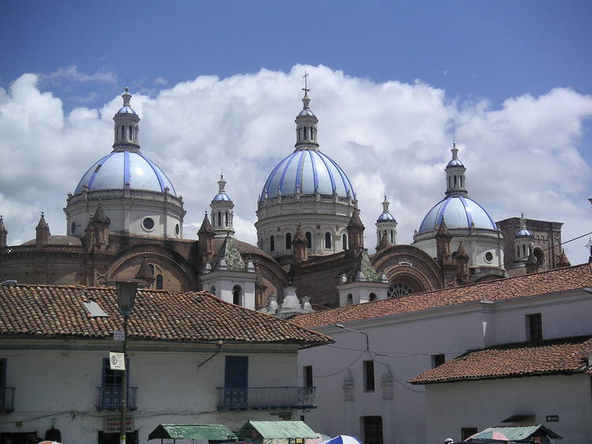
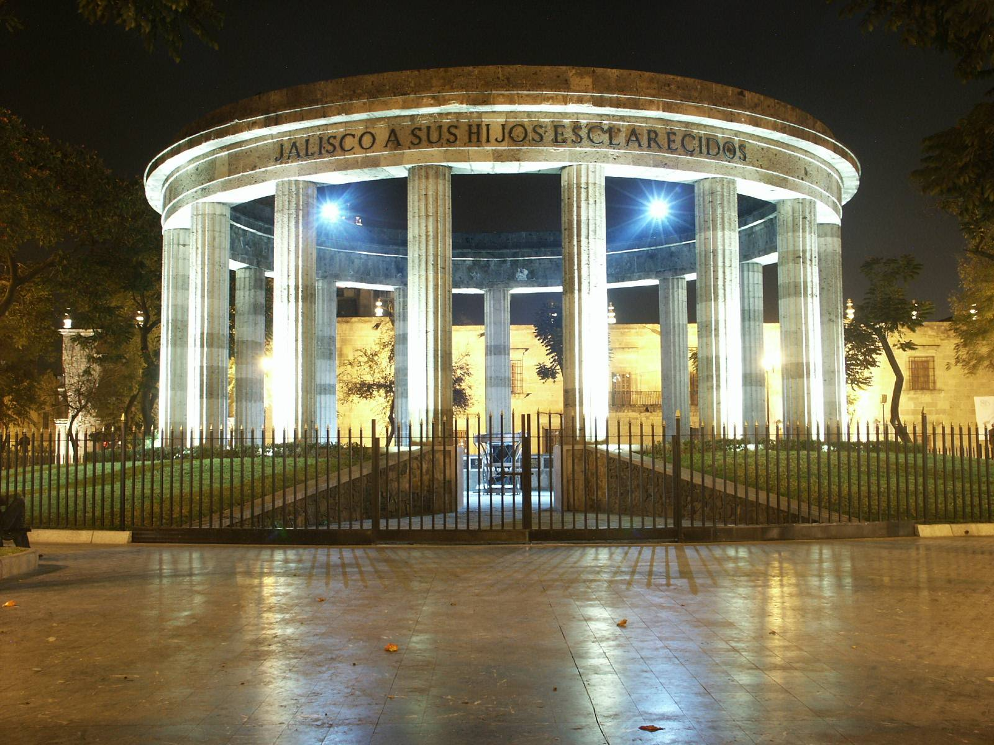
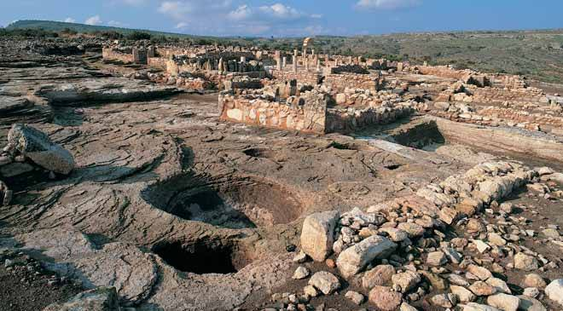
FAMOUS PLACES:
-Mosques: -Gates+City walls -Bombos i Chozos
de la Mancha
-Historic Centre of Santa Ana Enterprise Forum El Tolmo de Minateda

Slide 9

THANKS FOR LISTENING
END!!!☺

