Slide 1
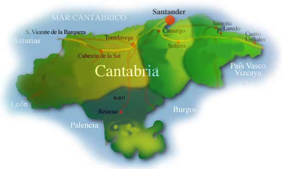
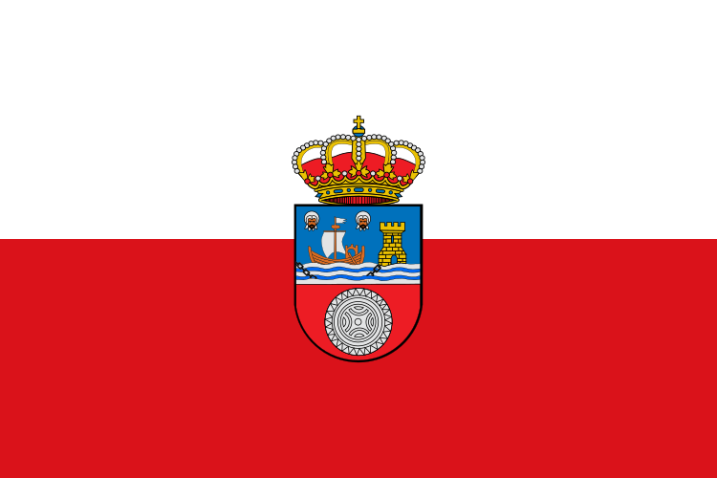
Cantabrian City

Slide 2
Information of Cantabria:
- Cantabria is Spanish autonomous community.
- Cantabria’s capital is Santander.
- The province of Cantabria was constituted on the 28 of July of 1778

Slide 3
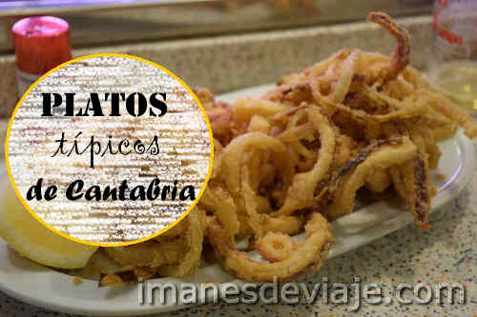
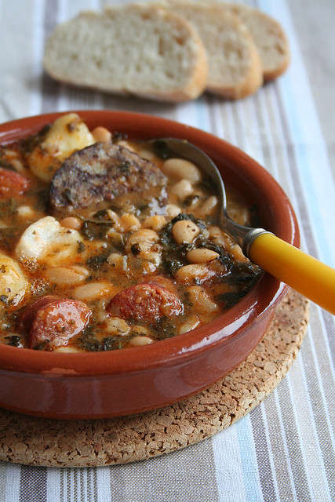
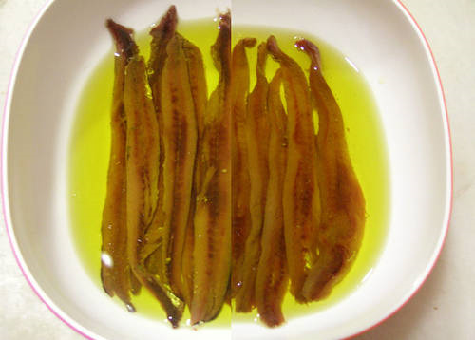
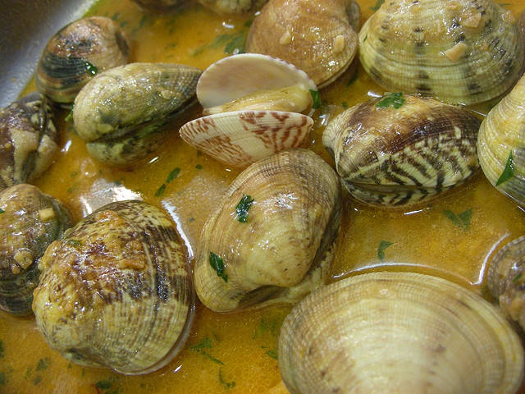
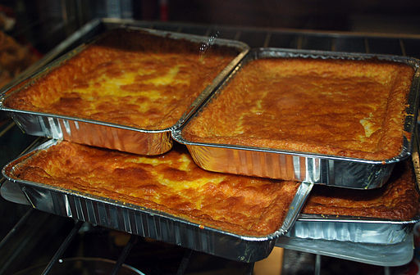
Traditional Food
do-montañes.jpg
The most traditional foods are:
Squid to the roman.
Stewed Mountain and Lébaniego .
The anchovies of Santoña .
Fish and sea food from the Cantabrian sea.
Beef.
Cantabrians cheeses.
Deserts Pasiego.
A pomace of Lébiana.

Slide 4
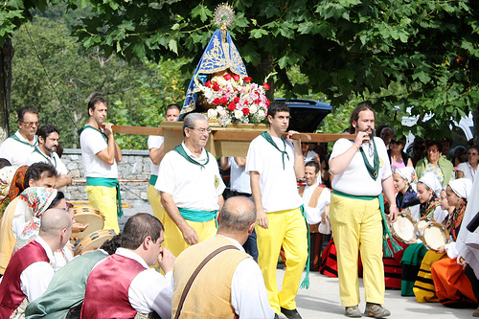
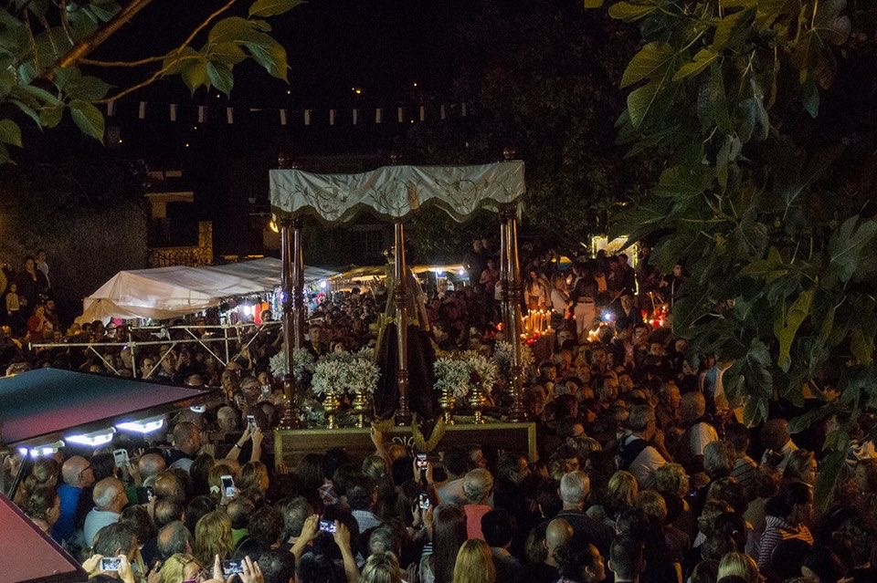
Festivities
The most famous festivities are :
The day of Cantabria
Festivities in Sant Juan and Sant Miguel
The fair of Ganado de Torrelavega
The Sailor Carnival
The festivities of the Coso Blanco
The festivity of the orujo
The Verbena of the shawl

Slide 5
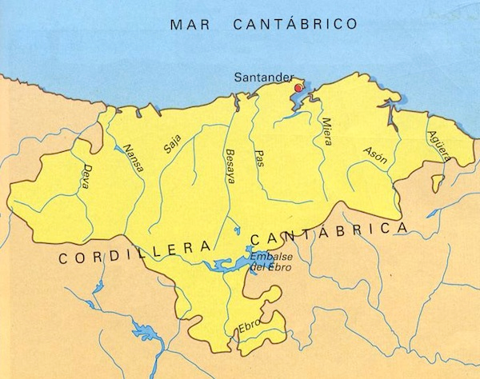
Geographical Information
RIVERS
Deva
Nansa
Asón
Ebro
Saja
Pas
Agüera
Besaya
Miera

Slide 6
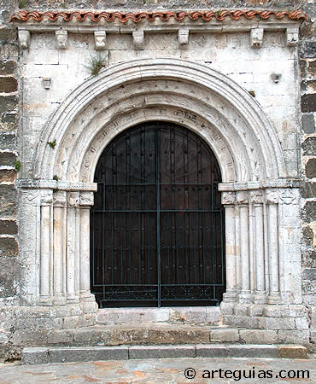
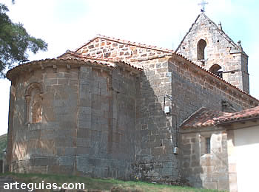
Famous Monuments
The church of Santa Maria De San Vicente De La Barquera Romanic church San Andrés Valdemora

Slide 7
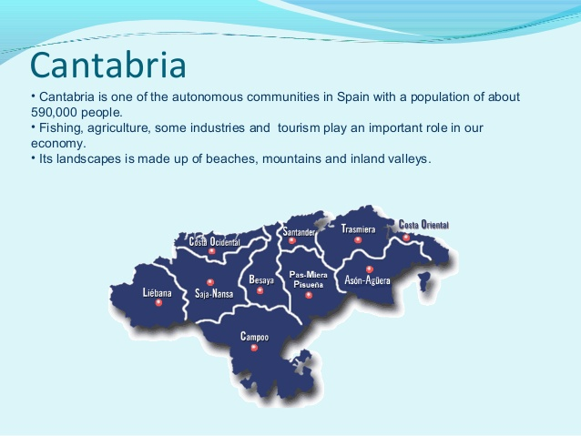
Population
OVER:

Slide 8
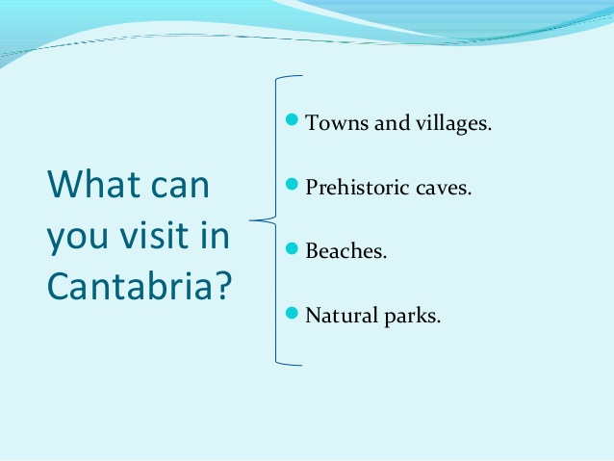
Recommendations

Slide 9

THANKS FOR WATCHING

