Slide 1
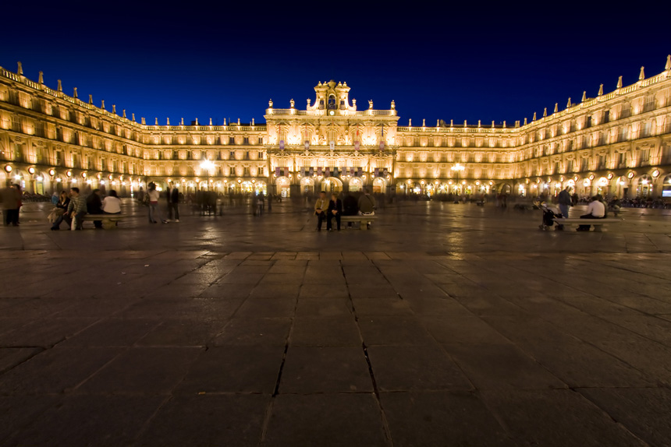
CASTILLA Y LEÓN
SDFDFDFEFEFFFFFFFFFED
IMPORTANT FACTS ABOUT CASTILLA Y LEÓN:

Slide 2
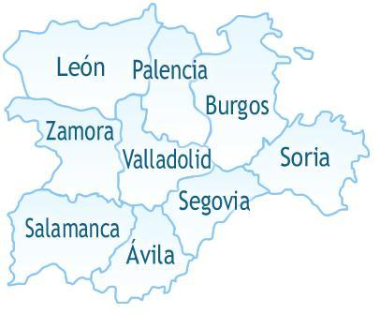
9 PROVINCES
León
Valladolid
Palencia
Burgos
Soria
Segovia
Ávila
Salamanca
Zamora

Slide 3
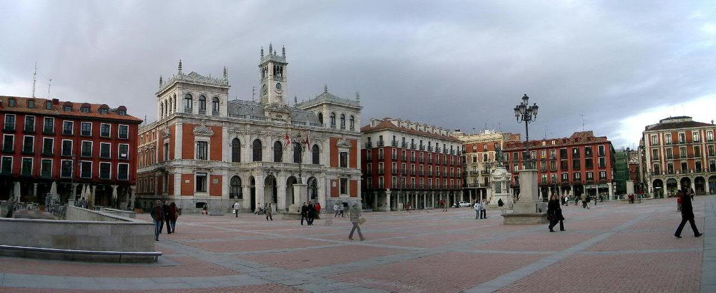
CAPITAL
Valladolid
(PLAZA MAYOR)

Slide 4
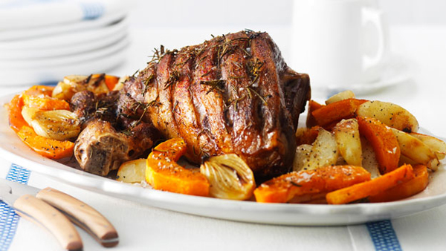
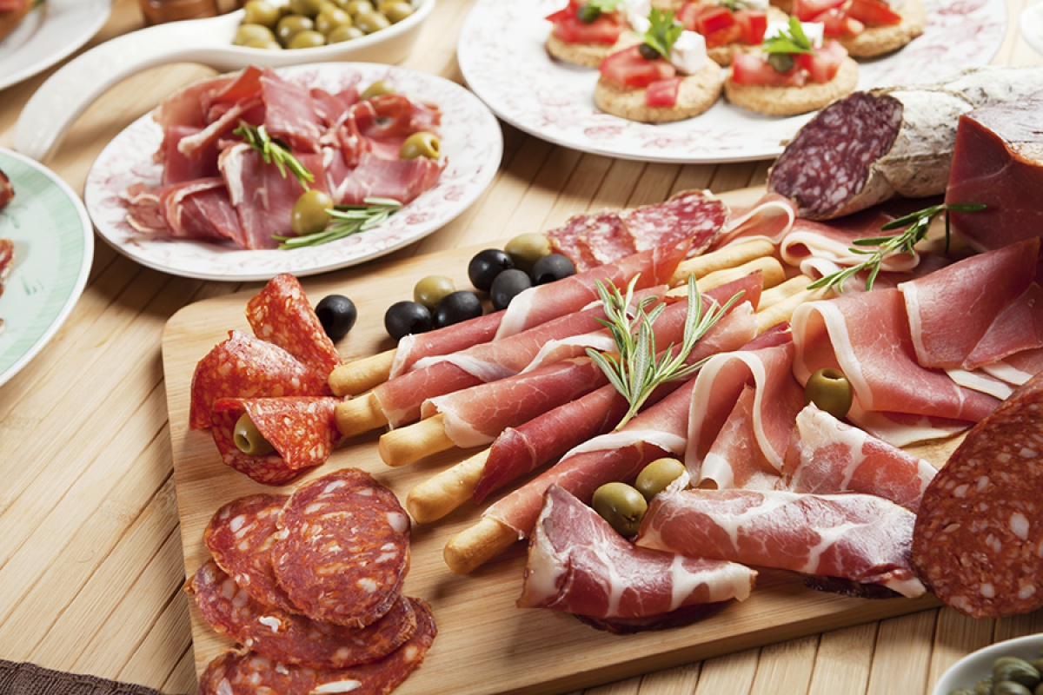
TRADICIONAL FOOD
Cordero asado al horno
Embutidos: salted jam,spanish lomo embutchado, sausage…
Wine

Slide 5

POPULATION
2.448 millions (2016)

Slide 6
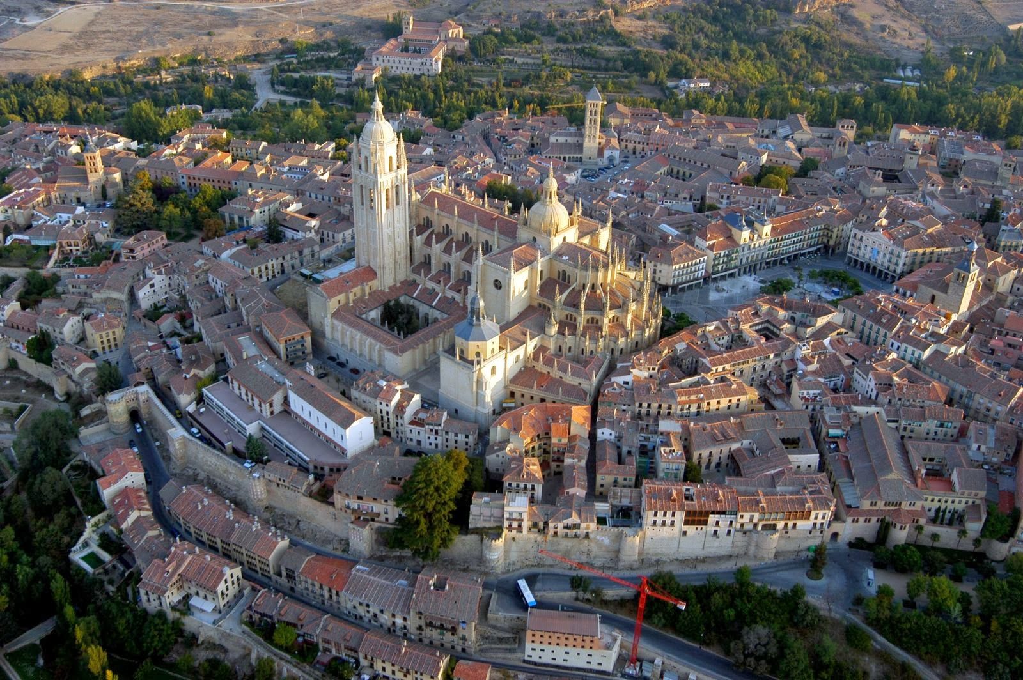
AREA
94.222 km2

Slide 7

LANGUAGE
Castellano

Slide 8
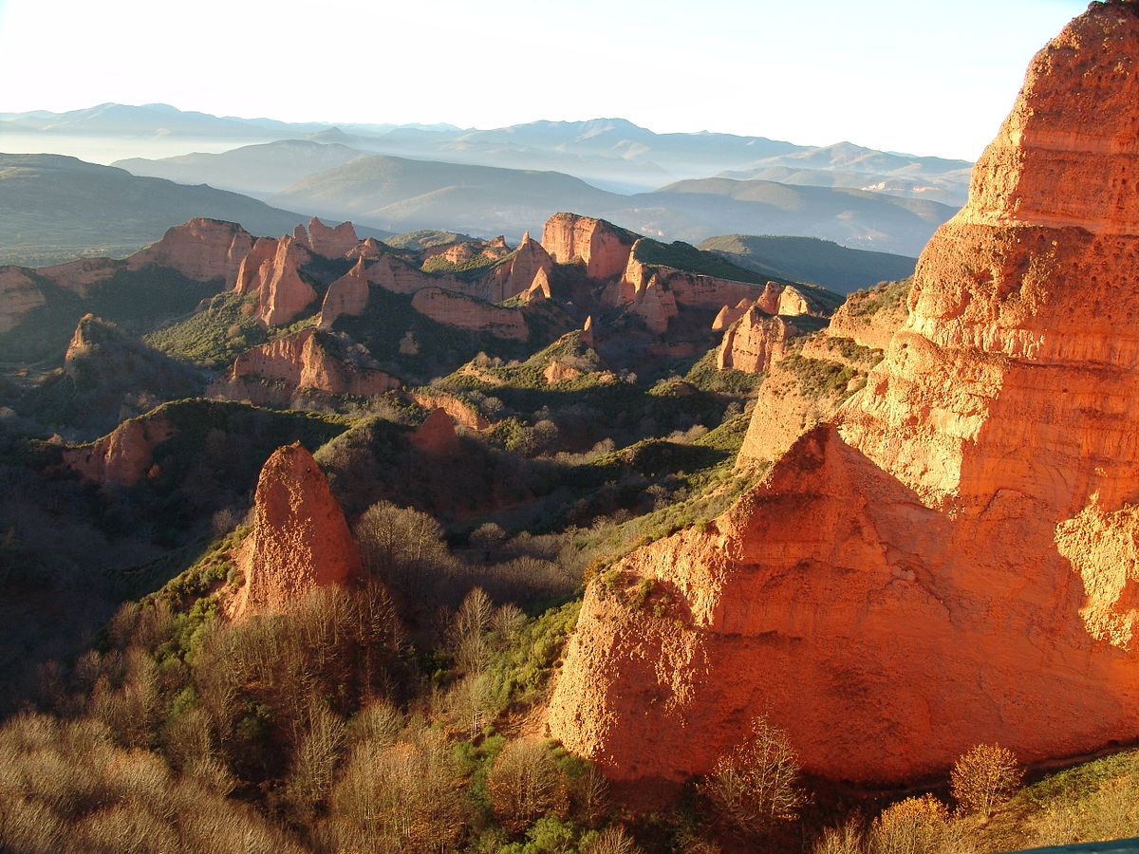
LAS MÉDULAS

Slide 9
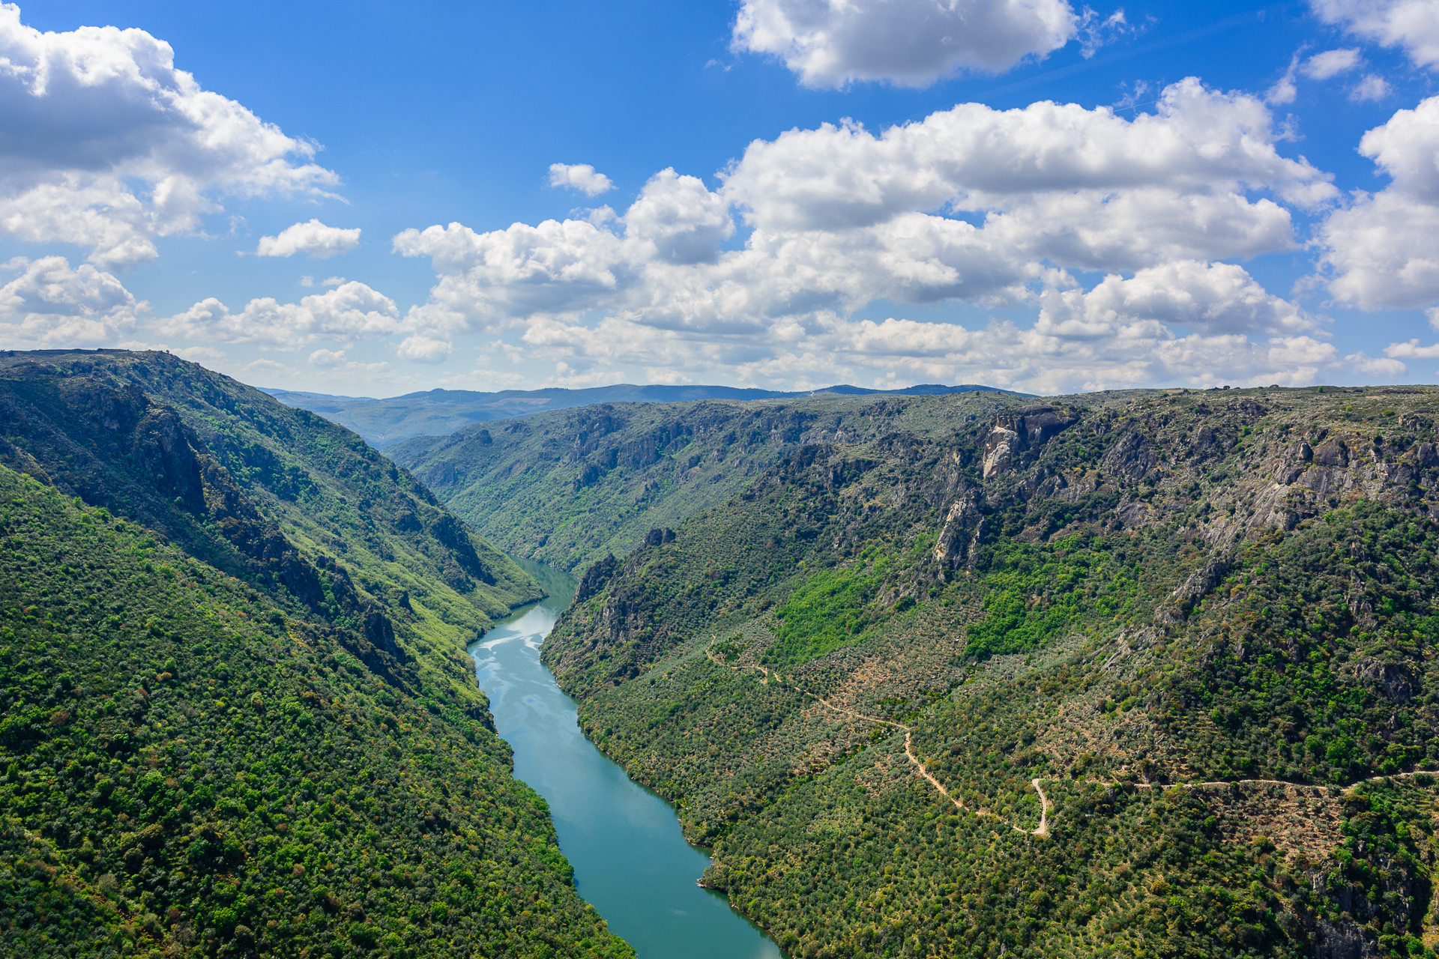
DUERO
River

Slide 10
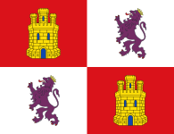
FLAG

Slide 11
the end…

