Slide 1

Andalucía
My autonomous communities

Slide 2
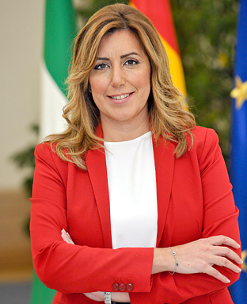
SHE IS THE PRESIDENT OF ANDALUCIA
She is called Susana Díaz Pacheco

Slide 3
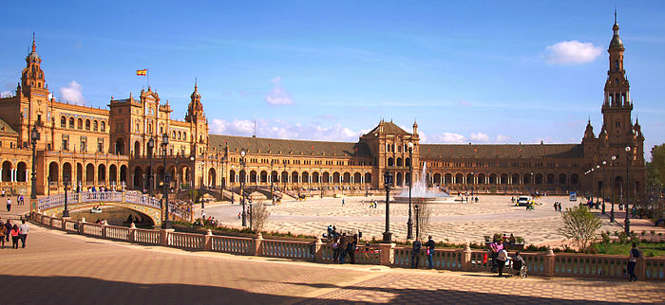
THIS IS THE CAPITAL OF ANDALUCIA
SEVILLA

Slide 4
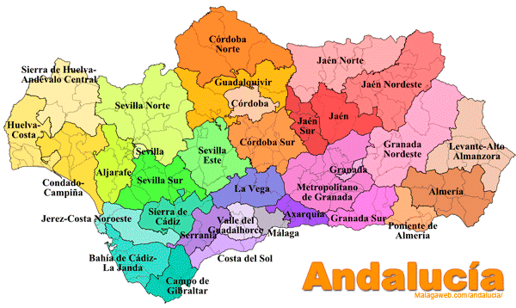
Facts: population,size.
Superface area: 87.597 squared km.
Poblation: 8.388.000 habitants.
The communities that limit Andalucía are:
Castilla, Región de Múrcia, Estrecho de Gibraltar

Slide 5
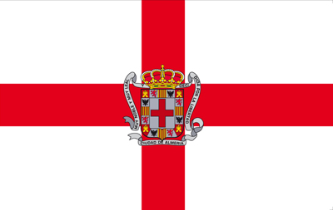
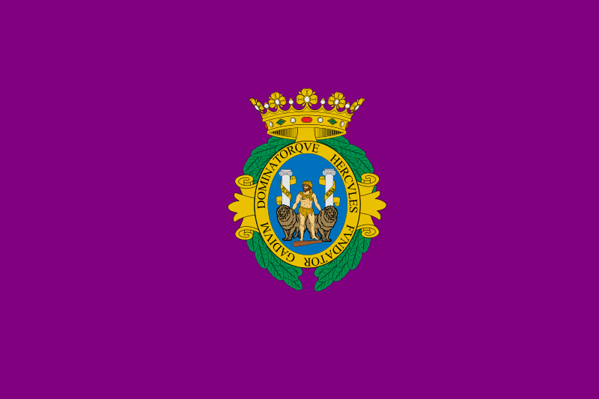
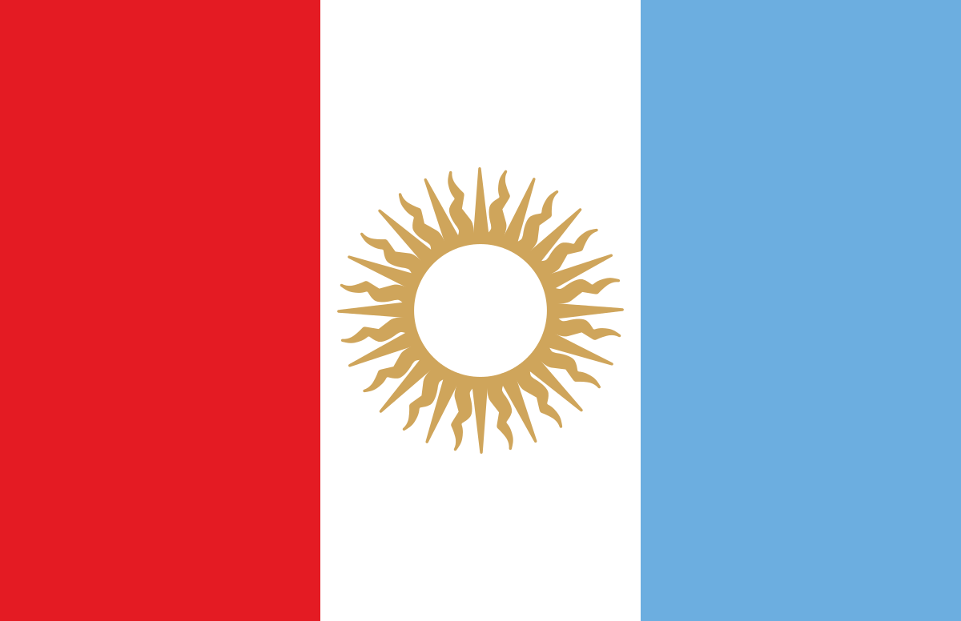
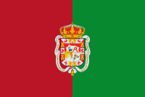
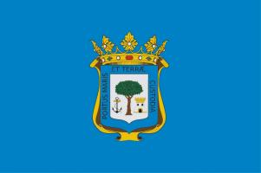
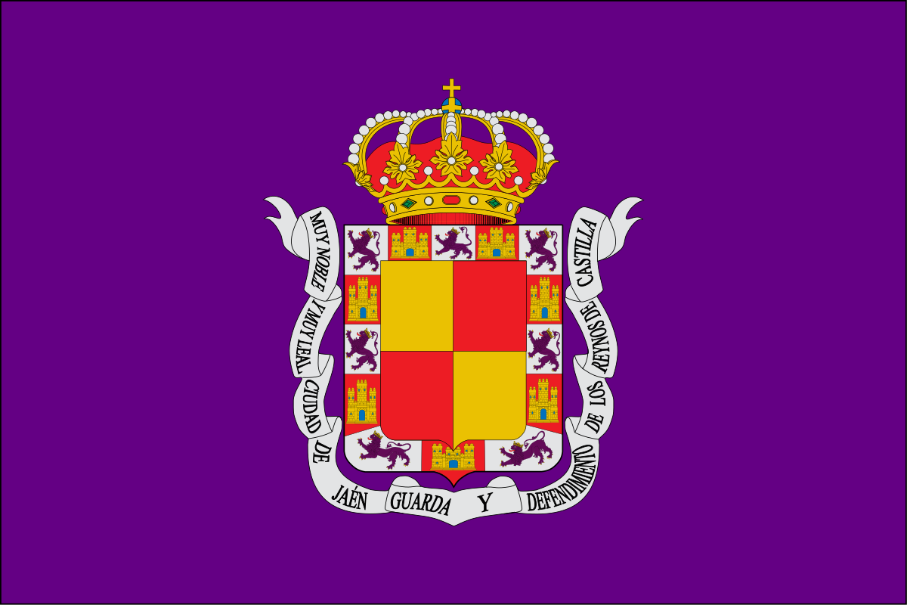
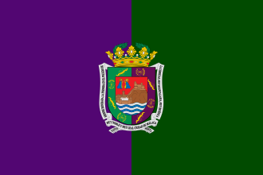

THIS ARE THE PROVINCES OF ANDALUCIA
ALMERÍA
CÁDIZ
CÓRDOBA
GRANADA
HUELVA
JAÉN
MÁLAGA
SEVILLA

Slide 6
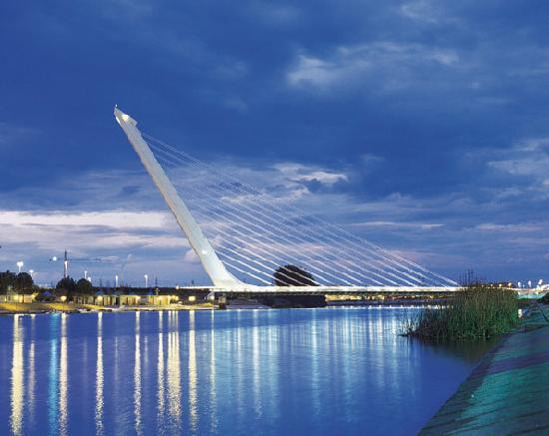
Rivers of Andalucia:
Guadalquivir, Guadiana, Guadalete, Genil, Tinto, Odiel, Segura, etc...
GUADALQUIVIR

Slide 7
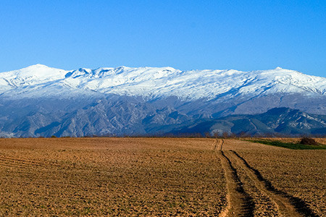
Mountains of Andalucia
Sierra Nevada, El torreón, Mulhacen, Pico Veleta, Cordilleras Béticas, Peña de los Enamorados, La Maroma, Pico Magima, etc…
SIERRA NEVADA

Slide 8
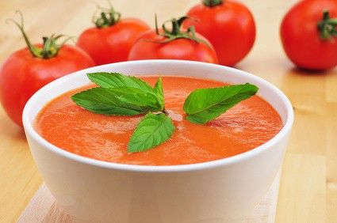
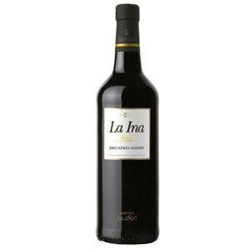
Foods and drinks typical of Andalucia
FOODS: salmorejo, gazpacho, mollete, migas, habas con jamón, aceite de oliva, mantecados, polvorones...
DRINKS: vino fino, vinos de Jerez, anís, rón,
mosto, manzanilla...

Slide 9
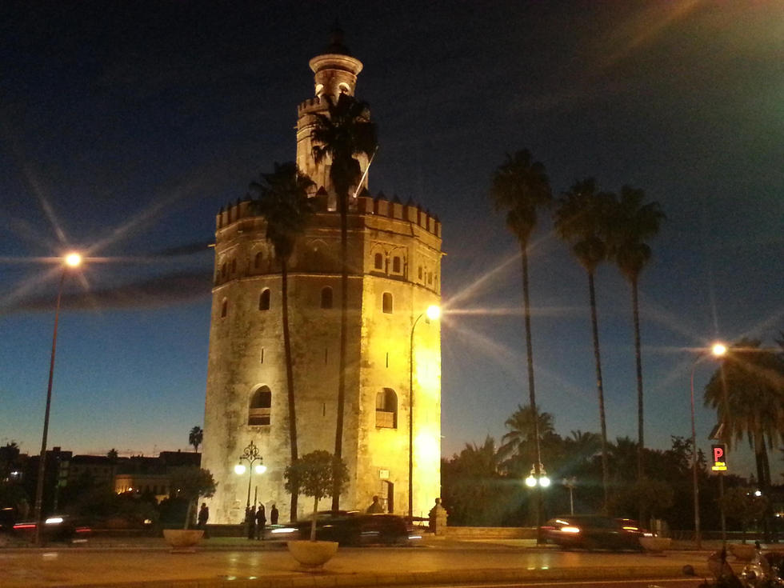
Famous Monuments
The famous monuments that have Andalucía are:
La Alhambra, Generalife, Albacín (Granada); El Alcázar, La Catedral; La Torre del Oro, El Archivo de Índias (Sevilla), La Mezquita, El Centro Histórico de Córdoba; Las Ciudades Renacentistas de Úbeda y Baeza .
LA TORRE DEL ORO

Slide 10
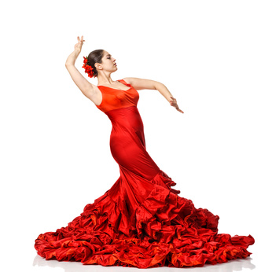
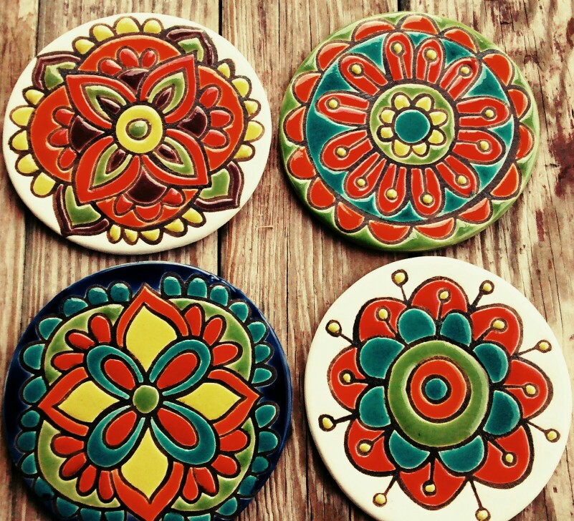
Traditions of Andalucia
The traditions of Andalucía are:
La Semana Santa, Feria de Abril and dancing of Sevillanas(Sevilla) Romería (Huelva).
The ceramic aswells is very famous in Andalucía.

Slide 11

Types of food and drinks

