Slide 1
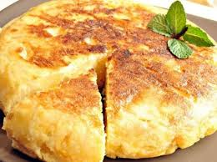
SPANISH OMELETTE

Slide 2
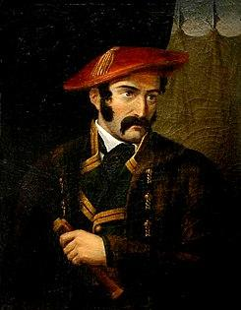
A LITTLE BIT OF HISTORY
Spanish omelette: Basque origin

Slide 3
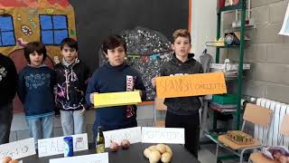
SPANISH OMELETTE RECIPE
INGREDIENTS (4/5people)
6-7 medium potatoes, peeled
1 whole yellow onion
5-6 large eggs
2-3 cups of olive oil for pan frying
Salt to taste
https://youtu.be/h5q-tc60t8Q

Slide 4
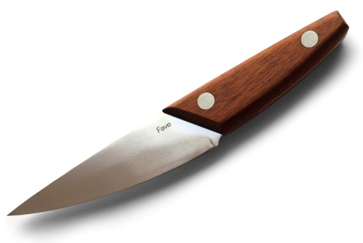
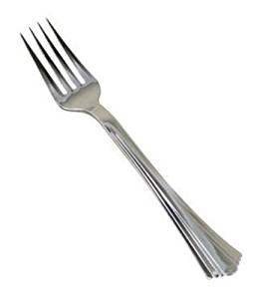
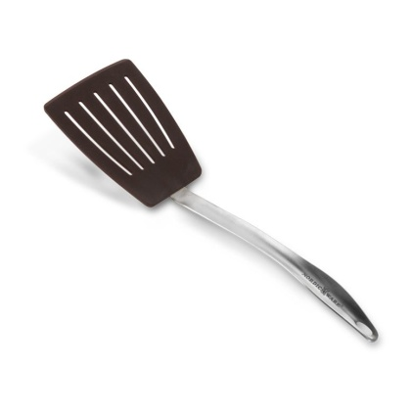
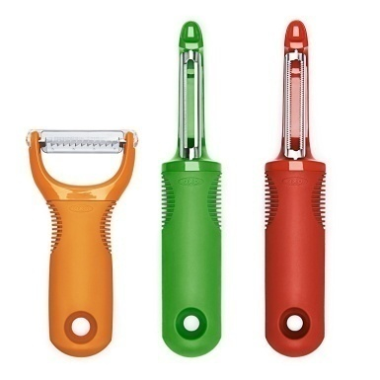
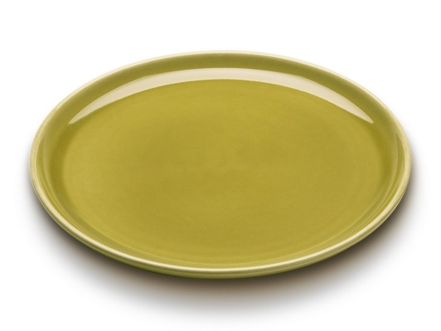
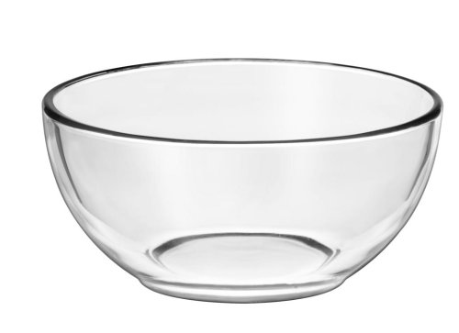
WE ALSO NEED SOME TOOLS
1 Sharp Knife for Chopping Onion and Potatoes
1 Large Frying Pan for Frying Potatoes and Onions
1 Peeler
1 Mixing Bowl
1 large fork
A spatula
A plate

Slide 5
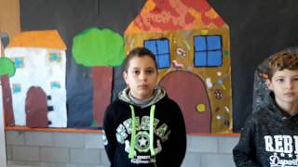
PREPARATION
Procedure1 :
We peel the potatoes
https://youtu.be/T4YUnRvE2nE

Slide 6
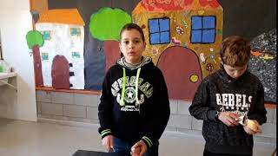
PREPARATION
Procedure 2 :
We peel the onion
https://youtu.be/JBJyPCbV_lg

Slide 7
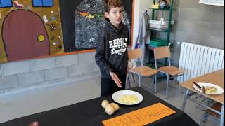
PREPARATION
Procedure 3 :
We cut the potatoes in
small slices
https://youtu.be/O51wJiB5qJI

Slide 8
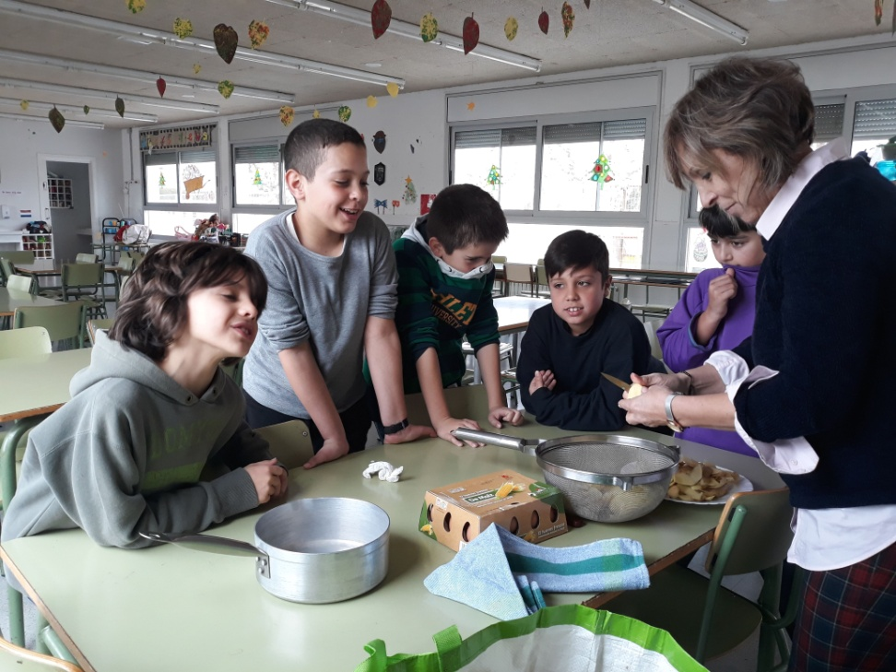
PREPARATION
Procedure 4 :
We chop the onion and we mix it with the potatoes

Slide 9
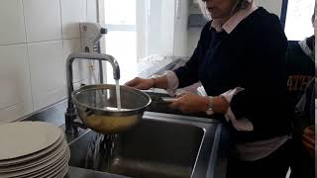
PREPARATION
Procedure 5 :
We wash and dry the potatoes and the onion
https://youtu.be/v7U6YQUUPm8

Slide 10
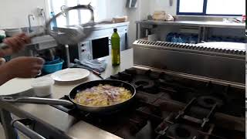
PREPARATION
Procedure 6 :
We put the ingredients in a frying pan with olive oil and a pinch of salt. They need 20-25 minutes so as to be well cooked.
https://youtu.be/IS2KTY9e6pw

Slide 11
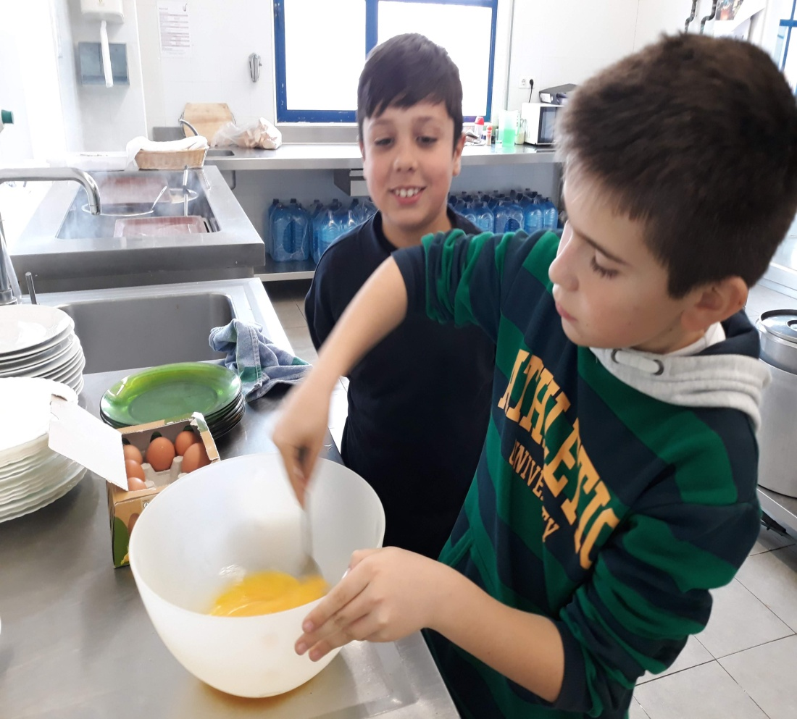
PREPARATION
Procedure 7 :
Meanwhile we crack and beat the eggs with a fork in a bowl.
We also add a pinch of salt

Slide 12
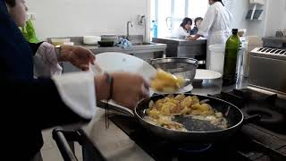

PREPARATION
Procedure 8 :
When the potatoes and onions are cooked we mix them with the eggs in the bowl.
https://youtu.be/nMihYcVhgI8
WE DON’T NEED ALL THE OLIVE OIL

Slide 13
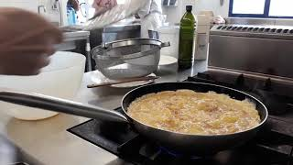
PREPARATION
Procedure 9 :
Finally , we throw all the dough in the pan again with a few amount of olive oil and wait until one side is done.
https://youtu.be/QLxKRdUM81g

Slide 14
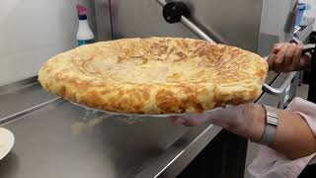

PREPARATION
Procedure 10
To finish, we turn over the omelette until the other side is done. (2-3 minutes, depending on the cooker).
https://youtu.be/UDaOEtcILX8

Slide 15
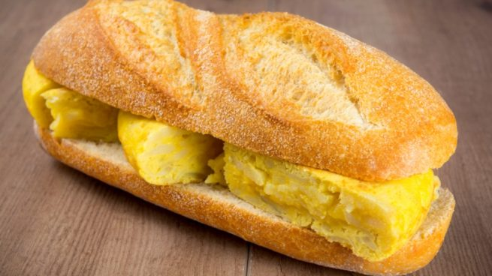
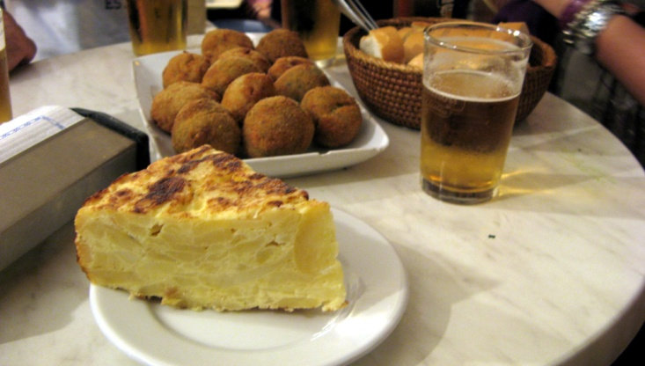
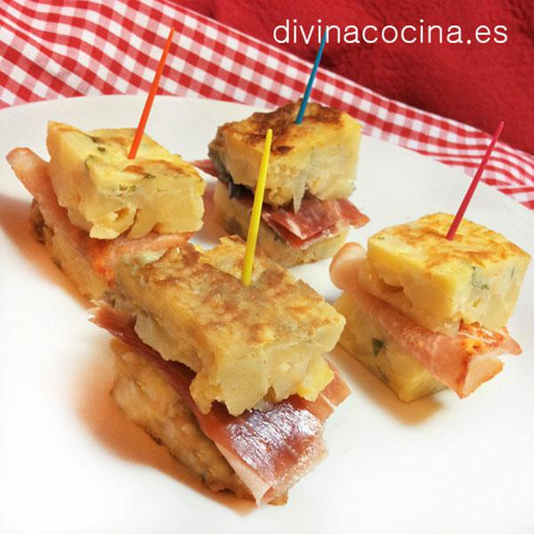
BON APPETIT!

