Slide 1
STRUCTURES - DIALOGUES

Slide 2
HELLO. WHAT’S YOUR NAME ?
MY NAME IS ......

Slide 3
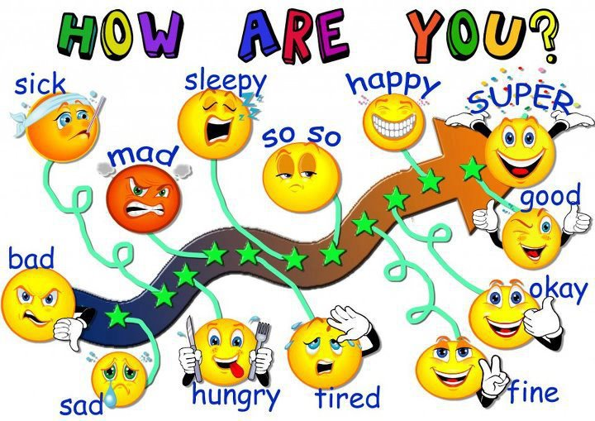
I’M ..FINE..,THANK YOU
HOW ARE YOU?

Slide 4
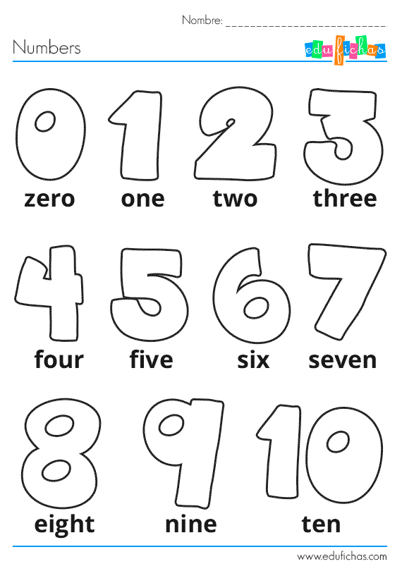
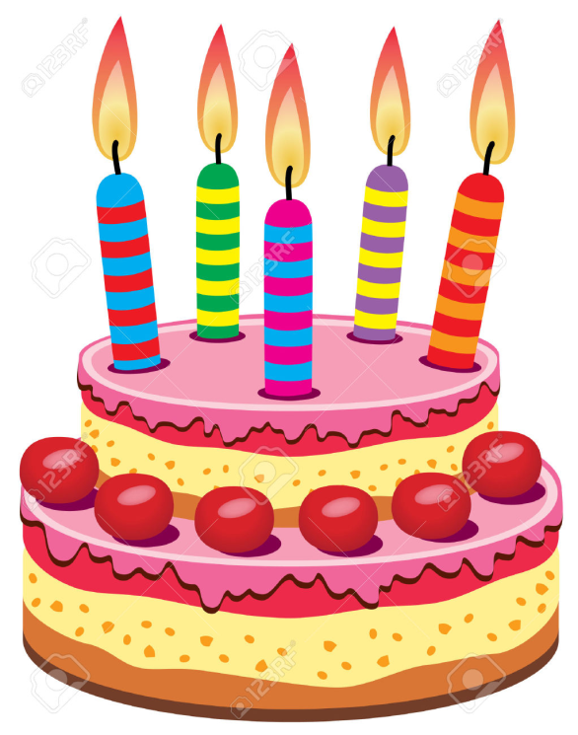
HOW OLD ARE YOU?
I’M ..SIX.. YEARS OLD.

Slide 5
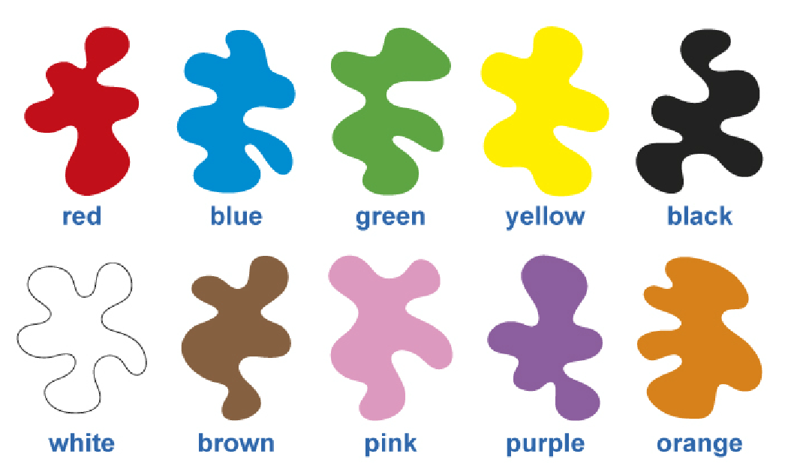
WHAT’S YOUR FAVOURITE COLOR?
MY FAVOURITE COLOR IS .........BLUE.........

Slide 6
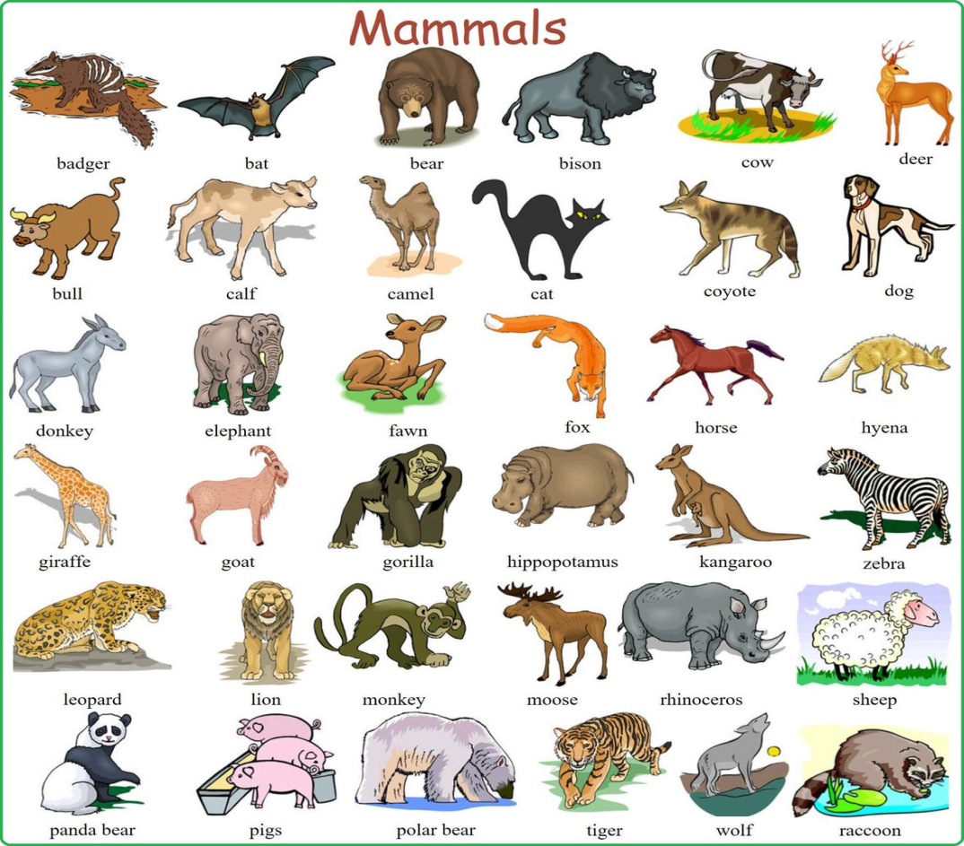
WHAT’S YOUR FAVOURITE ANIMAL ?
MY FAVOURITE ANIMAL IS ........................

Slide 7
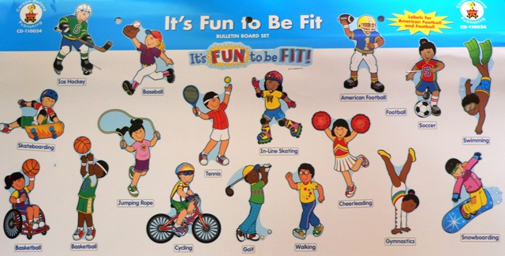
WHAT’S YOUR FAVOURITE SPORT ?
MY FAVOURITE SPORT IS ........................

Slide 8
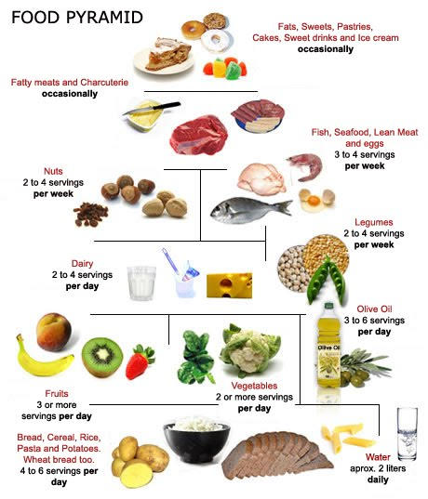
WHAT’S YOUR FAVOURITE FOOD ?
MY FAVOURITE FOOD IS .........

Slide 9
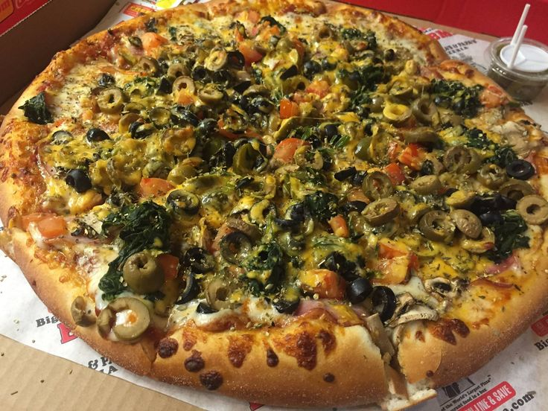
DO YOU LIKE PIZZA ?
YES, I DO NO, I DON’T

Slide 10
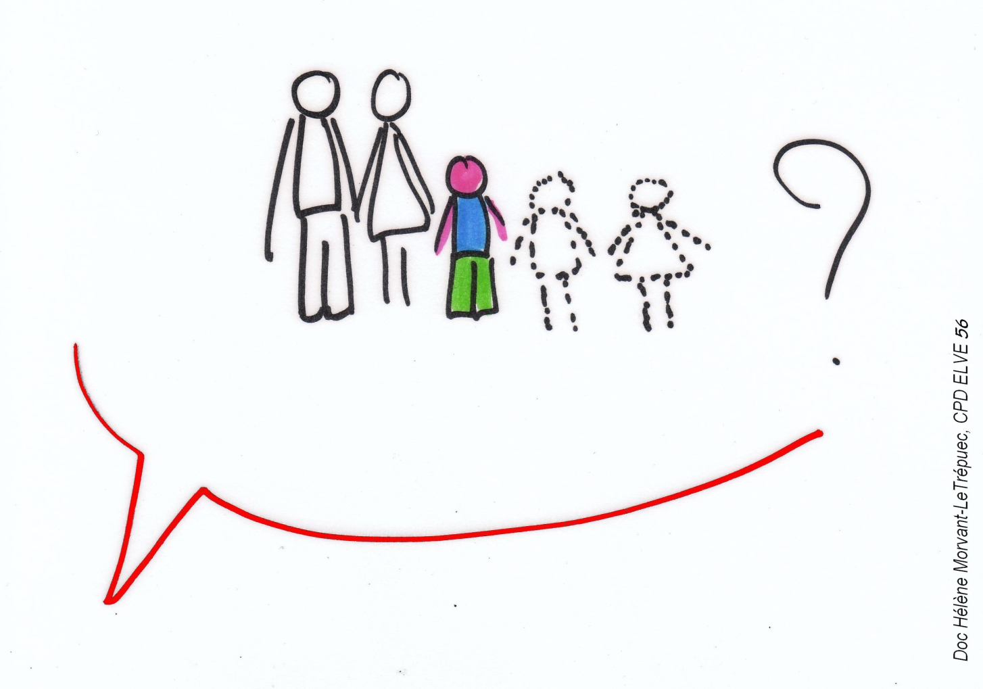
HAVE YOU GOT ANY BROTHER OR SISTER ?
I’VE GOT .............
NO, I HAVE NOT.

Slide 11
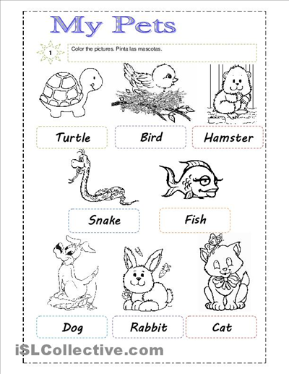
HAVE YOU GOT A PET ?
I’VE GOT A ..................
NO, I HAVEN’T GOT PETS.

Slide 12
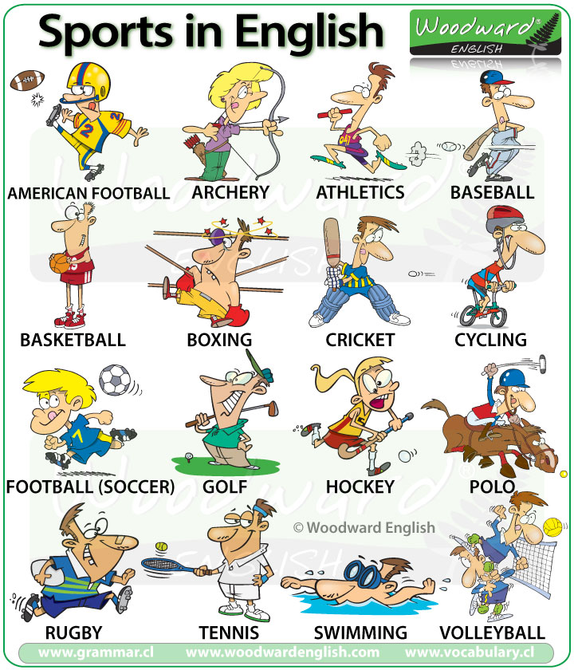
CAN YOU PLAY TENNIS?
YES, I CAN.
NO, I CAN’T.

Slide 13
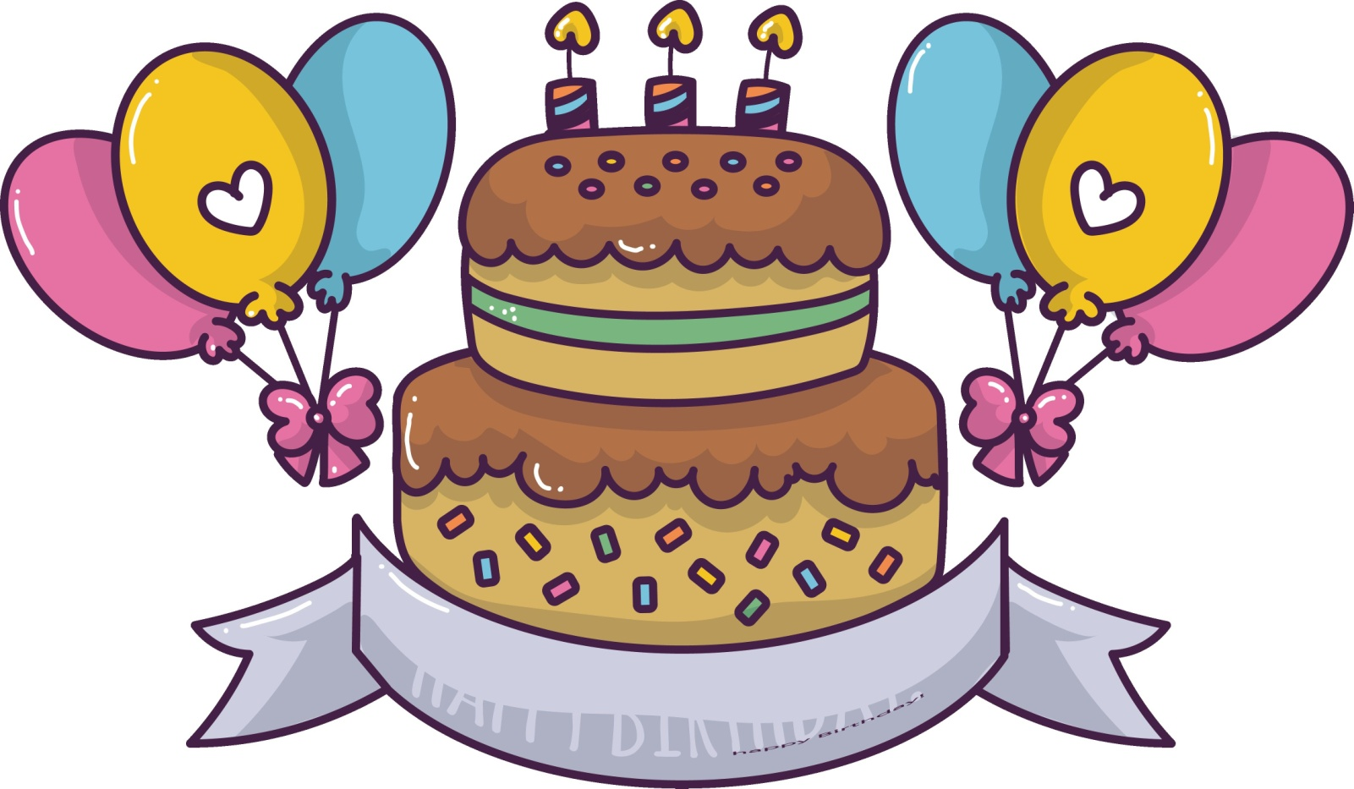
WHEN IS YOUR BIRTHDAY?
MY BIRTHDAY IS ON THE 25th OF APRIL.

Slide 14
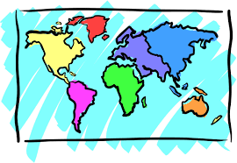
WHERE ARE YOU FROM?
I’M FROM GREAT BRITAIN.

Slide 15
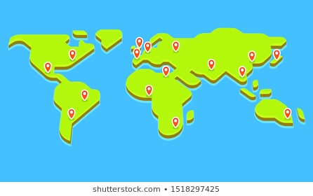
WHERE DO YOU LIVE?
I LIVE IN TERRASSA.

Slide 16
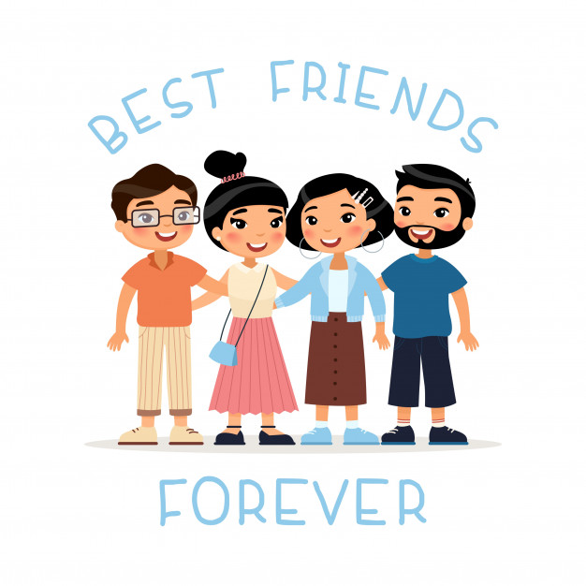
WHO’S YOUR BEST FRIEND?
MY BEST FRIEND IS ...........

Slide 17
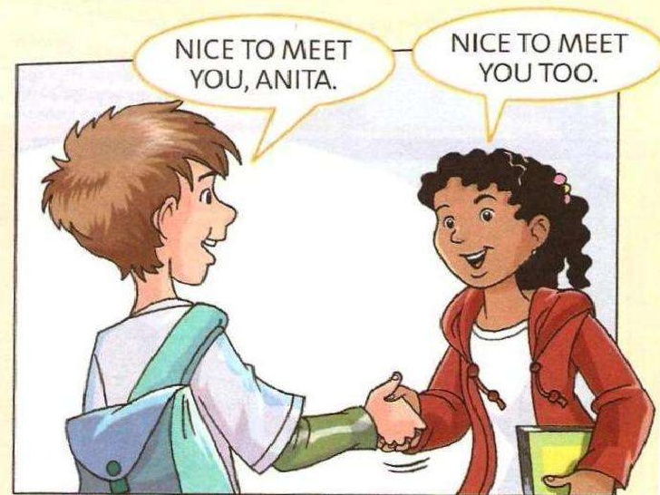
OK, IT’S NICE TO MEET YOU MY FRIEND
IT’S NICE TO MEET YOU TOO!

