Slide 1
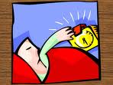
Wake up

Slide 2
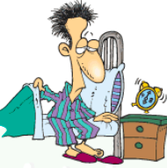
Get up at…

Slide 3
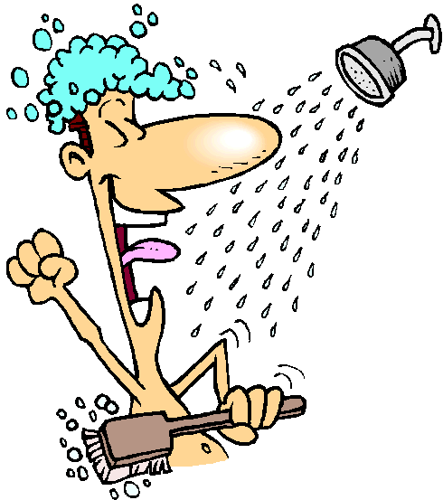
Have a shower

Slide 4
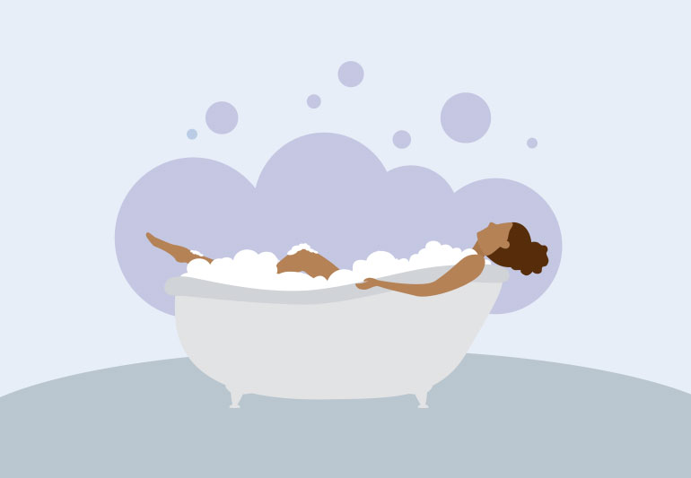
Have a bath

Slide 5

have a shave

Slide 6

Have breakfast

Slide 7
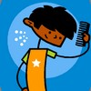
comb

Slide 8
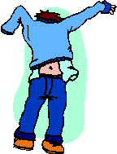
Get dressed

Slide 9

Brush your teeth

Slide 10

Put on make-up

Slide 11

Go to work (by bus…)
Get to work

Slide 12
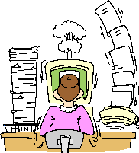
Work
Start work at…
Finish work at...

Slide 13

study

Slide 14
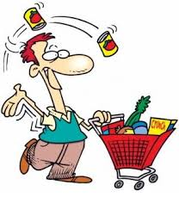
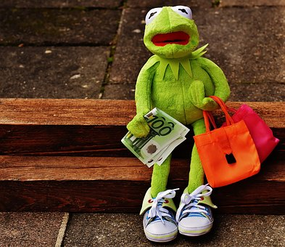
Go shopping

Slide 15
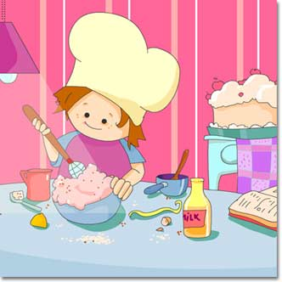
Cook
Make dinner

Slide 16

Have lunch (at home, at work…)

Slide 17

Drink (water)
Have a glass of water

Slide 18
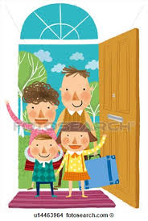
Go home
Get home

Slide 19
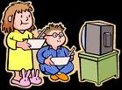
Watch TV

Slide 20
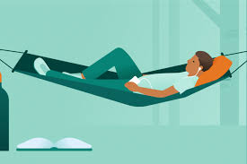
Relax

Slide 21

Listen to music

Slide 22
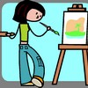
Paint

Slide 23
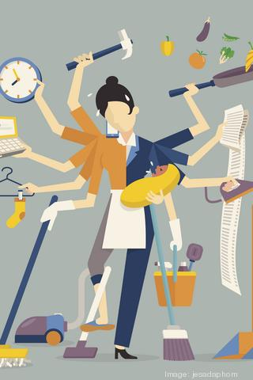
Do the housework

Slide 24

Take the dog for a walk

Slide 25
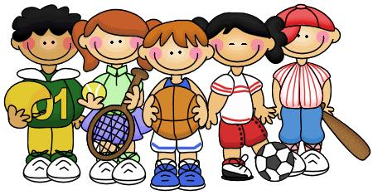
Play sport

Slide 26
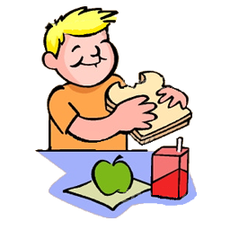
Have a snack/ have tea

Slide 27

Read

Slide 28
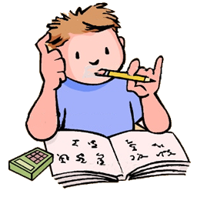
Do your homework

Slide 29
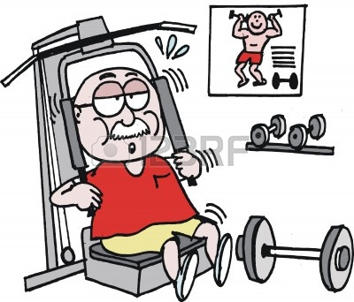
Do exercise

Slide 30
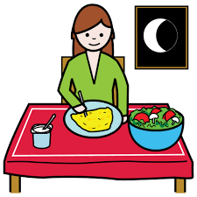
Have dinner

Slide 31

Go to bed

Slide 32

Sleep (for eight hours)

Slide 33

dream

