Slide 1
CHOCOLATE, CHOCOLATE, EVERYWHERE!
Abril Parareda Domenech
Year 6

Slide 2
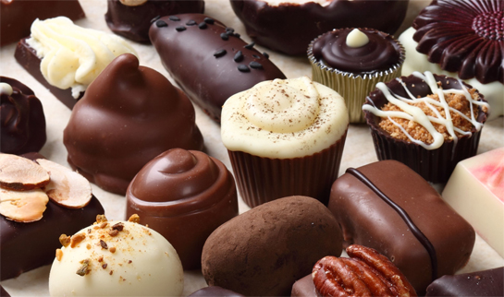
CHOCOLATE, CHOCOLATE, EVERYWHERE
Chocolate is a popular food. Chocolate comes in different flavours, shapes and sizes.

Slide 3
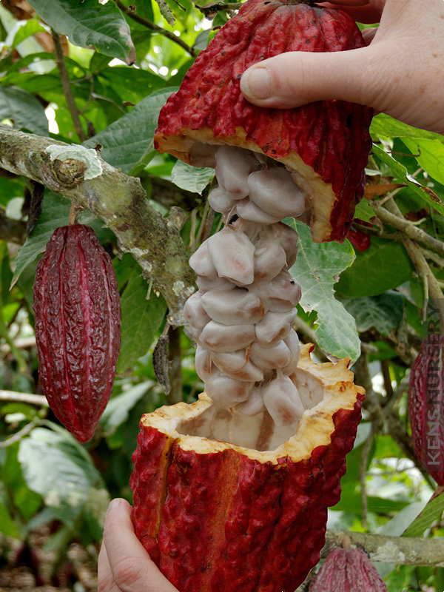
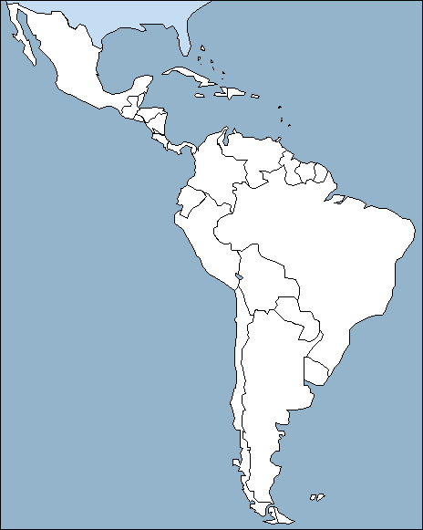
THE COCOA TREE
cocoa tree
The cocoa tree comes from Central and South America.
cocoa beans
fruit

Slide 4
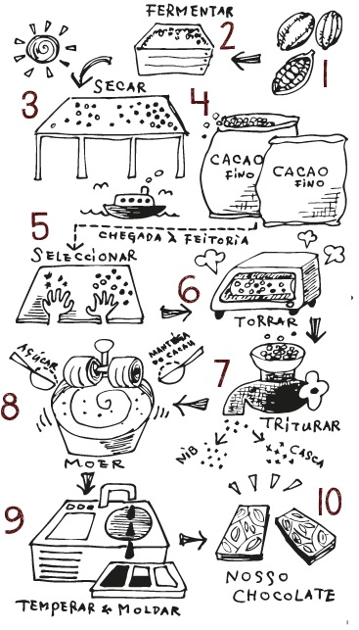
HOW TO MAKE CHOCOLATE
Pick the cocoa beans.
Leave the beans for a few days.
Dry the beans in the sun.
The beans go into a machine to cook them.
Shells come off the cocoa beans.
Another machine presses the beans and makes a brown liquid.
The chocolate maker adds milk and sugar.
Mix.
The chocolate maker makes chocolate in different shapes.

Slide 5
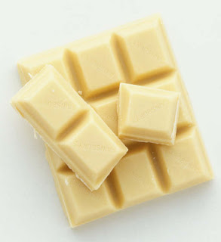
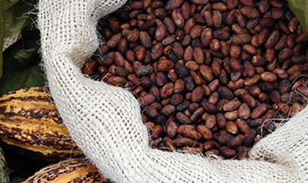
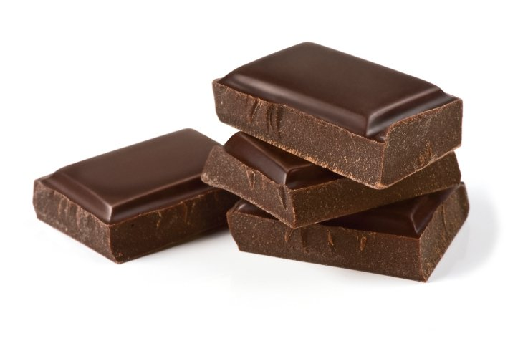
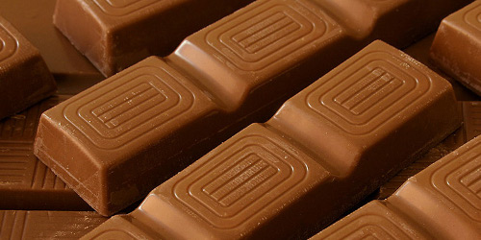
DIFFERENT TYPES OF CHOCOLATE

Slide 6
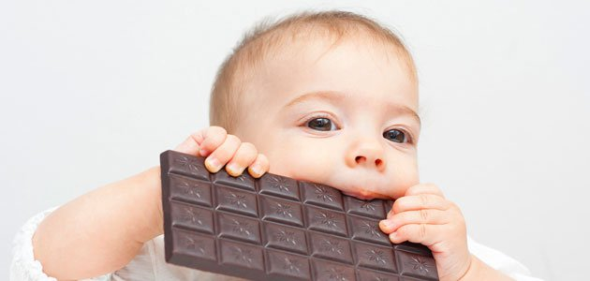
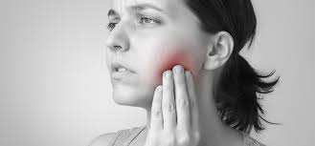
IS CHOCOLATE GOOD FOR YOU?
Eat a little chocolate helps to keep your heart healthy. But eating a lot of chocolate can be bad for you.

Slide 7
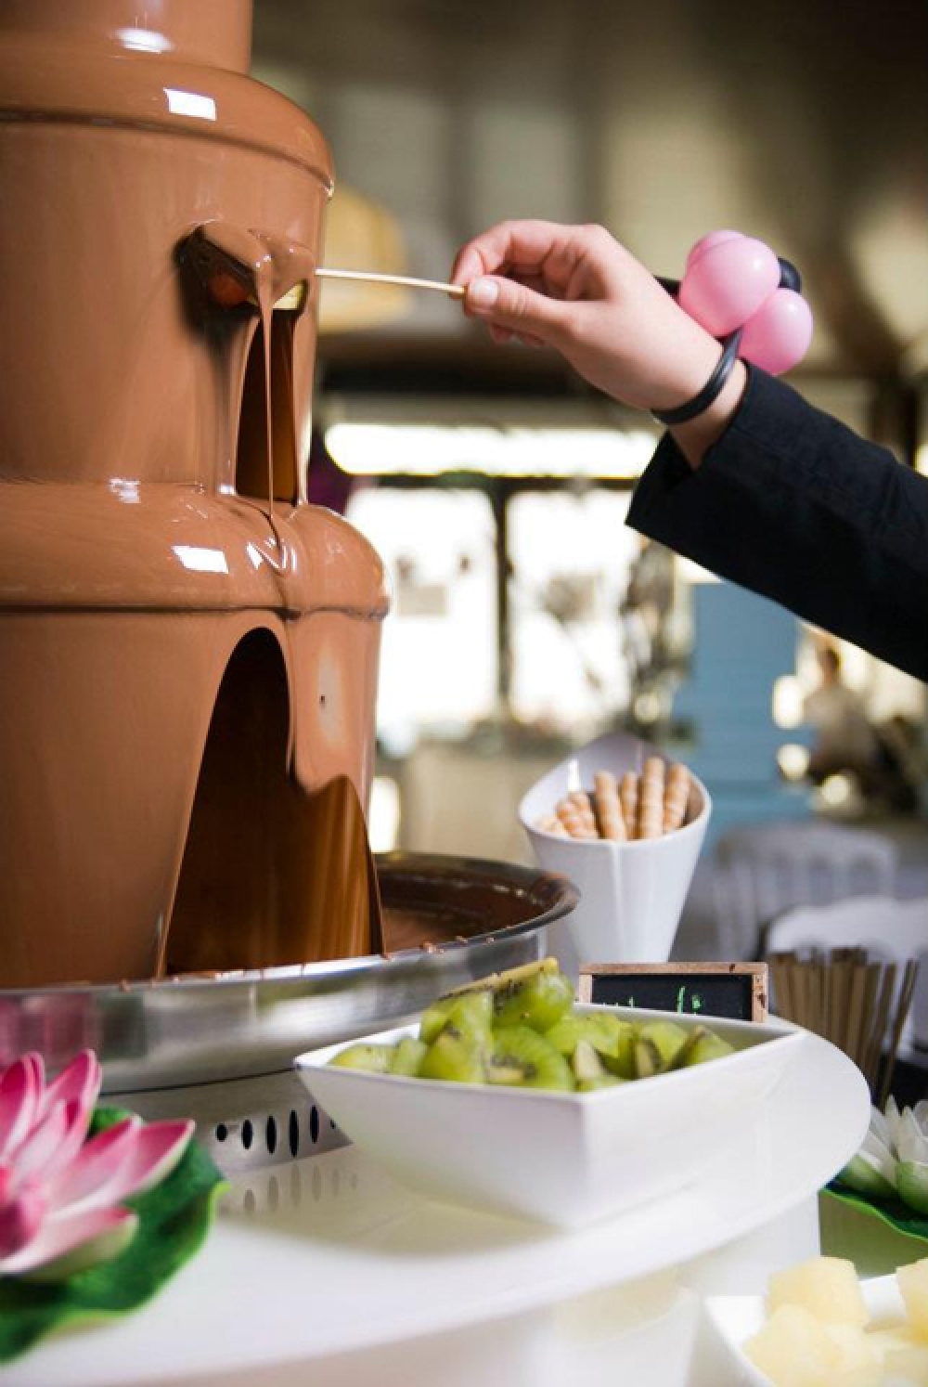
HOORAY FOR CHOCOLATE!
Some people give chocolate to celebrate.

Slide 8
THANKS FOR LISTENING!

