Slide 1
WHAT TIME IS IT?

Slide 2
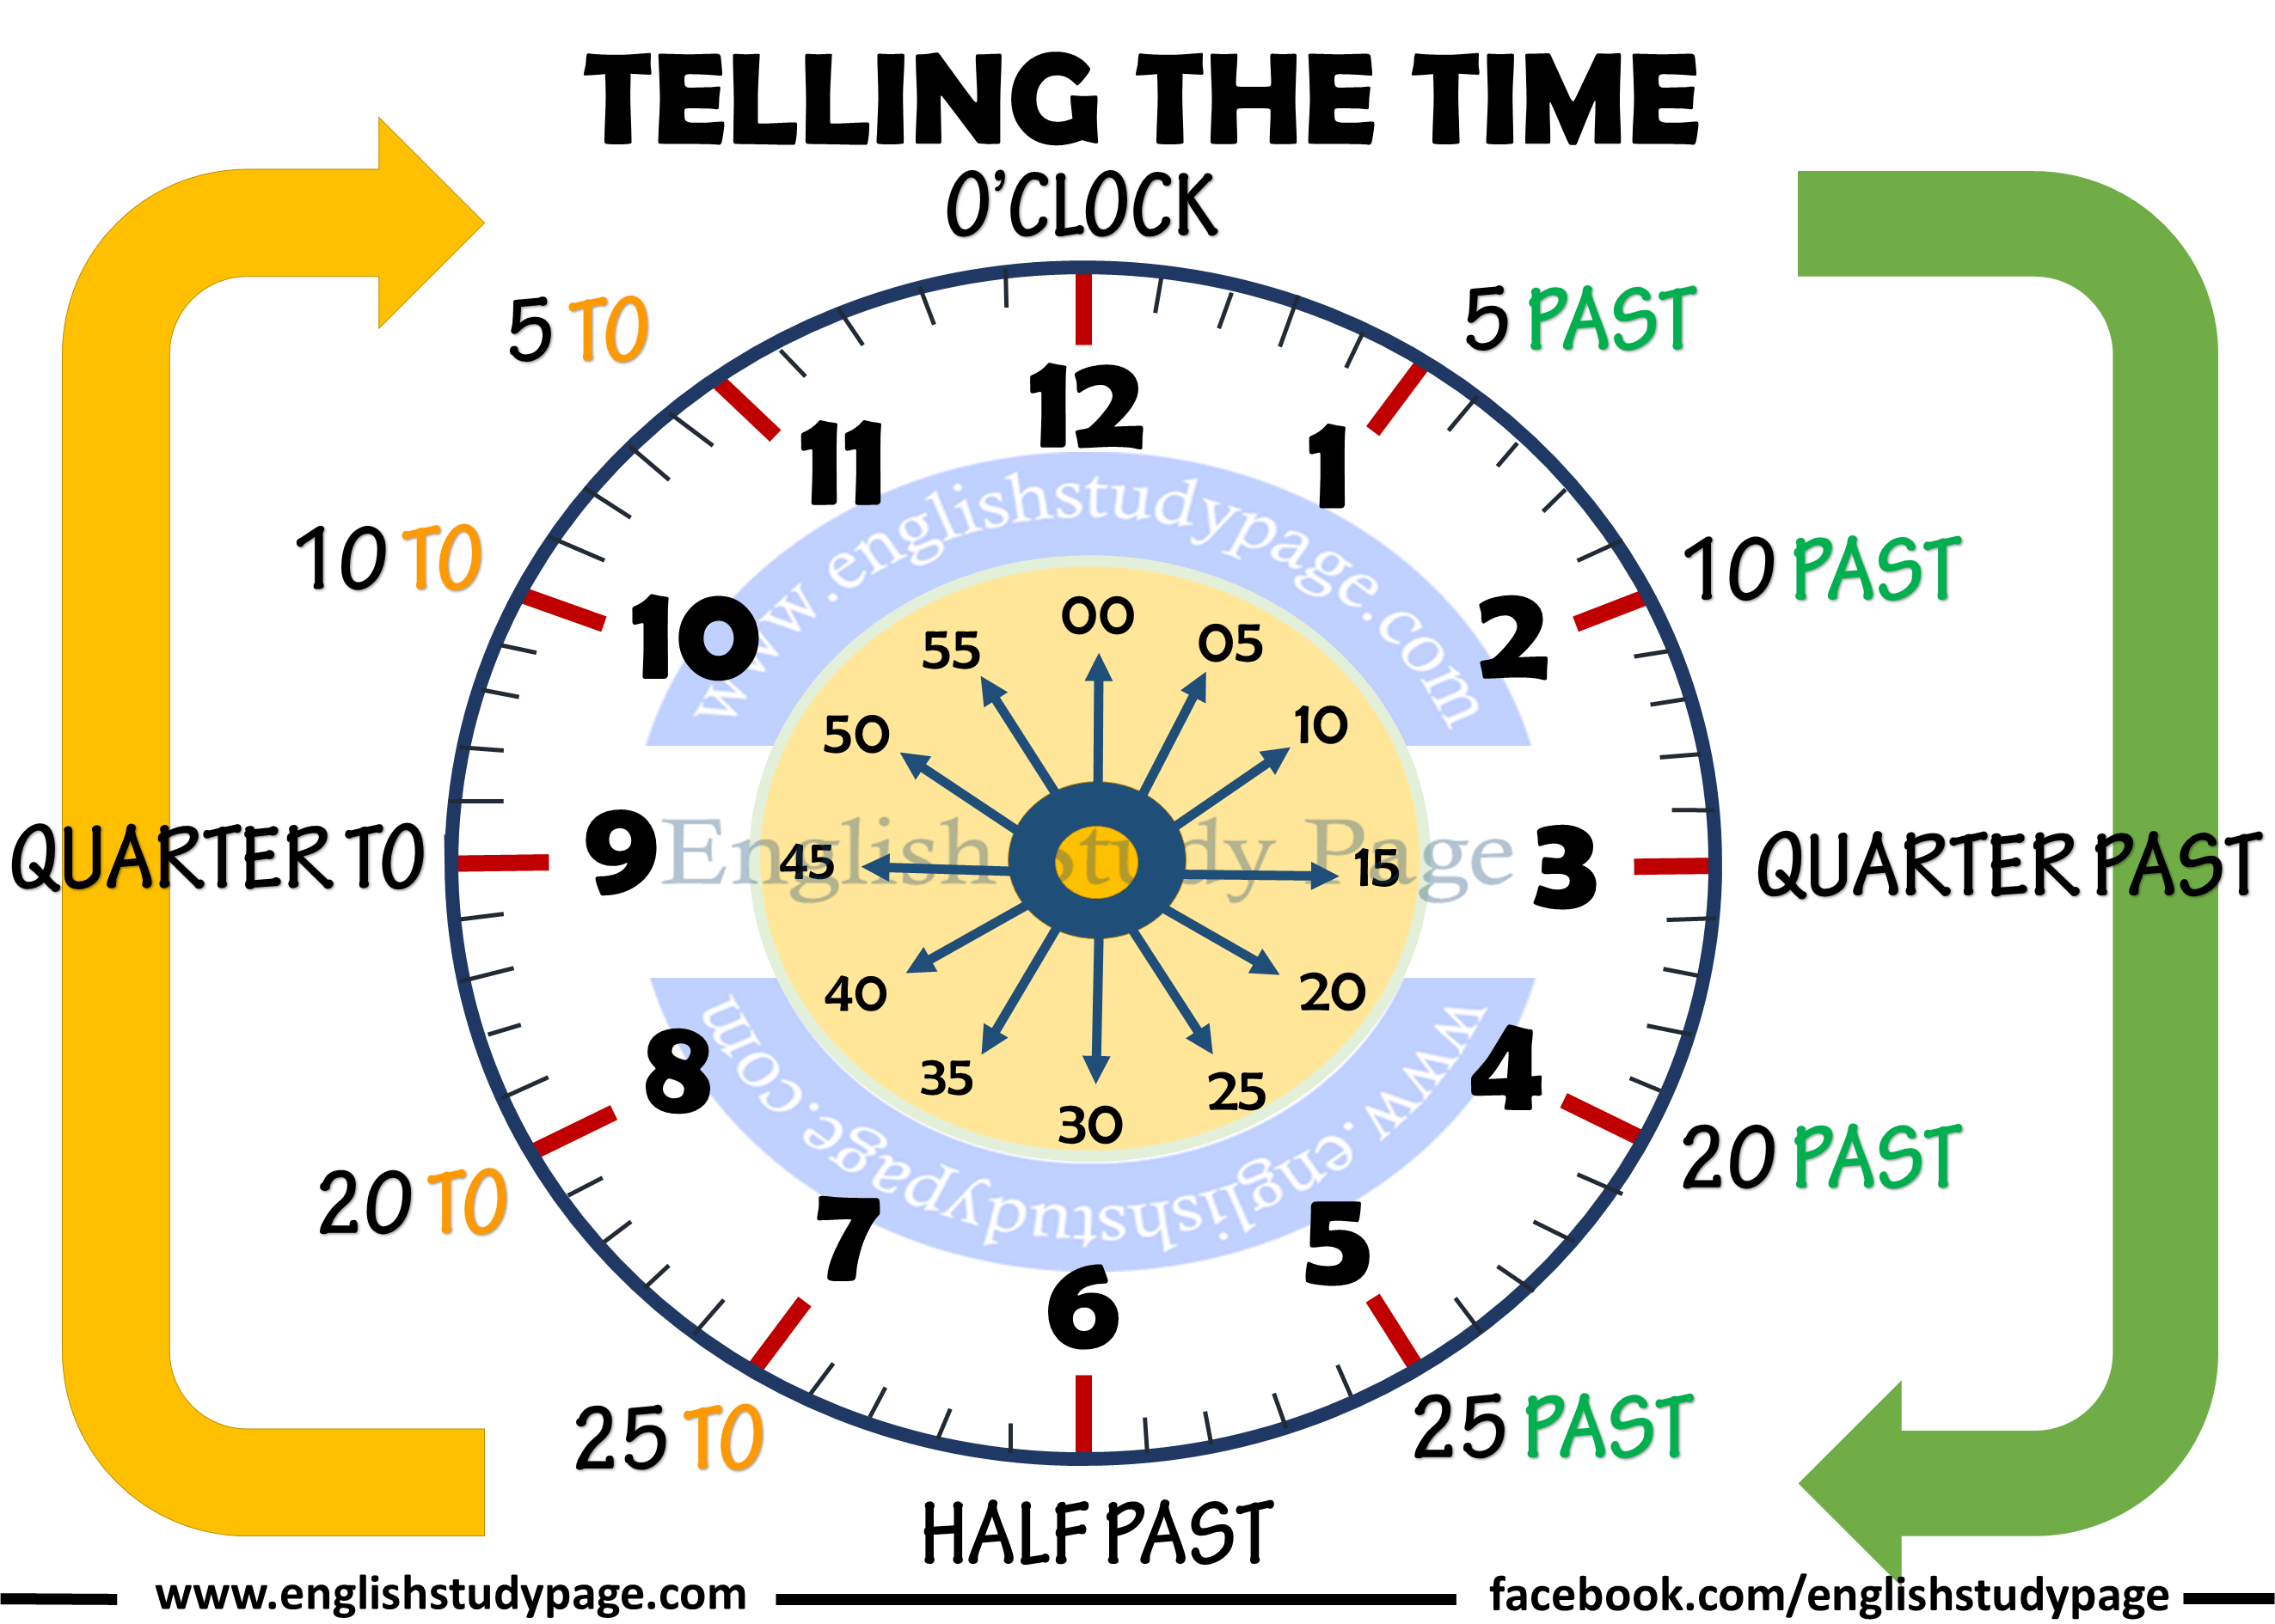
WHAT TIME IS IT?

Slide 3
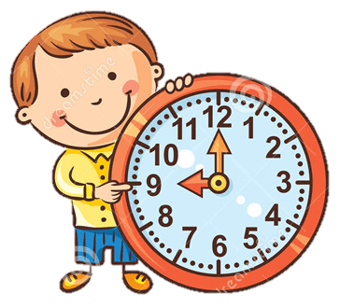
WHAT TIME IS IT?
It’s o’clock
It’s nine o’clock (9:00)

Slide 4
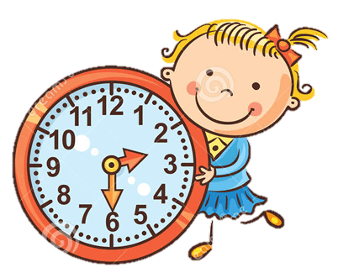
WHAT TIME IS IT?
It’s half past .
It’s half past two (2:30)

Slide 5
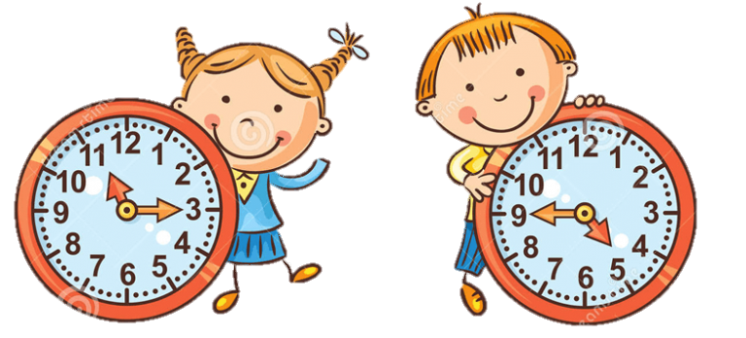
WHAT TIME IS IT?
It’s quarter past .
It’s quarter to (+1).
It’s quarter past eleven (11.15)
It’s quarter to five (4.45)

Slide 6
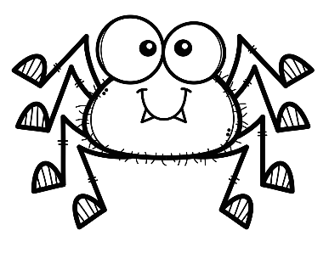
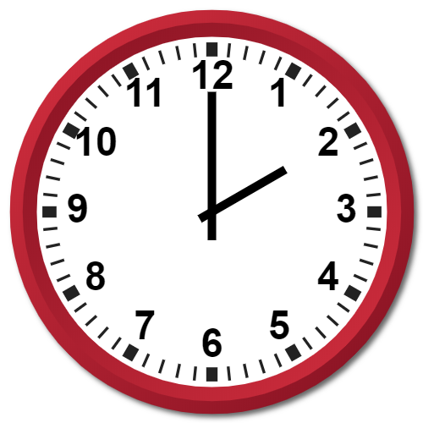
WHAT TIME IS IT?
It’s two o’clock (2:00)

Slide 7
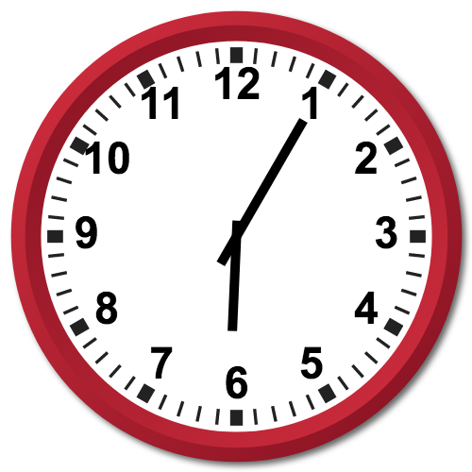
WHAT TIME IS IT?
It’s five past six
(6:05)

Slide 8
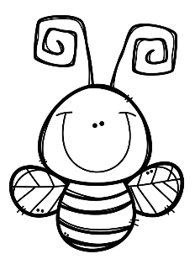
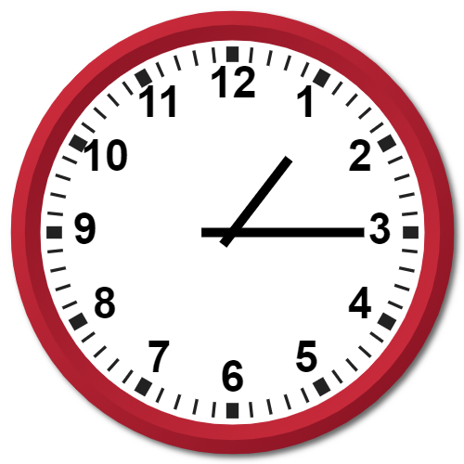
WHAT TIME IS IT?
It’s quarter past one
(1:15)

Slide 9
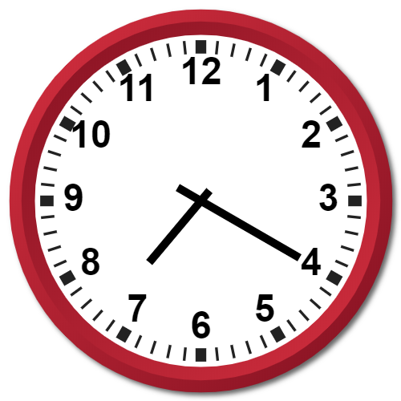
WHAT TIME IS IT?
It’s twenty past seven
(7:20)

Slide 10
WHAT TIME IS IT?
It’s half past eight
(8:30)

Slide 11
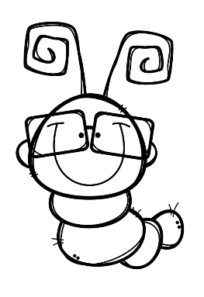
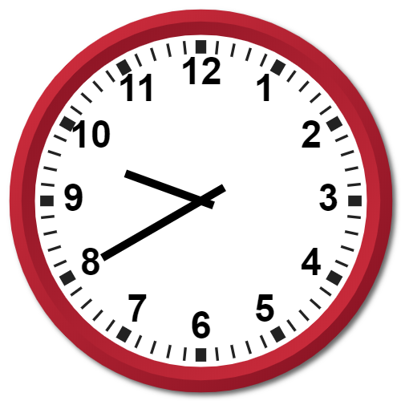
WHAT TIME IS IT?
It’s twenty to ten
(9:40)
Remember: minutes to arrive to

Slide 12
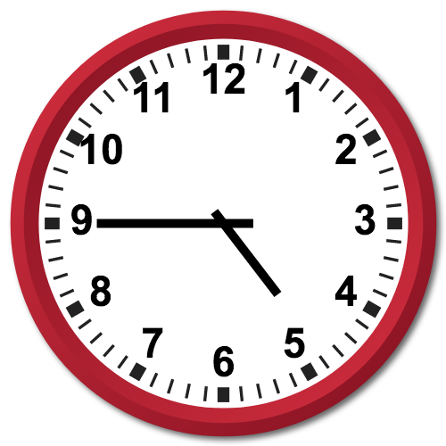
WHAT TIME IS IT?
It’s quarter to five
(4:45)
Remember: minutes to arrive to

Slide 13
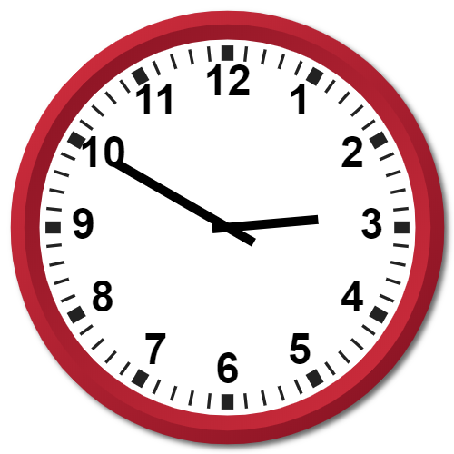
WHAT TIME IS IT?
It’s ten to three (2:50)
Remember: minutes to arrive to

