Slide 1

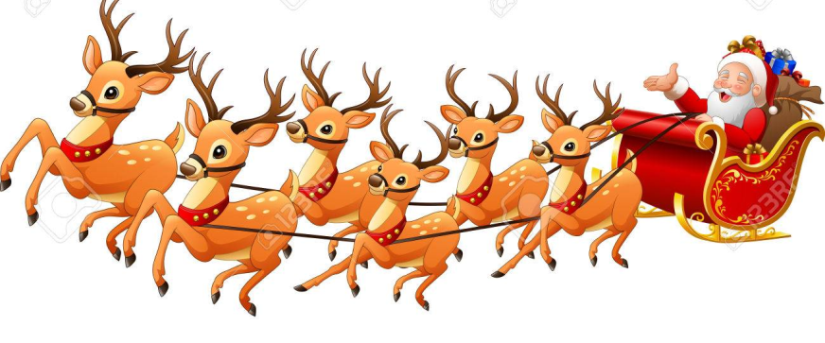




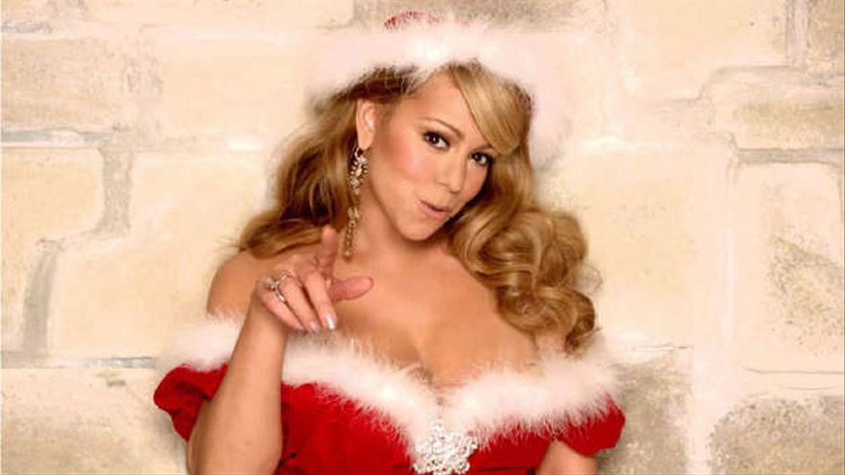
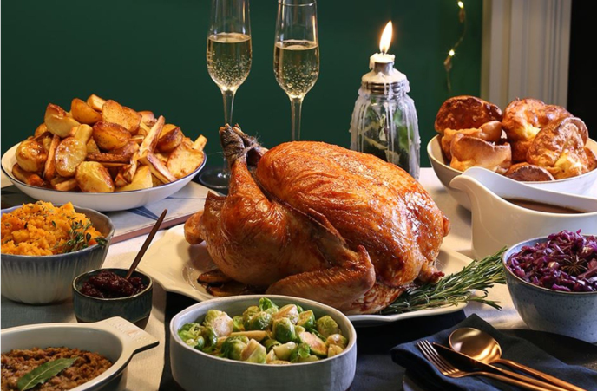


Slide 2
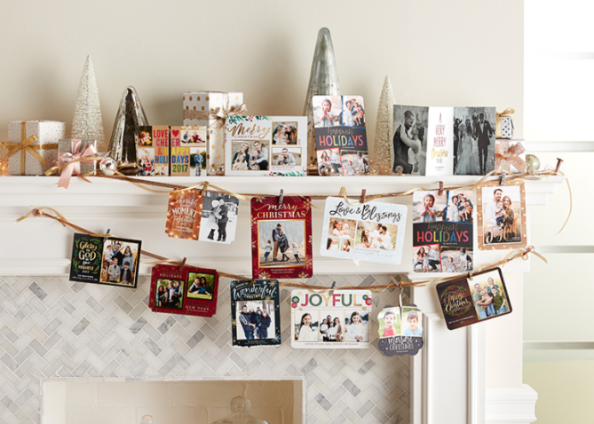
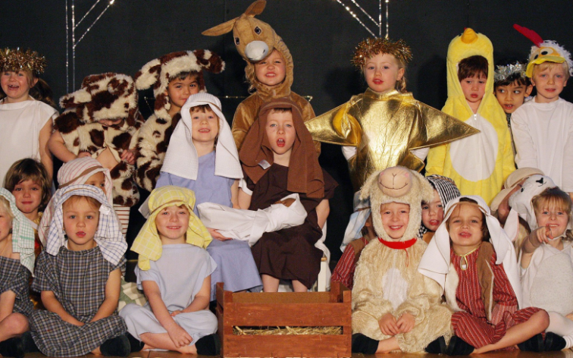
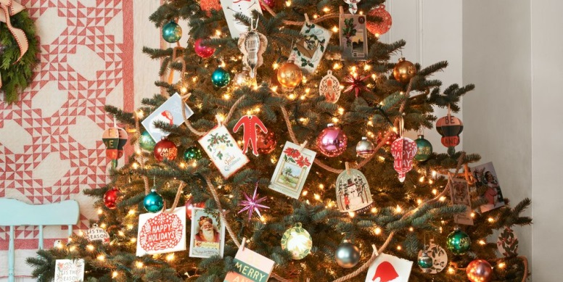
What do they do Before Christmas in the uk/US?
Put up the Christmas tree, decorations and lights.
Send Christmas cards to friends and family
Schoolchildren perform nativity plays, which tell the story of when Jesus was born.

Slide 3
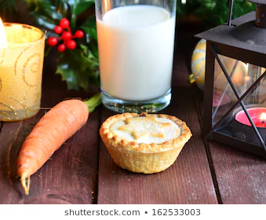
Don’t forget to leave a mince pie and milk for Father Christmas under the tree, and a carrot for Rudolph the red-nosed reindeer!

Slide 4
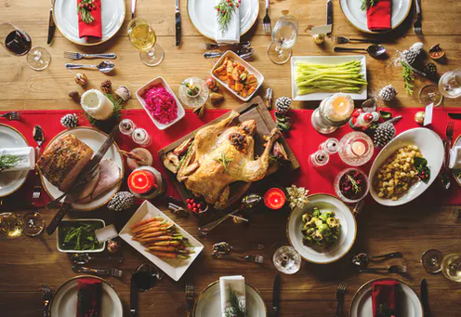
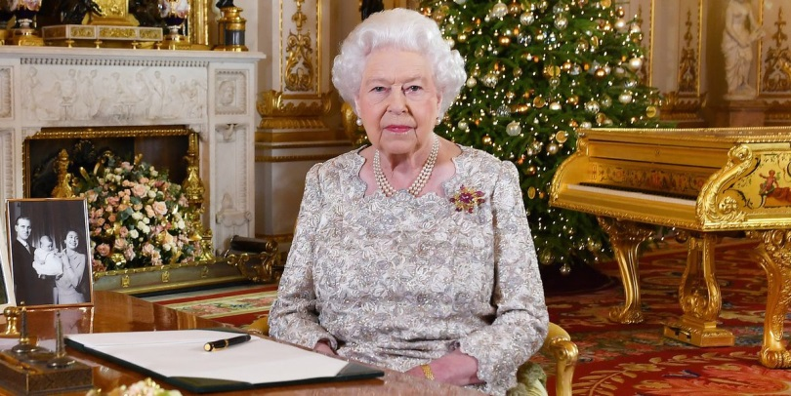
On Christmas day
Exchange presents and play Christmas games with friends and family.
Have Christmas dinner with the family (turkey with roast vegetables).
The Queen makes her Christmas Speech on TV!

Slide 5


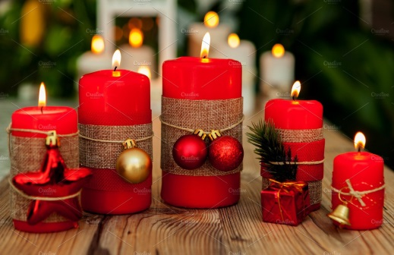
After Christmas…
Take down the Christmas tree on the Epiphany on January 6th.
Eat and drink a lot, relax, and visit friends and family, most people do not work between Christmas and new year.
Tidy up and take down Christmas decorations.
How many of these Christmas decorations can you name? (answers on the next slide)

Slide 6
After Christmas…
Take down the Christmas tree on the Epiphany on January 6th.
Eat and drink a lot, relax, and visit friends and family, most people do not work between Christmas and new year.
Tidy up and take down Christmas decorations.
How many of these Christmas decorations can you name? (answers on the next slide)
Wreath
Candles
Mistletoe

Slide 7
If you want to play a game…
…you could play Charades! It is a very popular game that families play together on Christmas day, where you have to explain the title of a book, film or TV programme without speaking, using only actions.
***go to video!***

Slide 8

… and happy new year!

