Slide 1
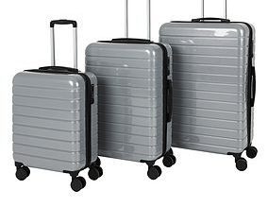
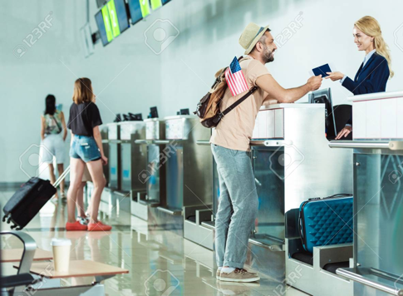
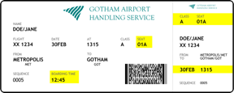
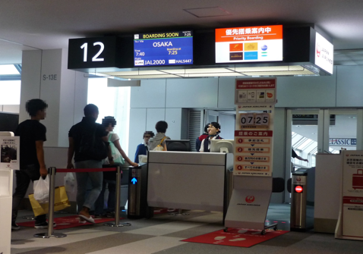
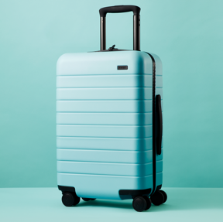
Match the words with the photo
1. Suitcase
2. Hand-luggage
3. Gate
4. Check in desk
5. Boarding card

Slide 2
Listen to the conversation and put the sentences into order.
a. I just have hand-luggage
b. Can I see your passport and ticket please.
c. Thanks for your help
d. Here's your boarding card
e. You'll start boarding at 7.30am.

Slide 3
Listen again and answer the questions:
1. Where is the passenger flying to?
2. Is she bringing hand-luggage on the plane?
3. What time does her flight leave?
4. What is the gate number?
5. How far (in minutes) is the gate?

Slide 4
Listen again and fill the gaps
Check-in desk: Hello, can I see your ______ and ticket please?
Passenger: Yes, here you go.
Check-in desk: Great, so you’re flying to Lisbon today, correct? How many _______ are you checking in?
Passenger: None, I just have hand-luggage to bring on the plane with me.
Check-in desk: Ok great, here’s your ______ _____. Your flight leaves at 7.30am from gate number 25.
Passenger: Thank you. What time do we start boarding?
Check-in desk: You’ll start boarding at ____.
Passenger: And how far is the gate from here?
Check-in desk: It’s 30 mins walk from here to the _____.
Passenger: Thanks for your help
Check-in desk: No problem, Have a ____ _______!!

