Slide 1
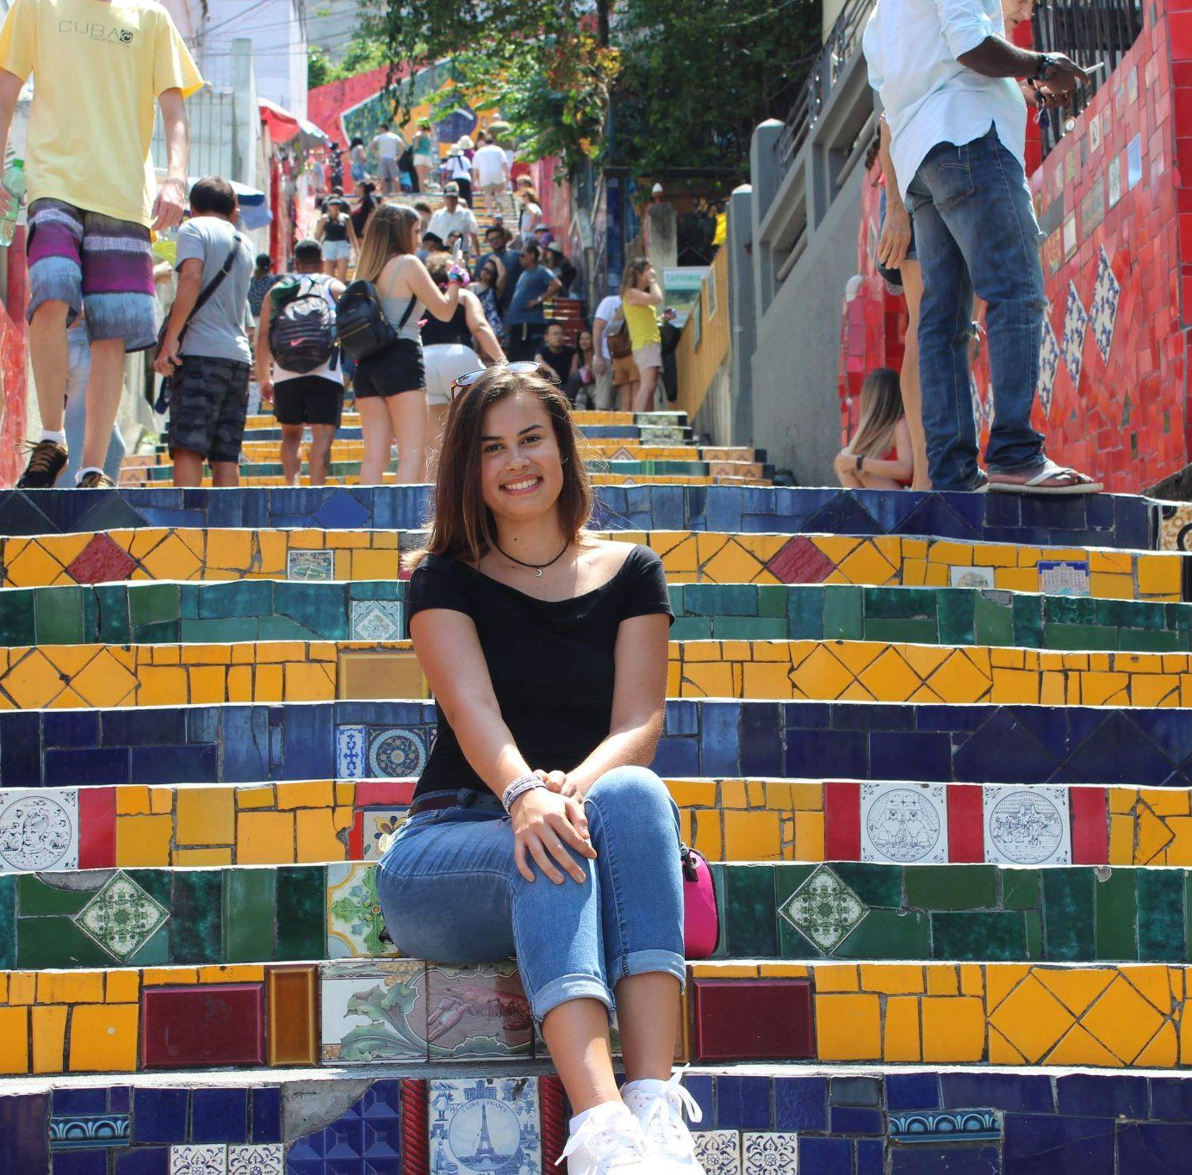
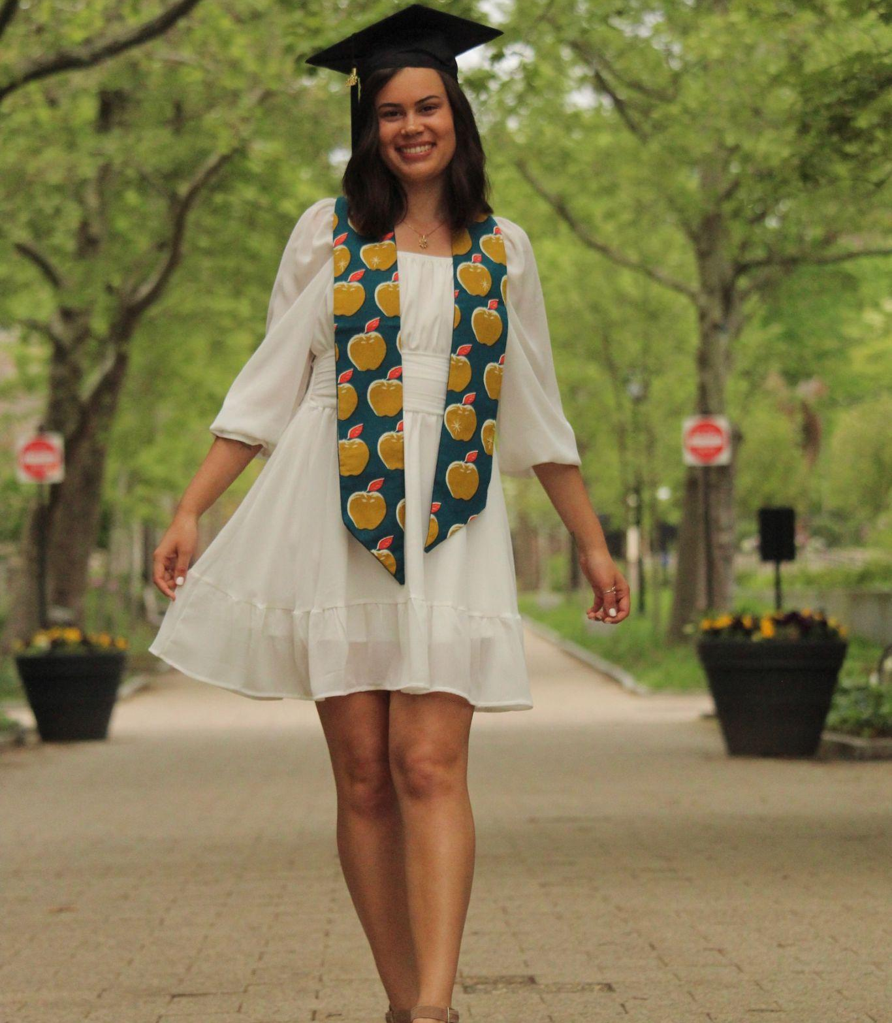
Hello!
My name is Simone.
I am 23 years old and grew up in Miami, FL. Throughout my life, I have experienced a variety of educational settings: a dual-language elementary school, homeschooling, an arts charter school, a community college, and most recently Yale University (where I graduated with a B.A. in Sociology and Education). These experiences led me to become passionate about providing high-quality education to students of all backgrounds.

Slide 2
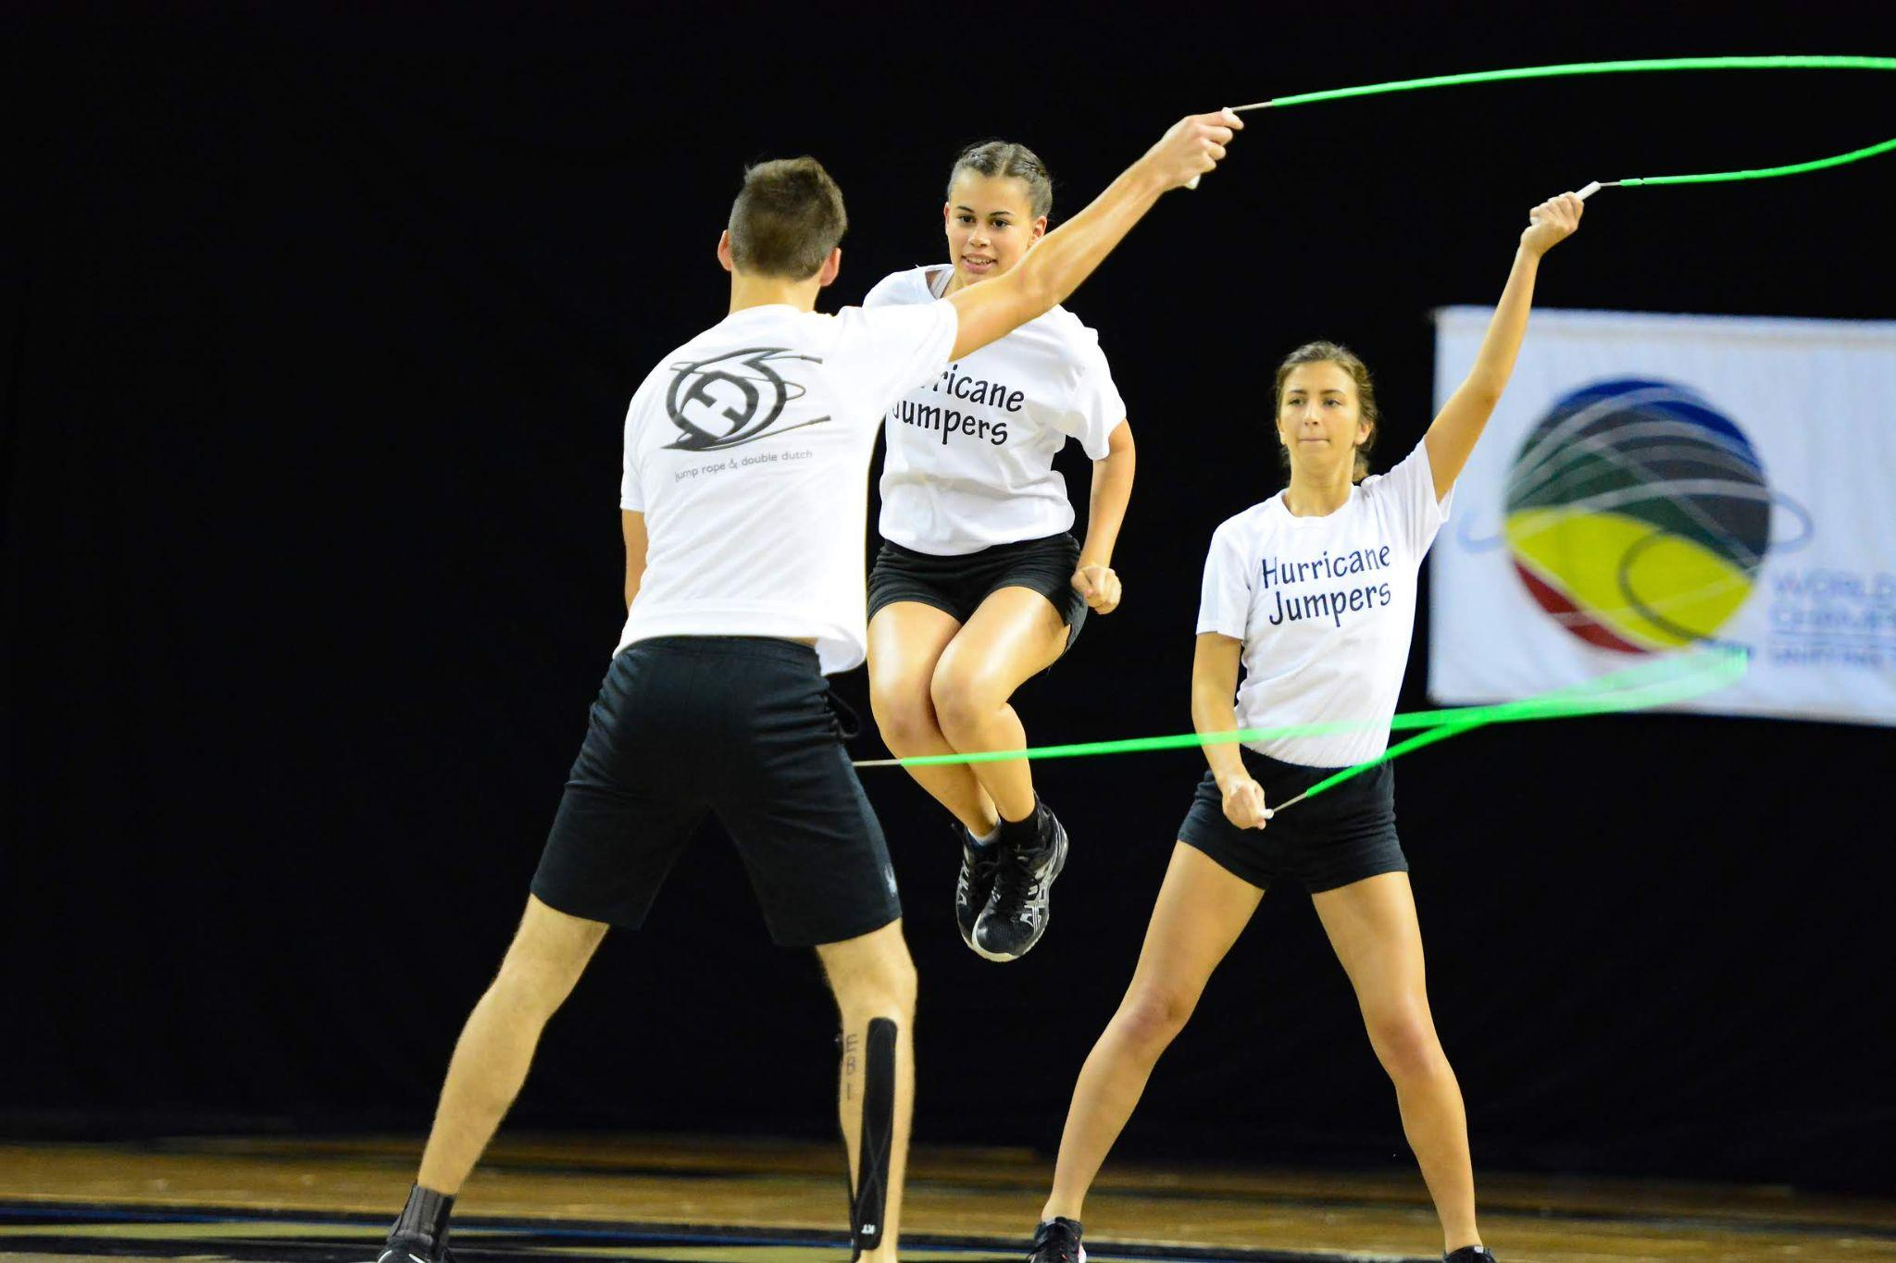
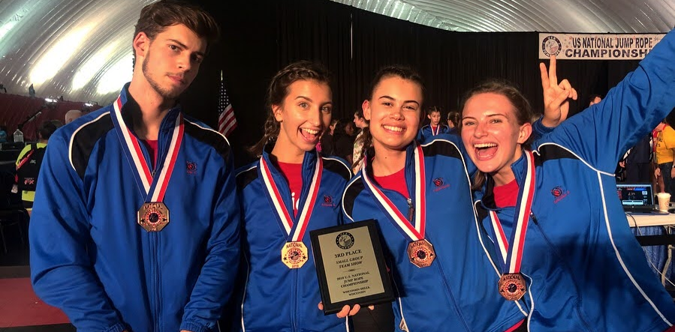
On a personal note, I am Brazilian-American and Portuguese is my first language. I have a big family and grew up taking care of my younger cousins. My hobbies include reading, singing, and visual arts. I am also a competitive jump roper and have ranked top 10 in both national and international competitions.
I am excited to meet all of you at Escola Flama! Gracías por la opportunidad!

