Slide 1
quiz

Slide 2
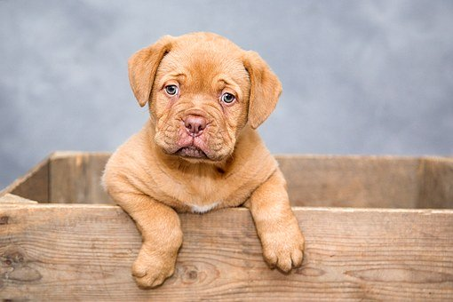
How do you spell "dog"?
a. No
b. D-O-G
c. No
d. I don't
e. Cat.
f. I have one dog.

Slide 3
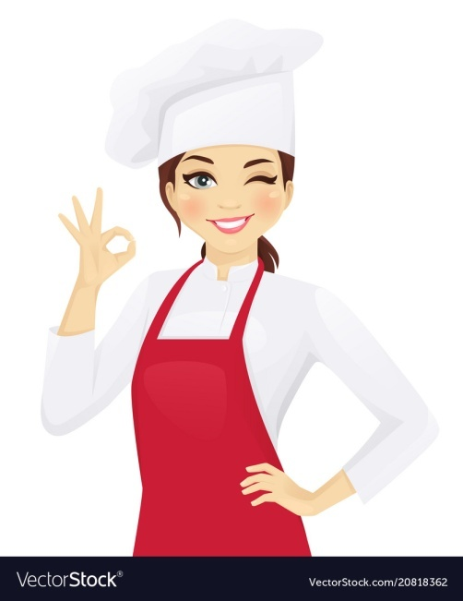
My mother is a good cook.
a. I agree with you.
b. I agree you.
c. I agree to you.
d. I agree for you.

Slide 4
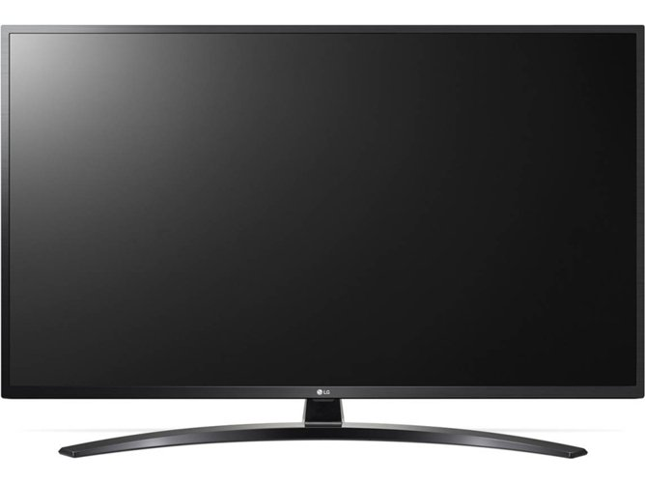
What does "TV" mean?
a. For one hour.
b. Yes
c. Television.
d. For one hour.
e. On Friday.

Slide 5
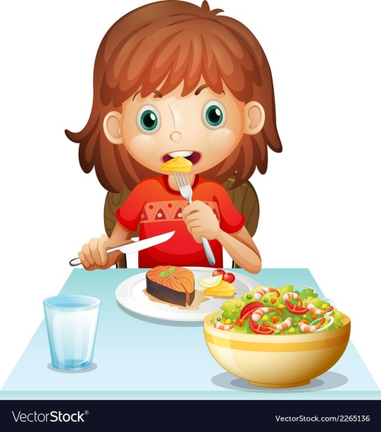
Where do you usually eat lunch?
a. Sandwich.
b. With Jane.
c. At 12:00.
d. In the cafeteria.

Slide 6
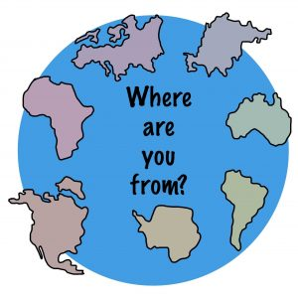
Where are you from?
a. New York.
b. 1982.
c. At school.

Slide 7

How do you get to school?
a. With train.
b. In train.
c. By train.

Slide 8
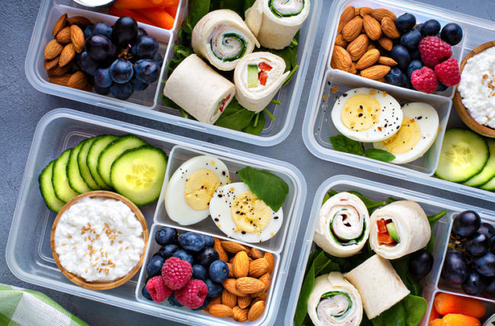
Which food is healthy?
a. Fruit.
b. Vegetables.
c. Ice cream

Slide 9
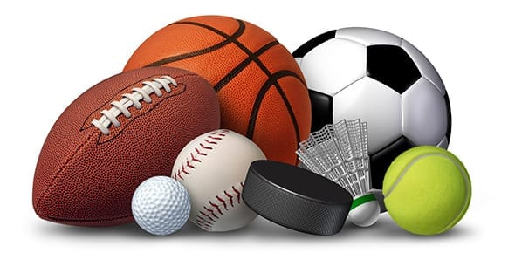
Which sport is not played outdoors?
a. Tennis.
b. Basketball.
c. Chest.

Slide 10
Which sport does need water?
a. Horse-riding.
b. Basketball.
c. Windsurf.

