Slide 1
Quiz TO DO WITH THE FAMILIES

Slide 2
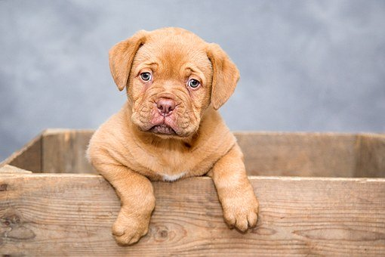
How do you spell "dog"?
a. No
b. D-O-G
c. No
d. I don't
e. Cat.
f. I have one dog.

Slide 3

My mother is a good cook.
a. I agree with you.
b. I agree you.
c. I agree to you.
d. I agree for you.

Slide 4
My father is a good cook.
a. I agree with you.
b. I agree you.
c. I agree to you.
d. I agree for you.

Slide 5

What does "TV" mean?
a. For one hour.
b. Yes
c. Television.
d. For one hour.
e. On Friday.

Slide 6
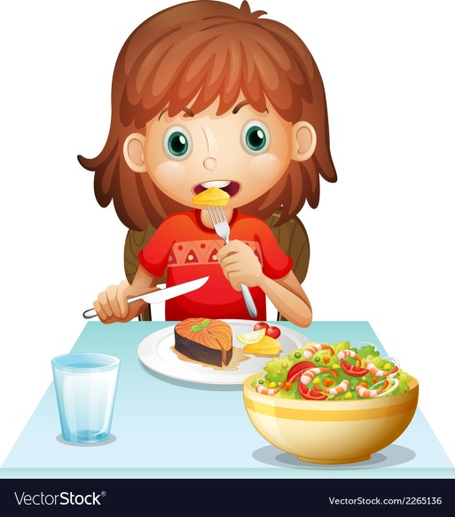
Where do you usually eat lunch?
a. Sandwich.
b. With Jane.
c. At 12:00.
d. In the cafeteria.

Slide 7
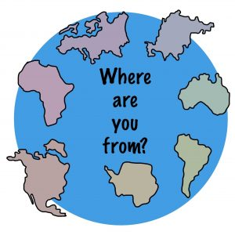
Where are you from?
a. New York.
b. 1982.
c. At school.

Slide 8

How do you get to school?
a. With train.
b. In train.
c. By train.

Slide 9
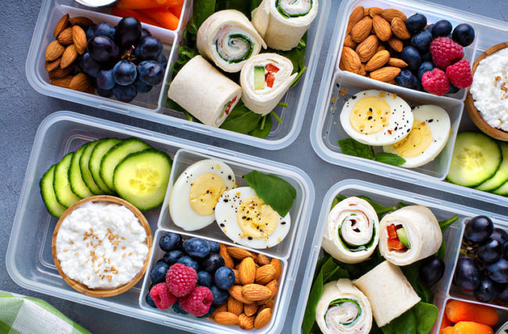
Which food is healthy?
a. Fruit.
b. Vegetables.
c. Ice cream

Slide 10

Which sport is not played outdoors?
a. Tennis.
b. Basketball.
c. Chest.

Slide 11
Which sport does need water?
a. Horse-riding.
b. Basketball.
c. Windsurf.

Slide 12
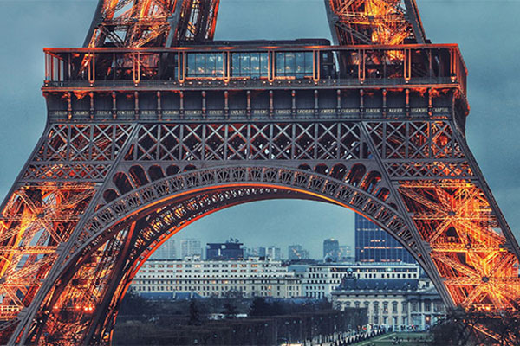
Which is the capital of France?
a.Paris.
b.Rome.
c.Madrid.

Slide 13
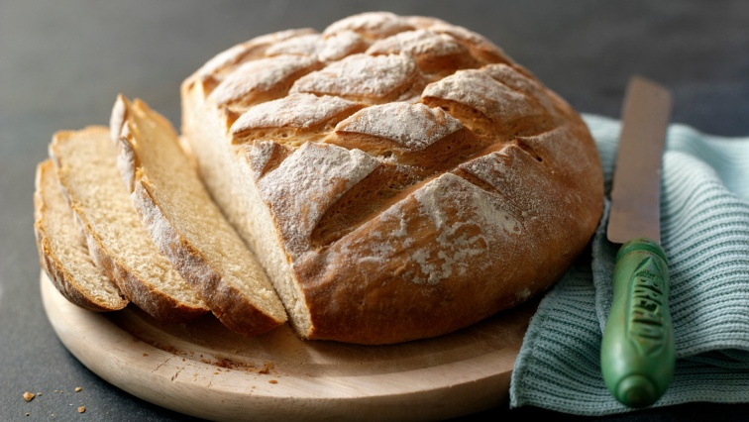
If I need bread I go to the…
a. Bakery.
b.Newsagent’s.
c.Park.

Slide 14
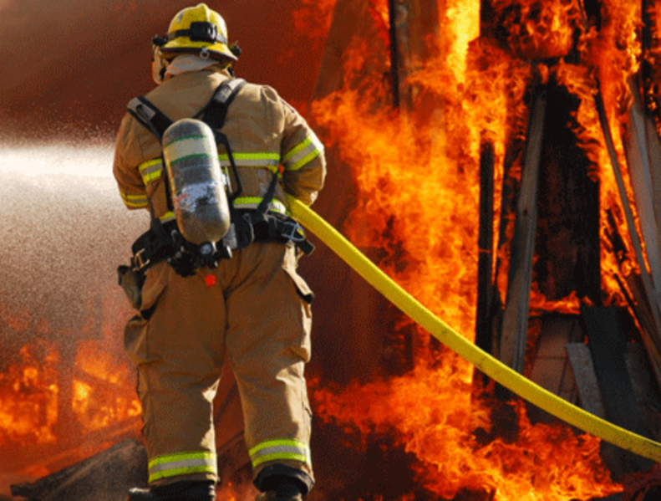
The person that puts out fire is a …
a.Doctor.
B. Firefighter.
c.Vet.

Slide 15
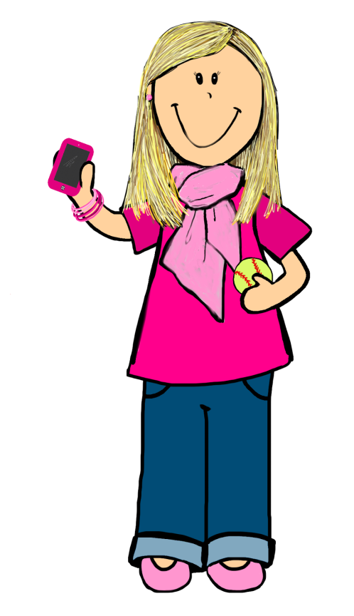
My cousin’s mother is my…
a.Sister.
B. Cousin.
c.Aunt.

Slide 16
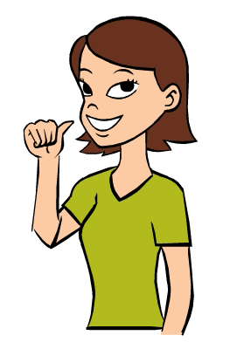
She’s …
a. Worried.
b. Happy.
c. Sad.

Slide 17
She’s wearing…
a. A green t-shirt.
b. Blue trousers.
c. A green jumper.

Slide 18
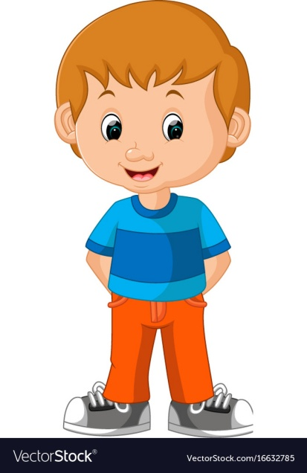
He’s wearing…
a. A blue t-shirt and red trousers.
b. A blue t-shirt and a red skirt.
c. Blue trousers and a red t-shirt.

Slide 19
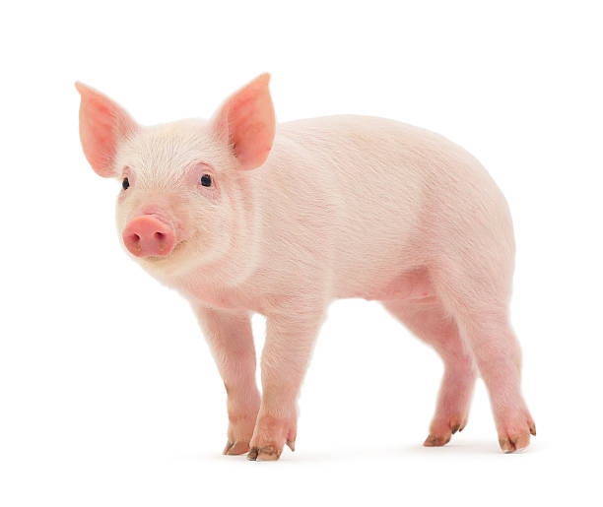
A pig is…
a. A pink animal that lives in a farm.
b. A green animal that lives in the jungle.
c.A brown animal that lives in a pond.

Slide 20
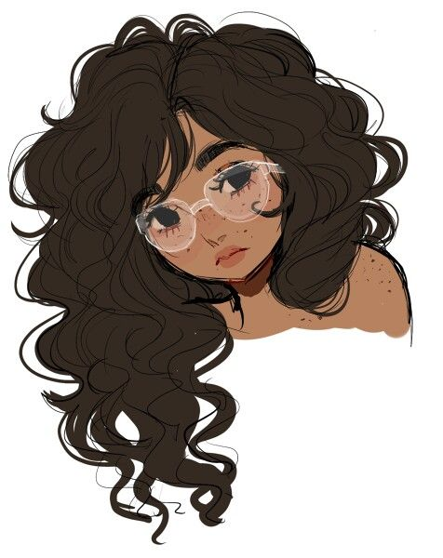
a. This girl has got curly dark hair.
b. This girl has got straight fair.
c. This girl has got short fair hair.

Slide 21
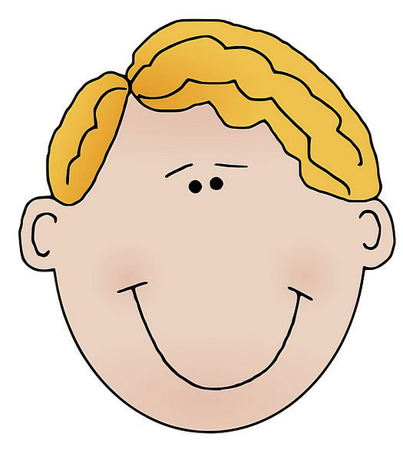
a. This boy has got curly dark hair.
b. This boy has got straight fair.
c. This boy has got short fair hair.

