Slide 1
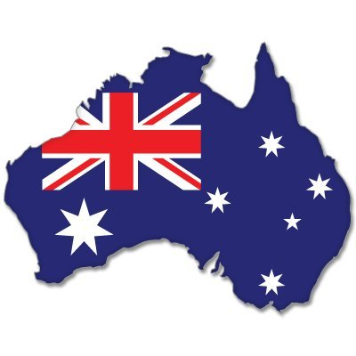
Australia

Slide 2
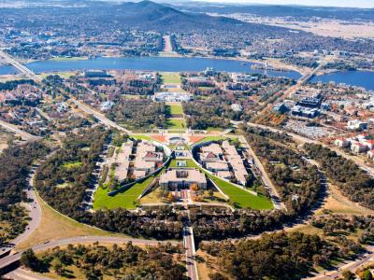
Australia´s Capital
Canberra has been Australia´s Capital since 1908 there are many sights including Australia´s Parliament and the Australian War Memorial.

Slide 3
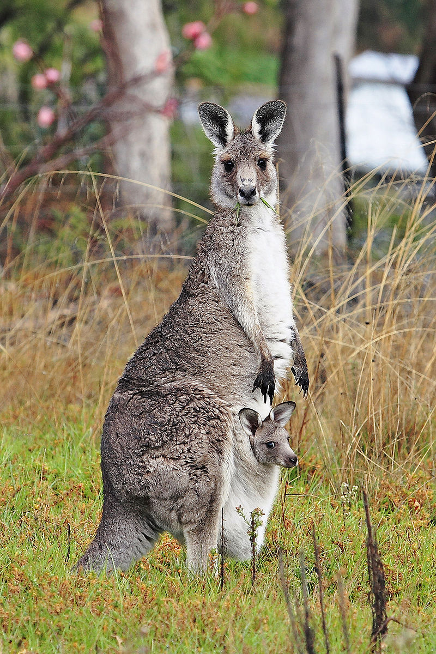
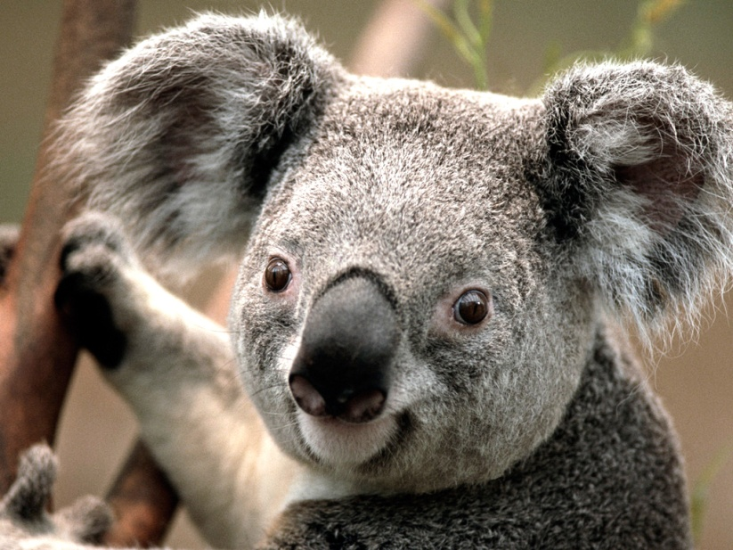
Animals
Australia has many Animals including Kangaroos, Koalas Emus and Crocodiles.
The most popular Animals of Australia is the Emu and Kangaroo

Slide 4
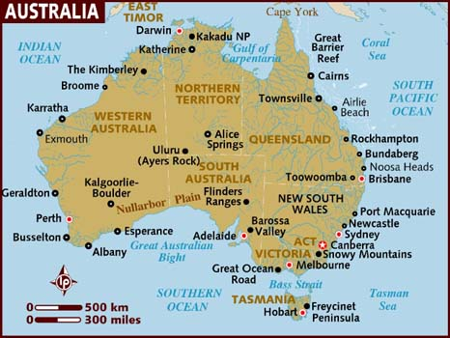
Regions in Australia
Australia only has four states with western Australia the biggest.

Slide 5
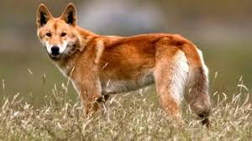
Australian Wild Dog
Australia has lots of Wild Dog´s with the most popular named the Dingo

Slide 6
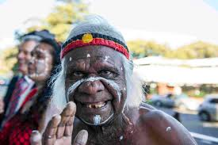
Native Australia
The first people of Australia are called the Aboriginals

Slide 7
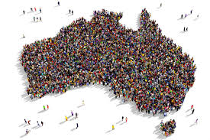
Population of Australia
The population of Australia is around twenty-twenty five million

Slide 8
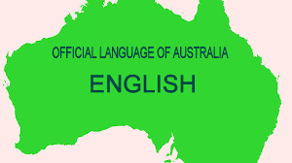
Language of Australia
The Language of Australia is English

Slide 9
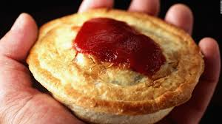
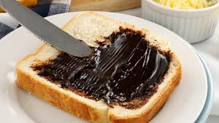
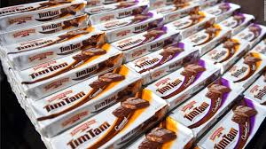
Australian Food
In Australia we have lots of interesting food including lamingtons chocolate biscuits and beef chicken and lamb. In Australia we also eat Kangaroo.

Slide 10
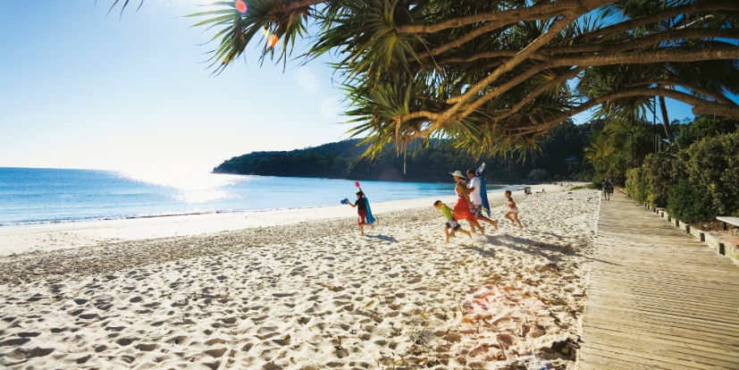
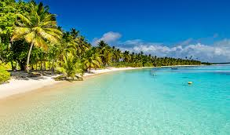
Beaches
Australia has many beautiful beaches including in a city called surfers paradise and the beaches are very good to visit in summer.

Slide 11
See you this Arvo = Afternoon
In Australian English See you this Arvo means I will see you in the Afternoon it is used in Australian English

Slide 12
Mate
In Australia we Say Gday Mate which means Hello Friend How are you?

