Slide 1
REPRODUCTIVE SYSTEM
Àngels Garriga
6th level of Primary School

Slide 2
MALE AND FEMALE
When we grow up, our body starts to change and our reproductive organs develop.
Reproductive system makes it possible for us to have babies.
Men and women have got different reproductive systems.
These systems need to work together in order to reproduce.

Slide 3
CHANGES IN PUBERTY
GIRLS
Usually, when a girl is 10 and 16 years old.
The breasts begin to develop and pubic hair grows, hair also grows in different parts of the body.
They grow taller and their hips are wider.
Spots and acne appear.
Between 10 and 15 years menstruation starts.
MENSTRUATION: an ovum is released from the ovaries every 28 days. This is called ovulation. If fertilisation is not happen, the blood comes away. When a woman is about 50 years starts a period called menopause.

Slide 4
BOYS
Usually, when a boy is 10 and 16 years old.
Their brain secretes hormones that activate the testicles to produce testosterone. It produces some changes.
Pubic hair begins to grow. Hair also grows on face and different parts of the body.
They become taller and heavier.
Their voice is lower.
Acne appears.
Semen is formed. They eyaculate.

Slide 5
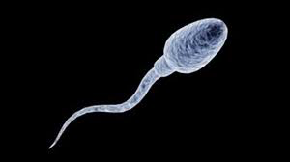
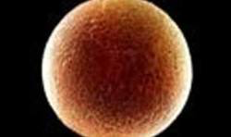
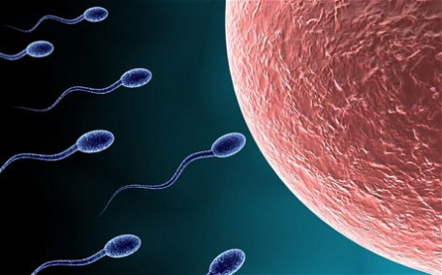
MALE AND FEMALE CELLS
Male cells are called sperms. Semen is a liquid that feeds sperms.
Female cells are called ovums or ova.
They need to work together in order to reproduce.

Slide 6
REPRODUCTIVE ORGANS
MALE REPRODUCTIVE ORGANS
There are internal and external organs.
The testicles produce male sex cells, called sperm.
Testicles are located in a sac called the scrotum.
The sperms travel through tubes called vas deferens from seminal vesicle to the urethra. The urethra is a tube in the penis. The sperm, finally, go outside the body. The urethra also expels urine.
The prostate gland produces a liquid called semen. This liquid carries the sperm and gives it nutrients.

Slide 7
MALE reproductive organs

Slide 8
REPRODUCTIVE ORGANS
FEMALE REPRODUCTIVE ORGANS
Most of female organs are internal.
The ovaries produce a female sex cell called ova.
The fallopian tubes connect the ovaries to the uterus. Babies develop inside the uterus.
The vagina is a muscular tube which connects the uterus to the outside of the body.
The vulva is on the outside of the body and covers the opening to the vagina.

Slide 9
FEMALE reproductive organs

Slide 10
MALE AND FEMALE ORGANS

