Slide 1
REPRODUCTIVE SYSTEM
Àngels Garriga
6th level of Primary School

Slide 2
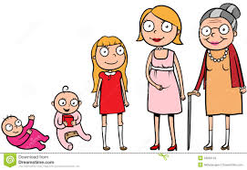
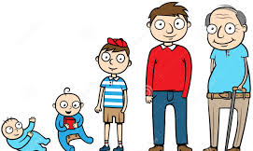
OUR BODY
While we grow up we change.
There are some stages of life:
Baby
Children
Adolescent
Adult
Elderly

Slide 3
What do we know?
IMPORTANT THINGS STAGES OF LIFE
https://www.youtube.com/watch?v=B0OhSug65oA

Slide 4
IMPORTANT THINGS
Baby (0-3 years old)
They need to sleep a lot of hours
They cry in order to comunicate (tired, dirty, thirsty, hungry, angry…)
It’s the first stage of life
It’s the shortest stage of life
They need help for all (eat, dressing up, move….)
Babies can’t run properly, they start to walk
Is when the teeth begin to grow
At this stage you learn to talk

Slide 5
Toddler (3 – 7 years old)
They start the school
They can’t cook
They begin to write and read
They grow a lot and very fast
They start to dressing up
They need less help than the babies

Slide 6
Children (7-12 years old)
They can’T be pregned
They have a lot of energy
They can read properly
PUBERTY begins, their body change.
The hormones develop and appear
Child can play to computer games or videogames, a little bit and the games right for this age
They can’t drink alcohol, smoke, do tattoes, drive, work and vote
Their brain is more develope than at the babies or toddler age
They can ride a bike and practice sports
They go to primary school
They can help at home (do the bed, clean and tiddy the room)

Slide 7
Teenager (13-19 years old)
They have emotional changes
They go to hight school and university
When they are 18 they can do more things (vote, drive, go to discotec, do tattoes…)
They can travel and go alone everywhere
Teenager can life alone
They can have a movile phone (celular)
They can have a boy or girlfriend.
Teenagers can work (from 16 years old)
Teenagers can be pregned, but is so difficult to have their own family
They have got authonomy they need an advice
They have got responsabilities

Slide 8
Adult (20-60 years old)
- They can have a family, is the best age to do it
They have a lot of responsabilities
They can drive
Usually, This is the longest stage of life
They have to work
At this age you can drink alcohol and smoke, but that’s not good for health
They can vote
They can cook
They can have a tattoo, but some culture think that is not good for health
They can take their own decititons

Slide 9
Elderly

