Slide 1
LIVING THINGS
5th of Primary School
1st Term

Slide 2
Living and non-living things
Let’s watch this video and complete the sentences!
https://www.youtube.com/watch?v=p51FiPO2_kQ

Slide 3
VITAL FUNCTIONS
Nutrition : living things take nutrients to change them into energy. LT need food.
Excretion: LT produce waste.
Respiration: LT breathe. They exchange gases.
Reproduction: LTcreate new living things.
Growth: LT grow up.
Movement: LT can move.
Interaction: LT interact with the world. They respond to changes.

Slide 4
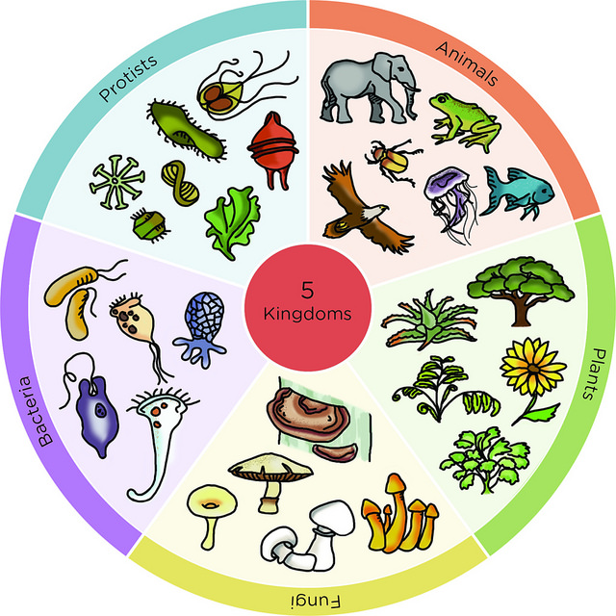
HOW ARE LIVING THINGS CLASSIFIED?

Slide 5
5 KINGDOMS
Animal
Plants
Fungi
Protist
Monera

Slide 6
KINGDOMS
Watch these videos too know how to classify living things!
www.oum.ox.ac.uk/thezone/animals/animalid/kingdom1.htm
https://www.youtube.com/watch?v=oMFqEp4Sf40

