Slide 1
ENERGY Science 5th

Slide 2
WHAT IS ENERGY?
Watch this funny video in order to understand what energy is and how can we save it.
https://www.youtube.com/watch?v=wyVF6R9e6xE
Energy is... The capacity to change things and the force that a person has.
We can obtain energy by... Food, water, sun, coal...
Energy is the power that allows us to do things.
Usually we can’t see it or touch it but it’s all around us.
Energy can take form or light, sound, heat or movement. It can power machines.

Slide 3
WHAT IS ENERGY?
It can change from one form to another too. For example, when you turn on a light, the electricity transforms into light and thermal energy.
https://www.youtube.com/watch?v=ycdke8MTSCI

Slide 4
HOW CAN WE OBTAIN ENERGY?
We can obtain energy by different sources such us: sun, wind, water, food, coal, gas...
There are two kinds of energy:
RENEWABLE | UNRENEWABLE
Sun Water Food Wind Wood | Gas Fuel: oil, petrol, diesel... Coal

Slide 5
HOW CAN WE SAVE ENERGY?
We can save energy doing small things every day: - Switch off lights. - Use energy saving lights bulbs. - Use the natural light. - Switch off the TV if you’re playing with another thing. - Charge the gadgets for a short time. - Walk or ride in order to not use transports.

Slide 6
FORMS OF ENERGY
There are six forms of energy!
Find them on this website!
http://www.cpalms.org/Uploads/resources/46550/2/14/docs/Six Forms of Energy-Explain Powerpoint.pdf

Slide 7
FORMS OF ENERGY
LIGHT ENERGY
SOUND ENERGY
HEAT/THERMAL ENERGY
ELECTRICAL ENERGY
CHEMICAL ENERGY
MECHANICAL/KINETIC ENERGY

Slide 8
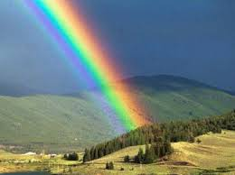
LIGHT ENERGY
Everything that produces light.
It could be natural like the Sun, or man-made like light bulbs and candles.
Light illuminates objects and allows us to see shapes, colours and sizes.
Light is the fastest form of energy. It travels at 300.000km per second.
Light looks white but it’s made up of seven different colours: red, orange, yellow, green, blue, indigo and violet.
Light always travels in a straight line until something gets in its way.

Slide 9
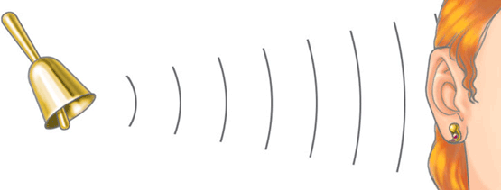
SOUND ENERGY
Is a vibration and can travel in any direction from the source. The vibrations move through the air until our ear.
Sound can travel very quickly, but not as fast as light.
Sound can travel through gases, liquids and solids, even if they are opaque.
PRODUCTION → TRANSMITION BY WAVES → RECEPTION

Slide 10
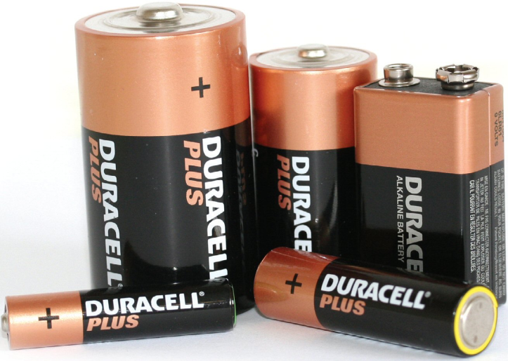
CHEMICAL ENERGY
Is released when a chemical reaction occurs.
Batteries and food are sources of chemical energy too.
When a car burns petrol, a chemical reaction occurs between the petrol and oxygen.
When you eat an apple you obtain the nutrients that give you energy.

Slide 11
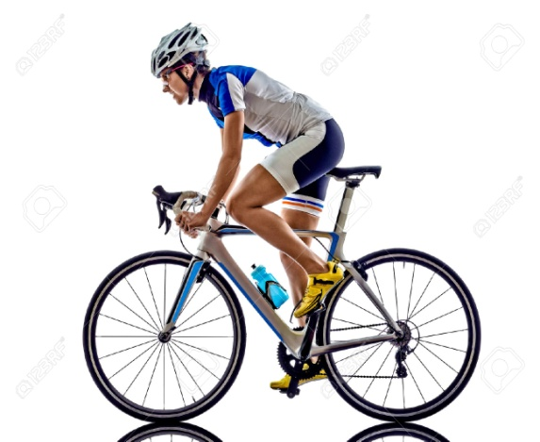
KINETIC ENERGY
All moving things have kinetic energy.
This energy is produced through a movement.
Living things have kinetic energy.
Example: car, windsurfer or bike rider when is in movement.

Slide 12
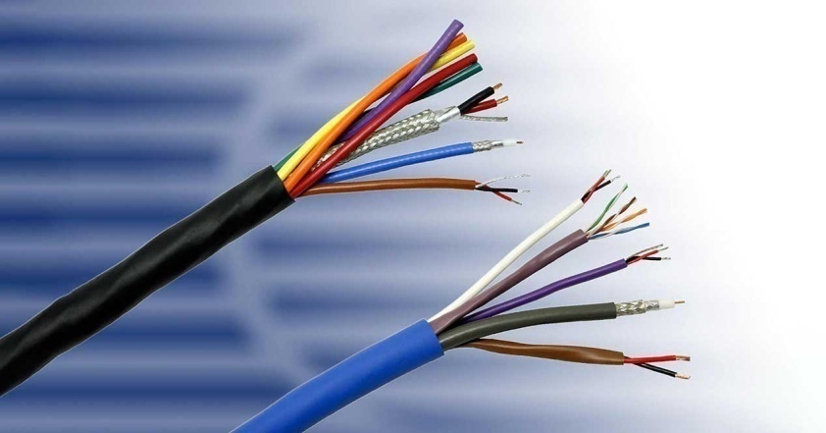
ELECTRICAL ENERGY
It’s used to power machines.
We can trasnform it into light, sound, heat and movement.
The energy to generate electricity comes from different sources: fossil fuels, wind, water, biomass, sunlight, nuclear power stations…

Slide 13
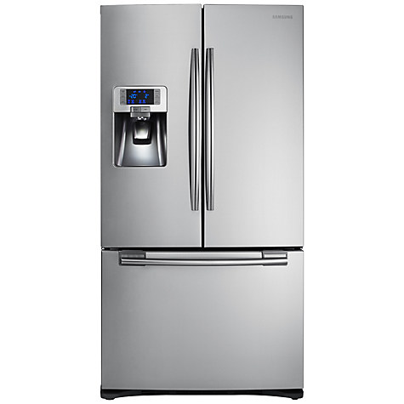
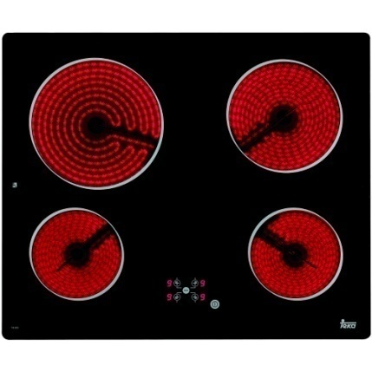
THERMAL ENERGY
It’s related with the temperature. It flows from a warm substance to a cooler substance.
A change in the thermal energy of a substance can also make the substance change state.
The Sun is the main source of heat on Earth.

