Slide 1
Respiratory System
Science
2018-2019

Slide 2
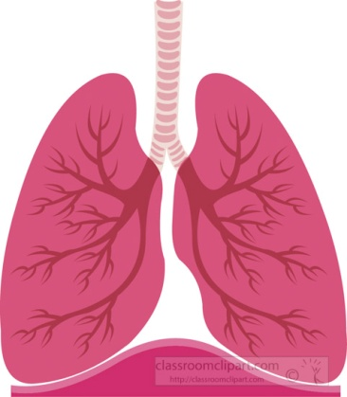
Respiratory System
The Respiratory System is related to respiration.
It’s made up of organs that help us breathe.
We breathe IN oxygen from the air.
We breathe OUT carbon dioxide.

Slide 3
PROCESS OF RESPIRATION
We breathe through the nose/mouth.
The pharynx opens and the air goes down a tube called the trachea.
The air travels down two tubes called bronchi and enters the lungs.
In lungs there are bronchioles and alveolies.
The oxygen from the air passes into the blood.
Gases exchange and carbon dioxide leaves the body.

Slide 4
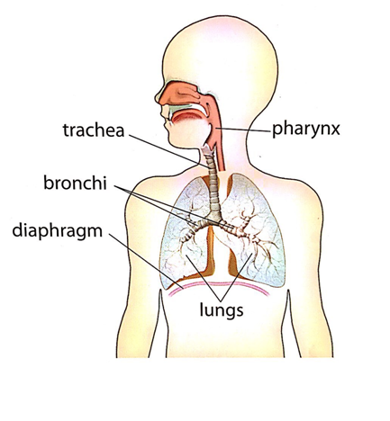
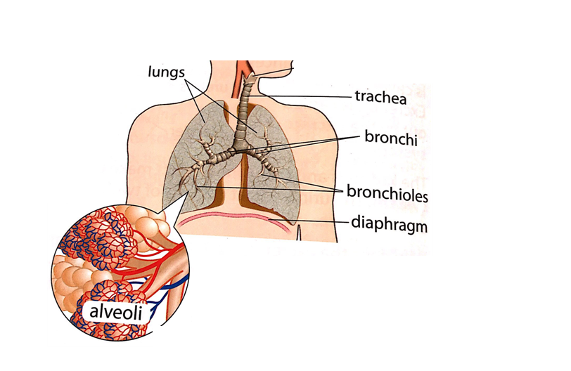
Respiratory system
Lungs…

Slide 5
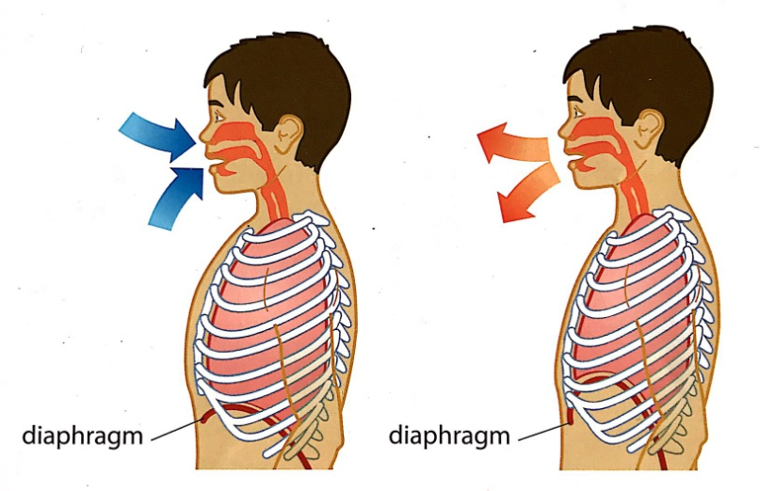
DIAPHRAGM
When we breathe a muscle called diaphragm contracts and relaxes.
When we breathe in, diaphragm contracts and lungs get bigger.
When we breathe out, diaphragm relaxes and lungs get smaller.

