Slide 1
Nervous system
By
Aina
Gisela
And
David
Notes:
Aina

Slide 2
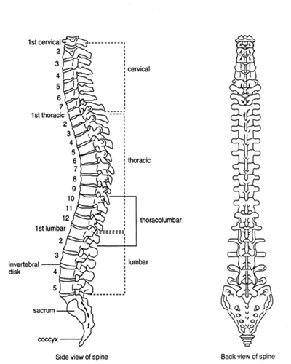
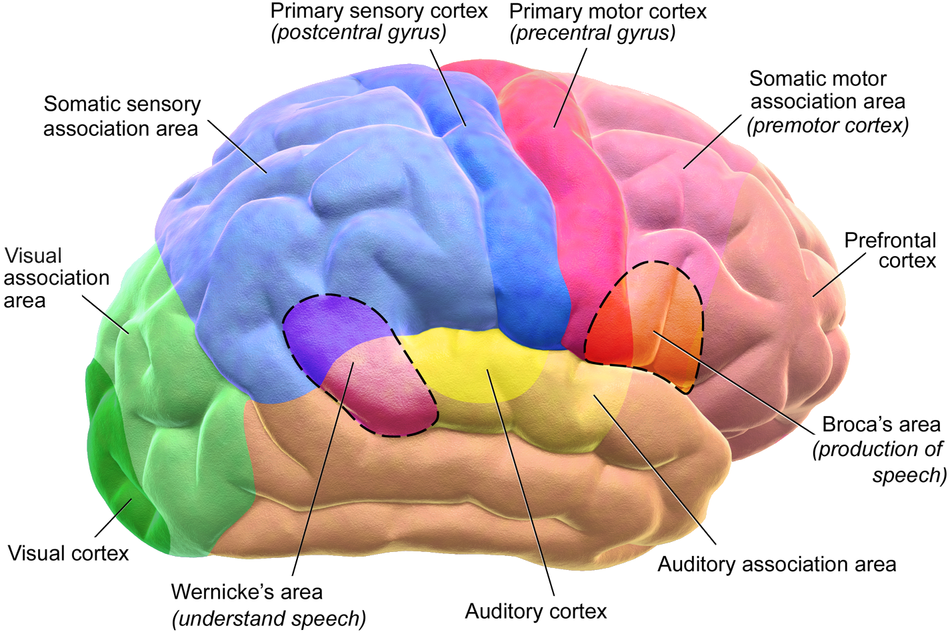
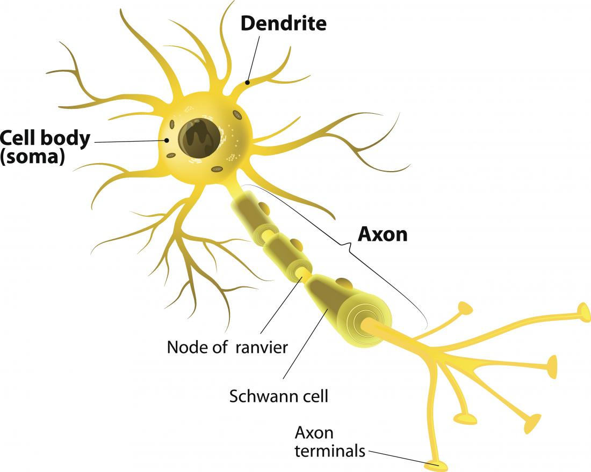
Components and organs
it’s made of these organs : brain, vertebral column and neurons.
Notes:
Davit

Slide 3
function
The nervous system captures information from the body and the environment.
Prepare the correct answers.
Notes:
Aina

Slide 4
Questions and hypotesis
How the brain can think so fast ?
The brain can think so fast because it has neurons.
The brain can send the information to the nervous sysytem
Notes:
davit

Slide 5
What are the nerves ?
Nerves are a type of hair
The nerves has a shape of a ribbon and a group of nerves make nervous fibres
Notes:
Aina

Slide 6
Interesting fact
Your brain does creative work better when you’re tired
´ Each hemisphere has different functions
Right hemisphere is the artistic
Left part is the mathematic and logical
. To work in good conditions, it needs to be hydrated (to have a zip of water) and oxygenated every 20 min.
Notes:
Gisela

Slide 7
Notes:
Davit

Slide 8
Notes:
aina

