Slide 1
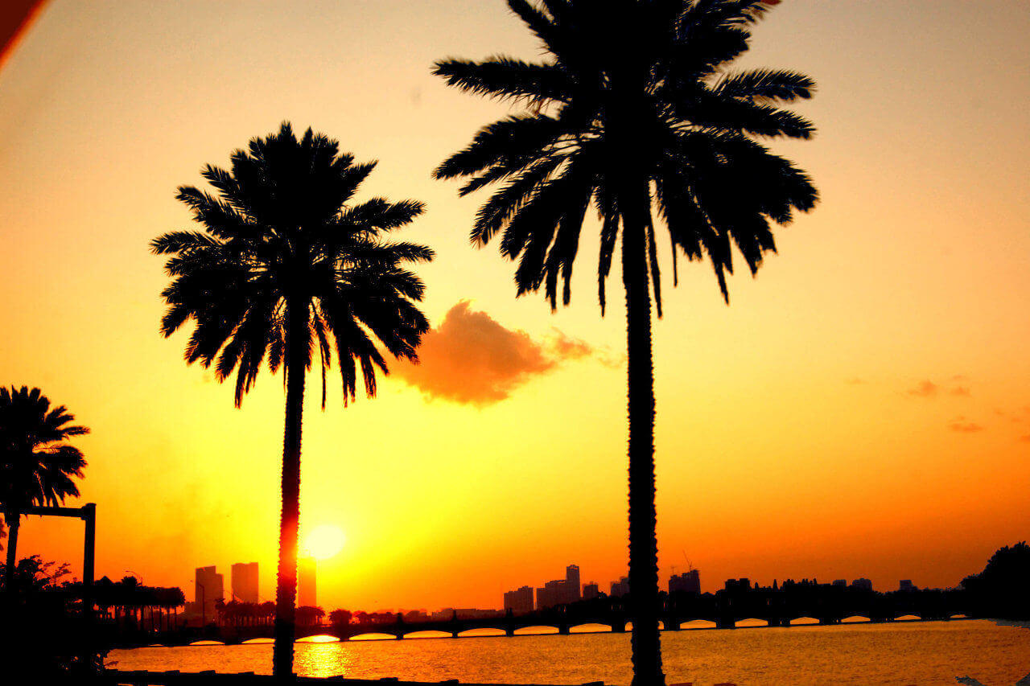
M
By: Ana López, Carla Valle, Carla Peña and Nerea Latorre.
MIAMI

Slide 2
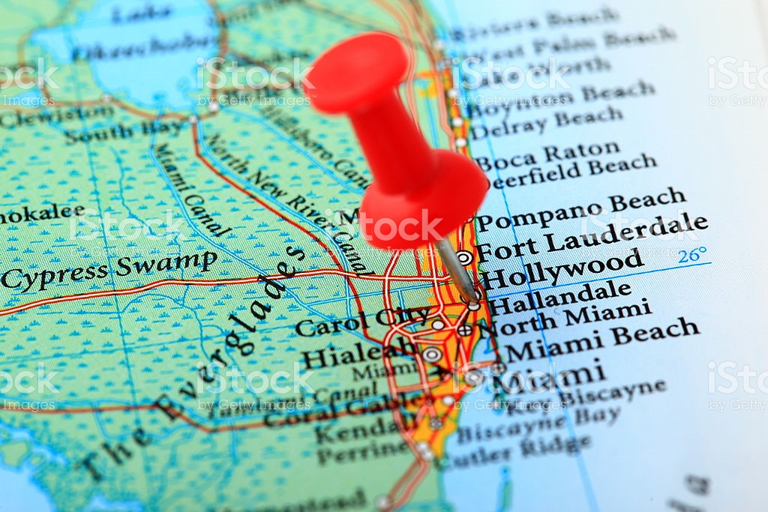
PLACE/COUNTRY:
Miami is a port city located in southeastern Florida, United States. It was founded on July 28, 1896 and according to the census of 2014.

Slide 3
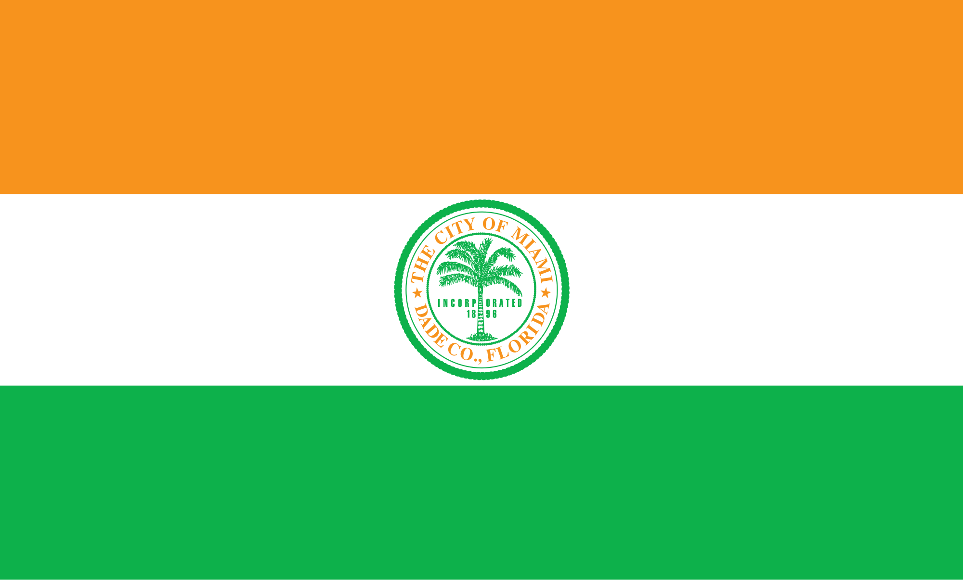
FLAG:
The flag of Miami is composed of three colors: top orange, white middle and green below. In the middle of the flag there is a round with a palm tree.

Slide 4
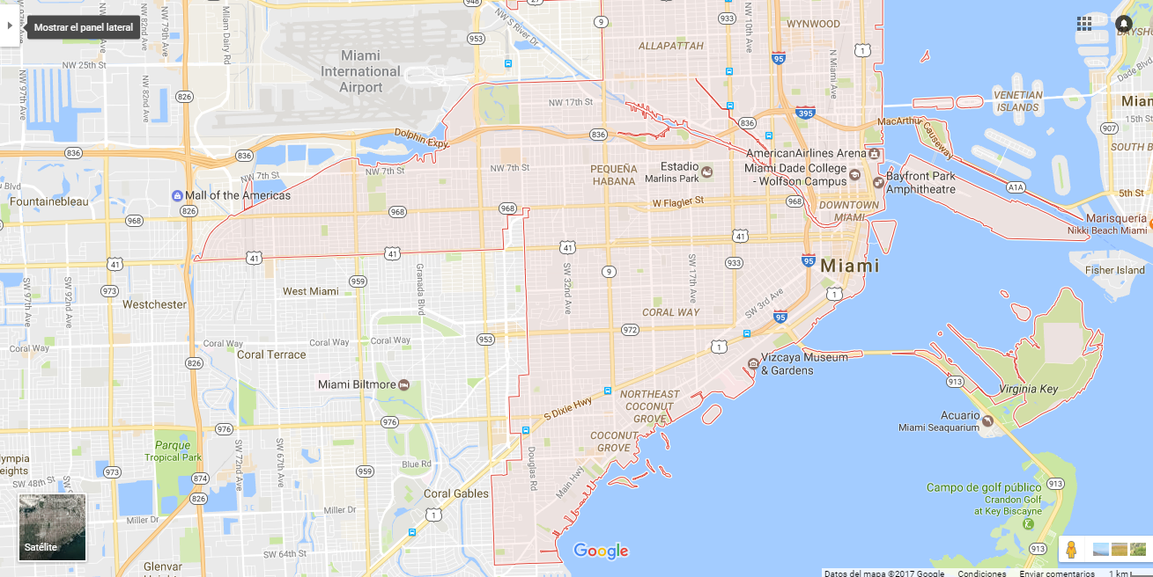
MAP:

Slide 5
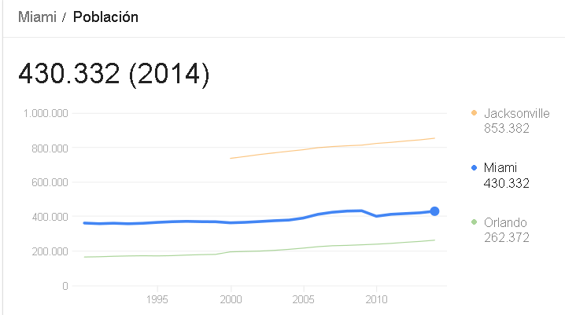
INHABITATNTS:
Miami in the year 2014 has got 430,332.

Slide 6
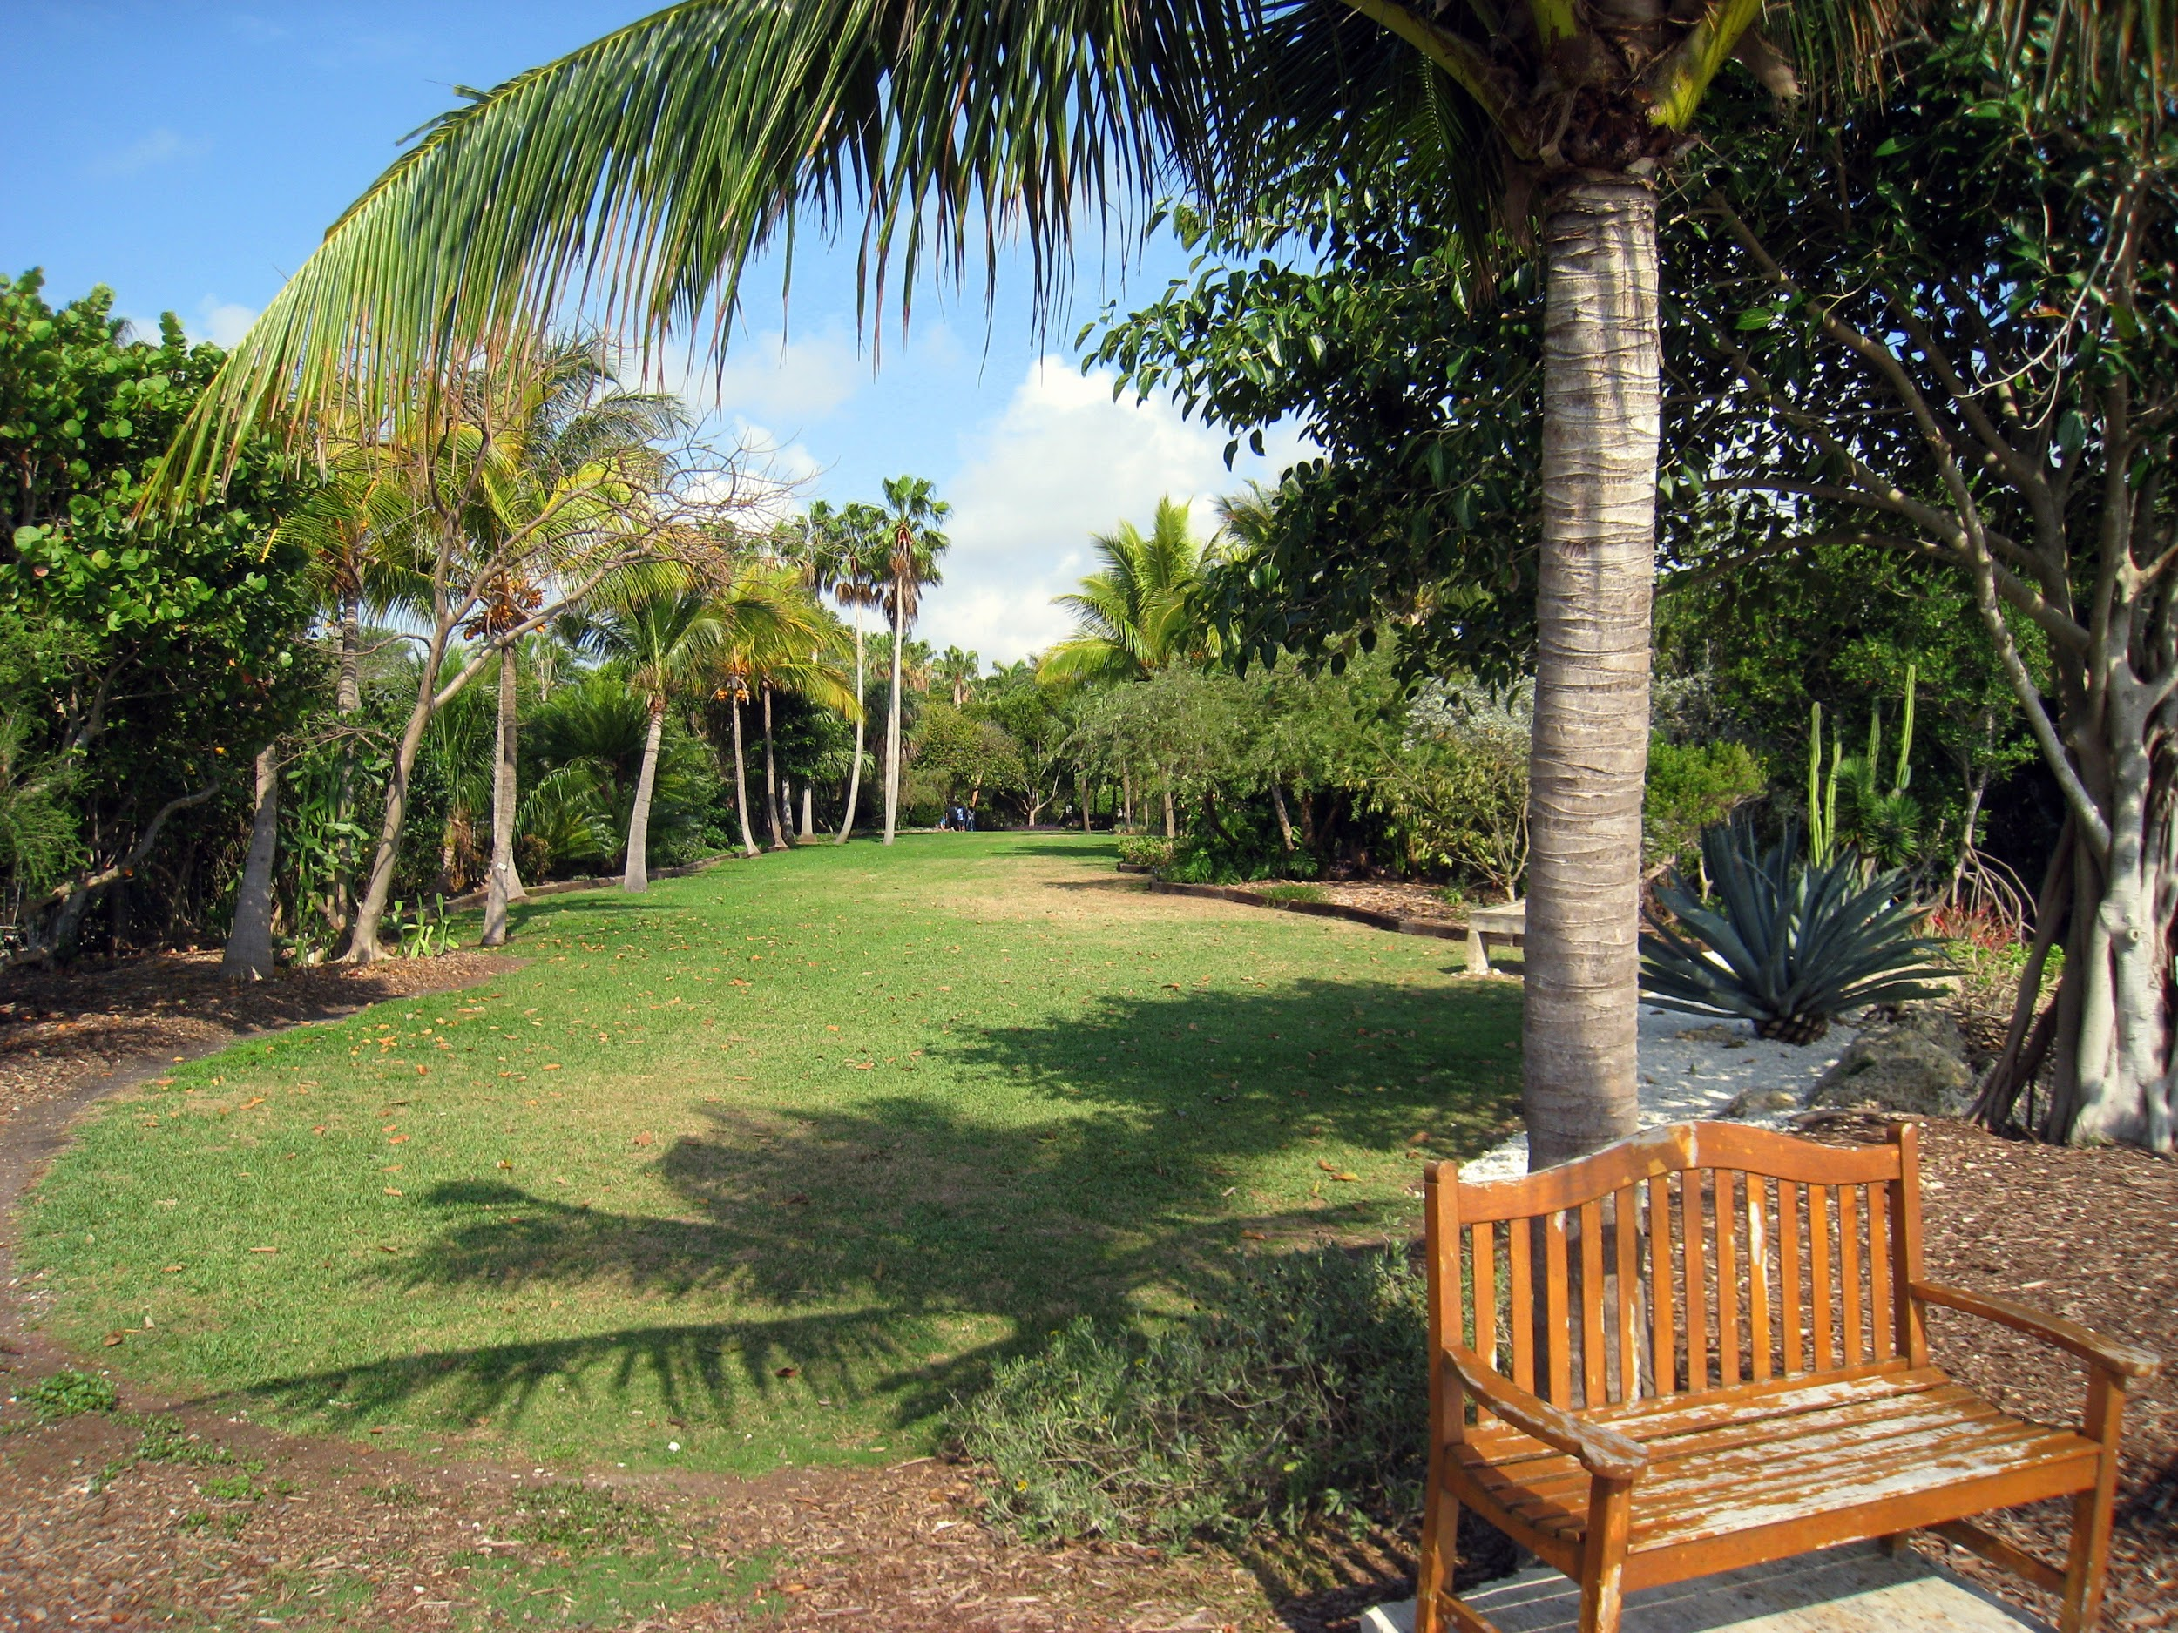
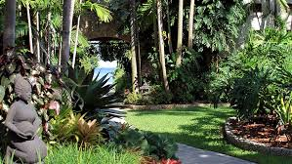
IMPORTANT MONUMENTS:
THE KAMPONG:
The Kampong is a tropical botanical garden. The garden is named with the word "Kampong" which comes from the Malay or Javanese language to designate a village or group of houses. "The Kampong" originally began as his personal collection of plants.

Slide 7
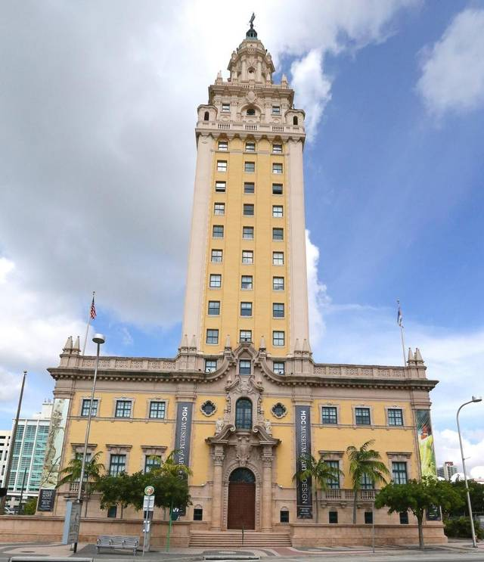
IMPORTANT MONUMENTS:
TOWER OF LIBERTY:
Freedom Tower (Tower of Liberty) is a historic building in Miami at 600 Boulevard Biscayne. Built in 1925 as the headquarters of News & Metropolis.
Restored in 2004 it houses meeting rooms, galleries and showrooms that have shown joint exhibitions with museums and entities.

Slide 8
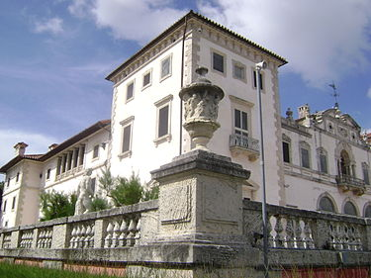
VILLA VIZCAYA:
The mansion is located next to Biscayne Bay in Miami-Dade County, Florida, and was built between 1914 and 1916 by architects.
In 1926 a hurricane damaged the mansion, gardens and other dependencies.

Slide 9
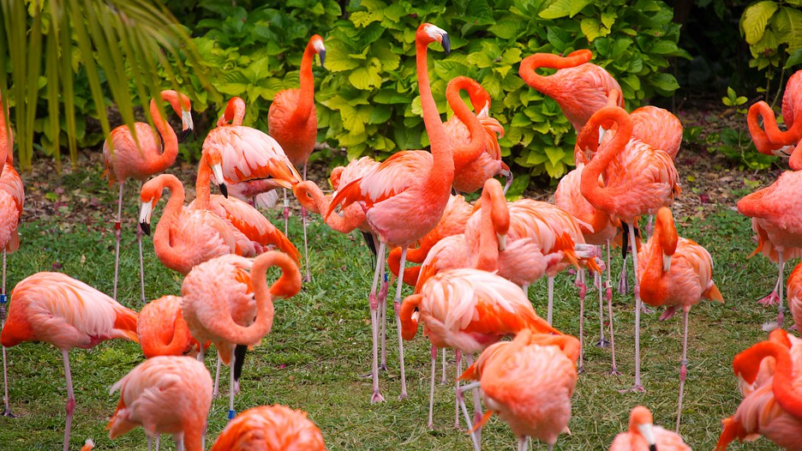
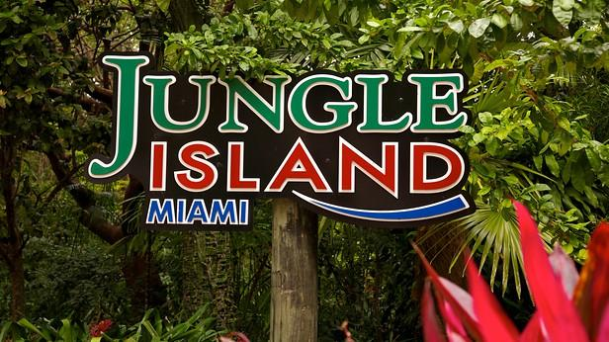
JUNGLE ISLAND:
Jungle Island is an interactive zoological park in Watson Island, Miami, Florida, United States.In 2007, the park was again renamed to Jungle Island.

Slide 10
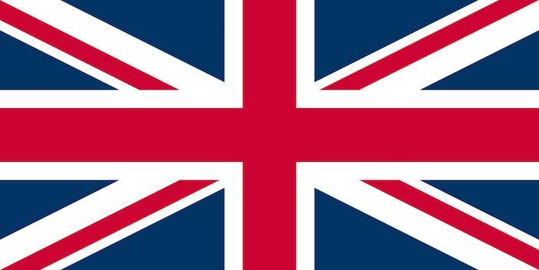
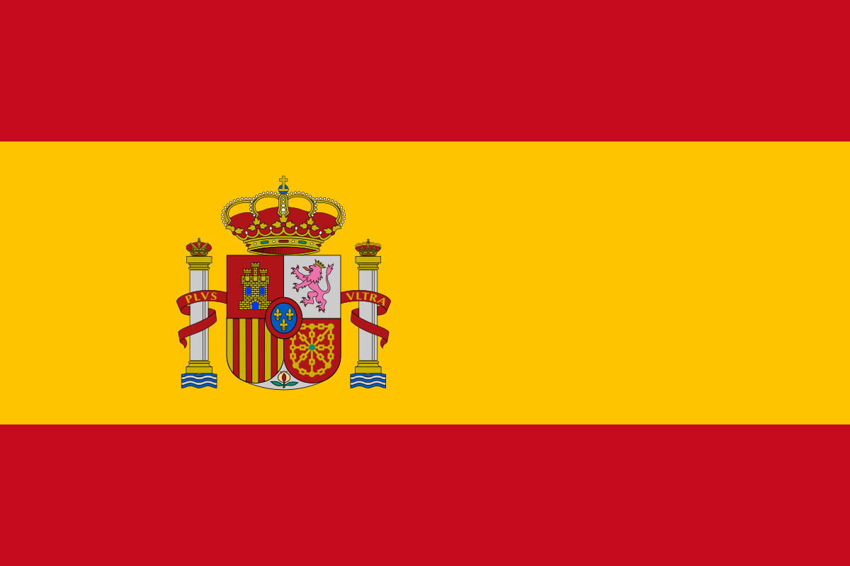
LANGUAGE SPOKEN:
The official language of Miami is English, more than 3/4 of the population speaks or understands Spanish, even in some areas clearly this language predominates. More than half of the inhabitants are of Hispanic descent then Spanish is always present.

Slide 11
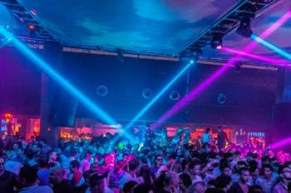
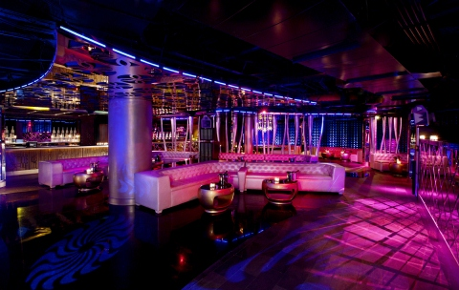
TYPICAL MÚSIC:
Miami always evokes days of beach and nights of good music to dance, especially to the rhythm of Cuban and Latin rhythms. If you have not danced rumba, guaracha, son, salsa, samba, merengue, cumbia or tango in Miami, the trip was incomplete.
The best places to dance is: In the heart of Little Havana, Habana 305, Cubaocho, The Covacha and Havana 1957 (BRICKELL).

Slide 12
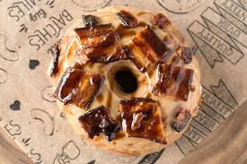
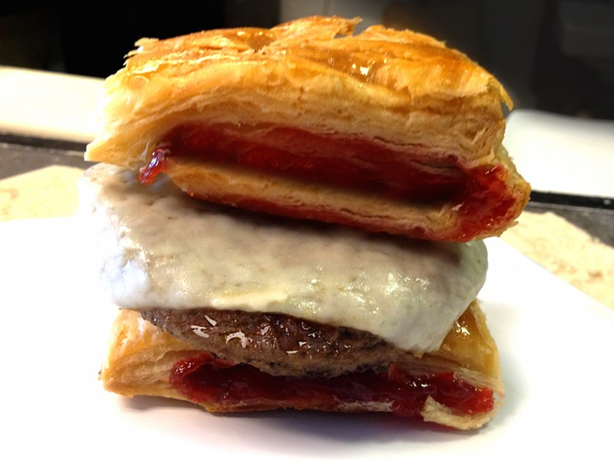
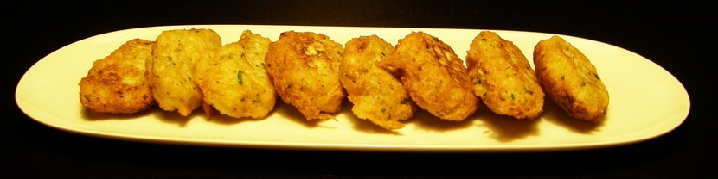
TYPICAL FOOD:
In the Donut:
In the pastelito:
In the Malanga:
Typical of Cuba or Haiti, this tuber is found and served with Creole Sauce and a very peppery base in places like Tap Tap, specializing in Haitian food and one of South Beach's most famous restaurants.
The most popular donut to order on UberEATS is the original glazed donut from the Salty Donut, followed up by the Miami shops maple bacon donut.
Only in Miami do pastelitos come in a variety of shapes (triangles, squares, even spheres)

Slide 13
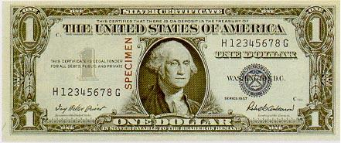
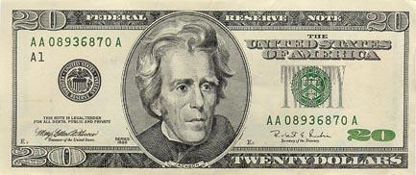
COIN:
The official currency used in miami is the US dollar.

Slide 14
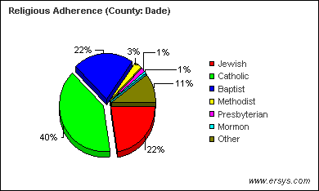
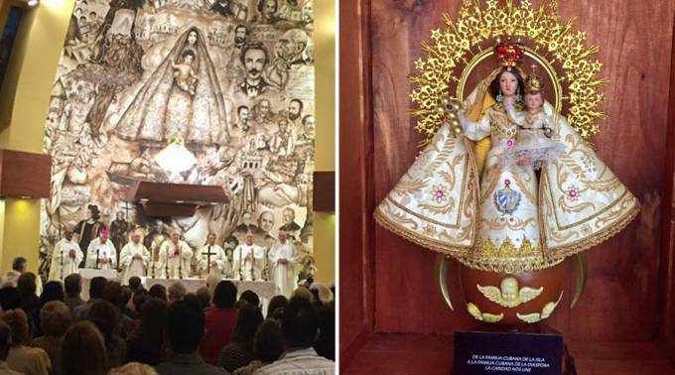
RELIGION:
In Miami, at present there are 500 different churches of more than 32 different confessions. Among the most important confessions are the Baptist with 79 churches representing the majority of the population and the Catholic Church.40

Slide 15
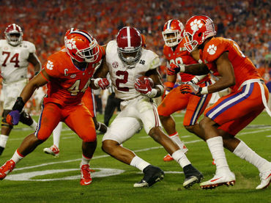
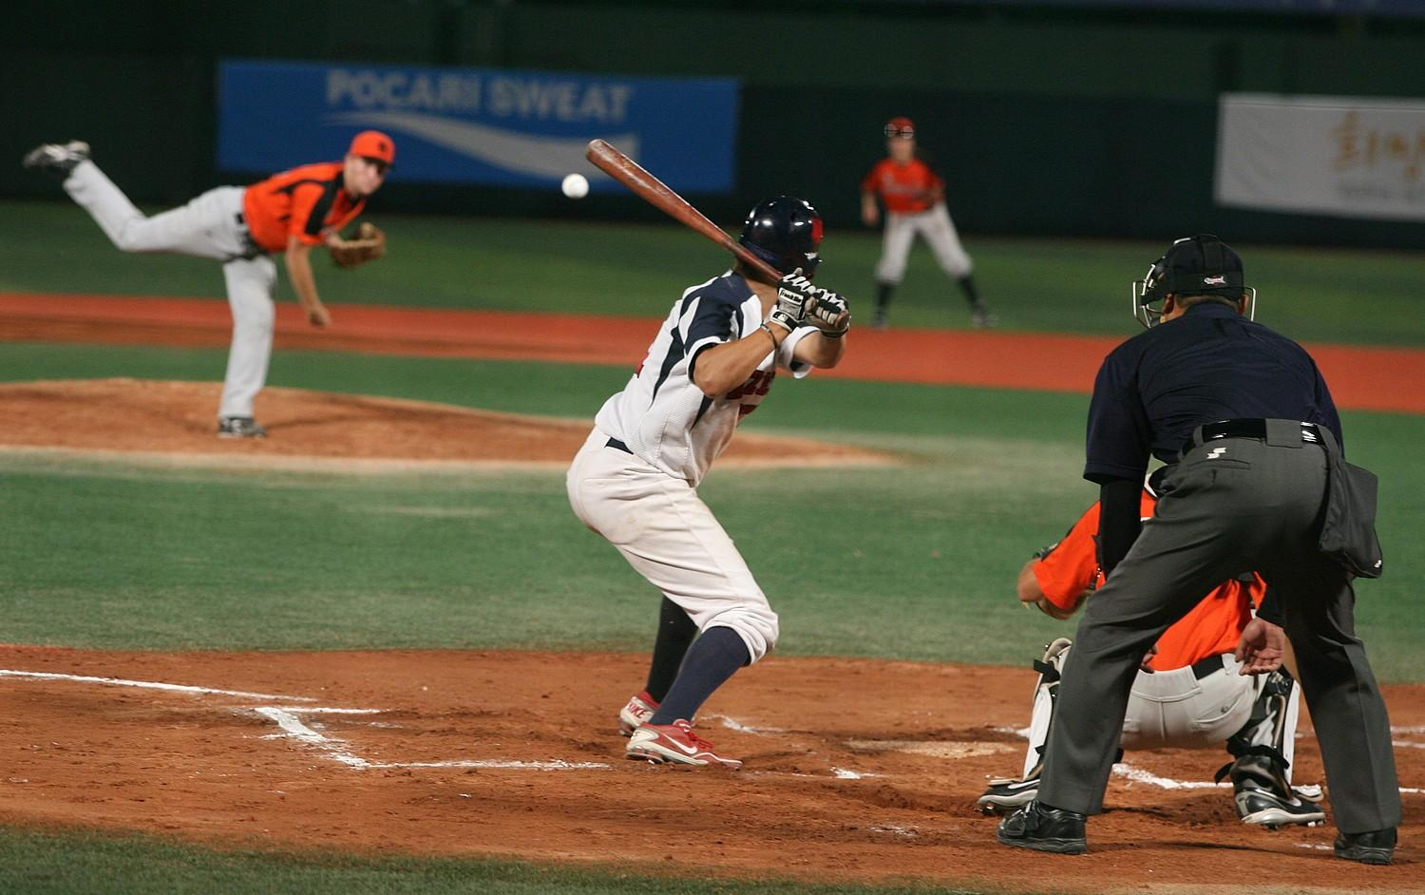

SPORTS:
The traditional sports of miami are american football, ice hockey, baseball,basketball and football.
American Football
Baseball
Ice hockey

Slide 16
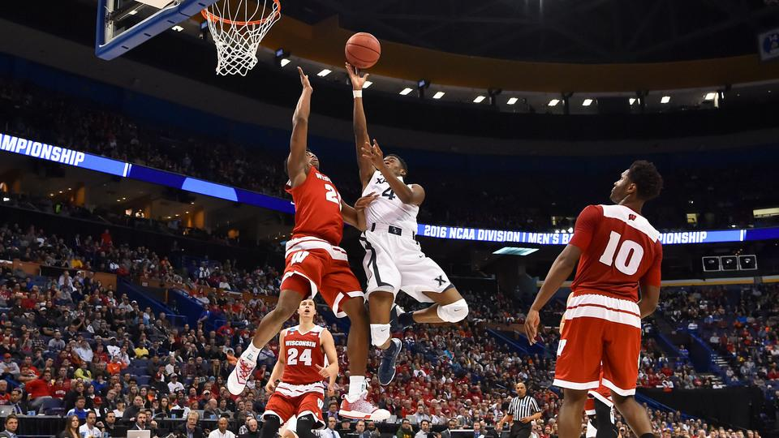
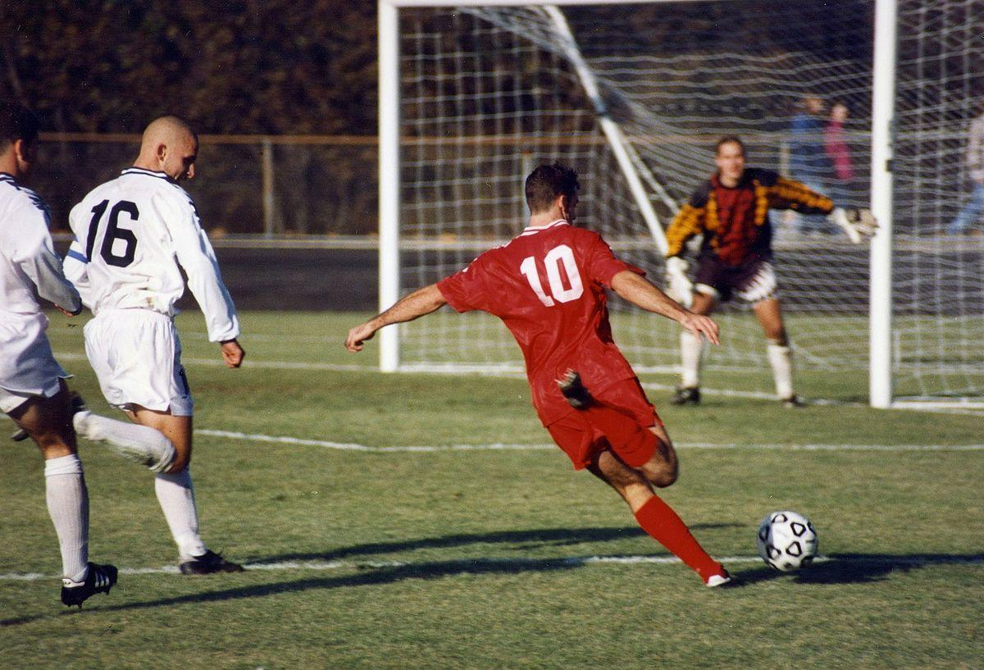
SPORTS:
Basketball
Football

Slide 17
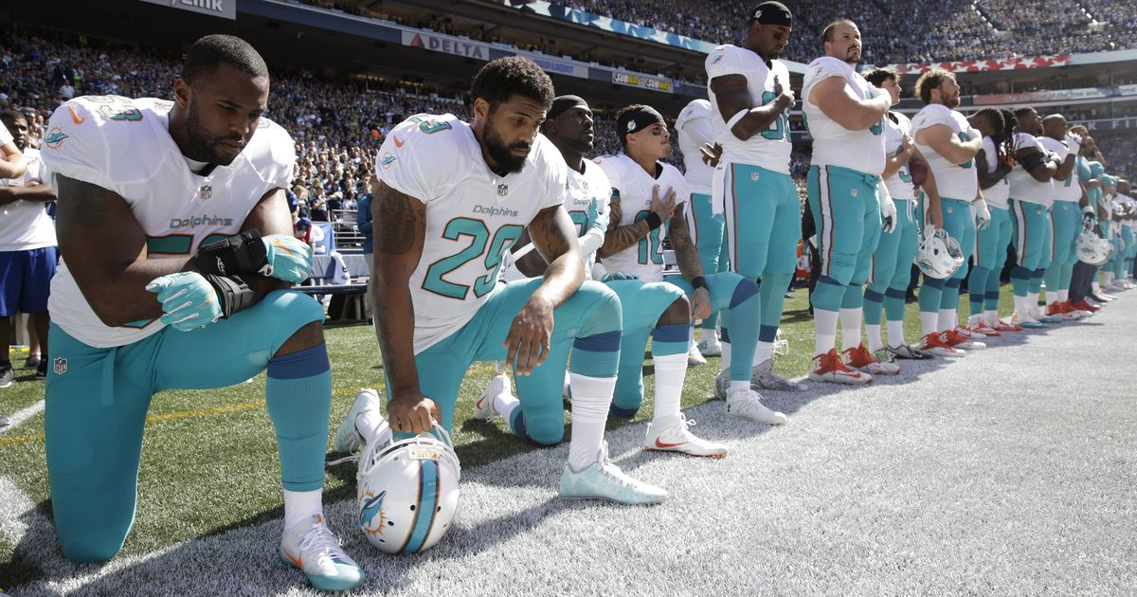
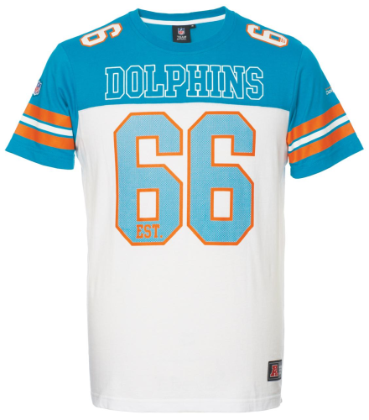
AMERICAN FOOTBALL:
The Miami Dolphins are a professional American football team from the city of Miami, Florida. They are part of the AFC East of the National Football League. They play at Hard Rock Stadium based in the city of Miami, Florida.

Slide 18
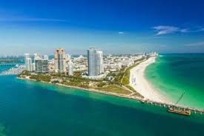
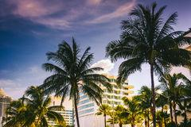
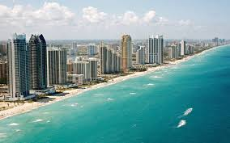
PICTURES:

Slide 19
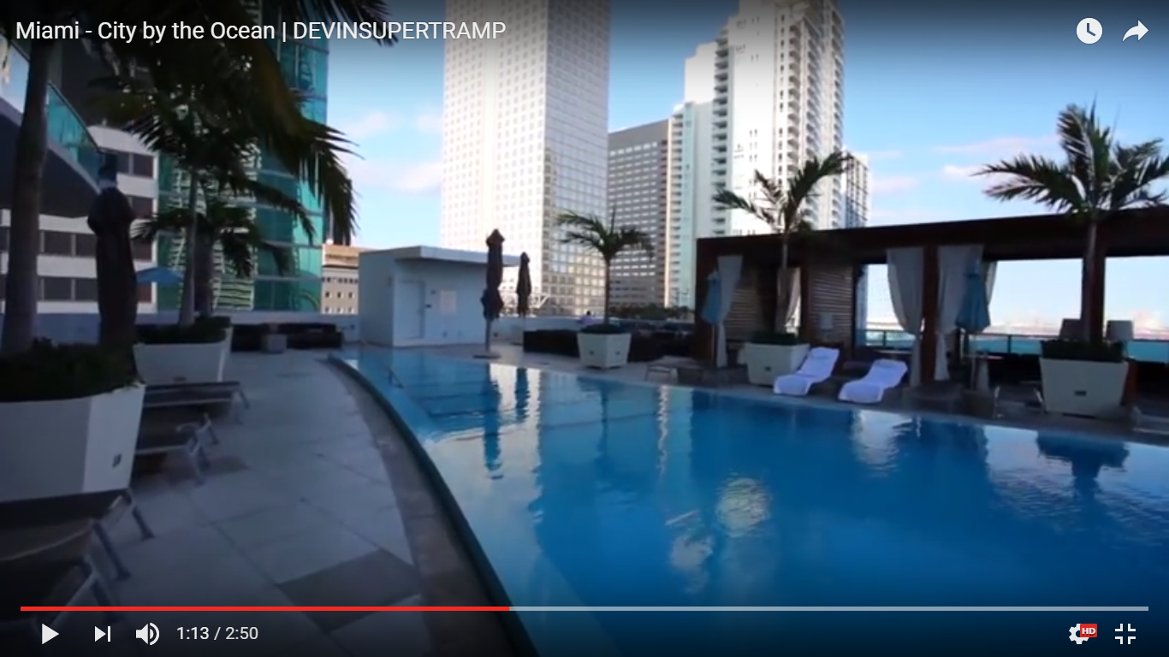
VÍDEOS:
Miami - City by the Ocean | DEVINSUPERTRAMP - YouTube
Now we are going to put a video. LOOK!!!

Slide 20
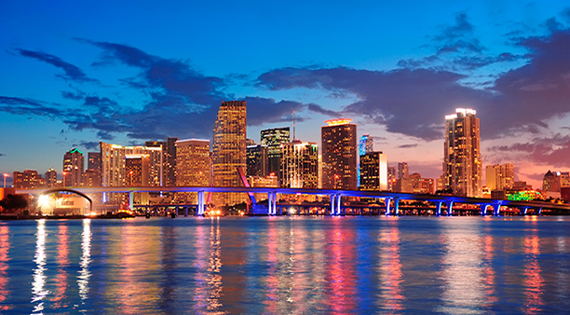
CONCLUSION:
The conclusion of all this is that miami is amazing and it is very beautiful!!!!!!!
Thanks!!!!

