Slide 1
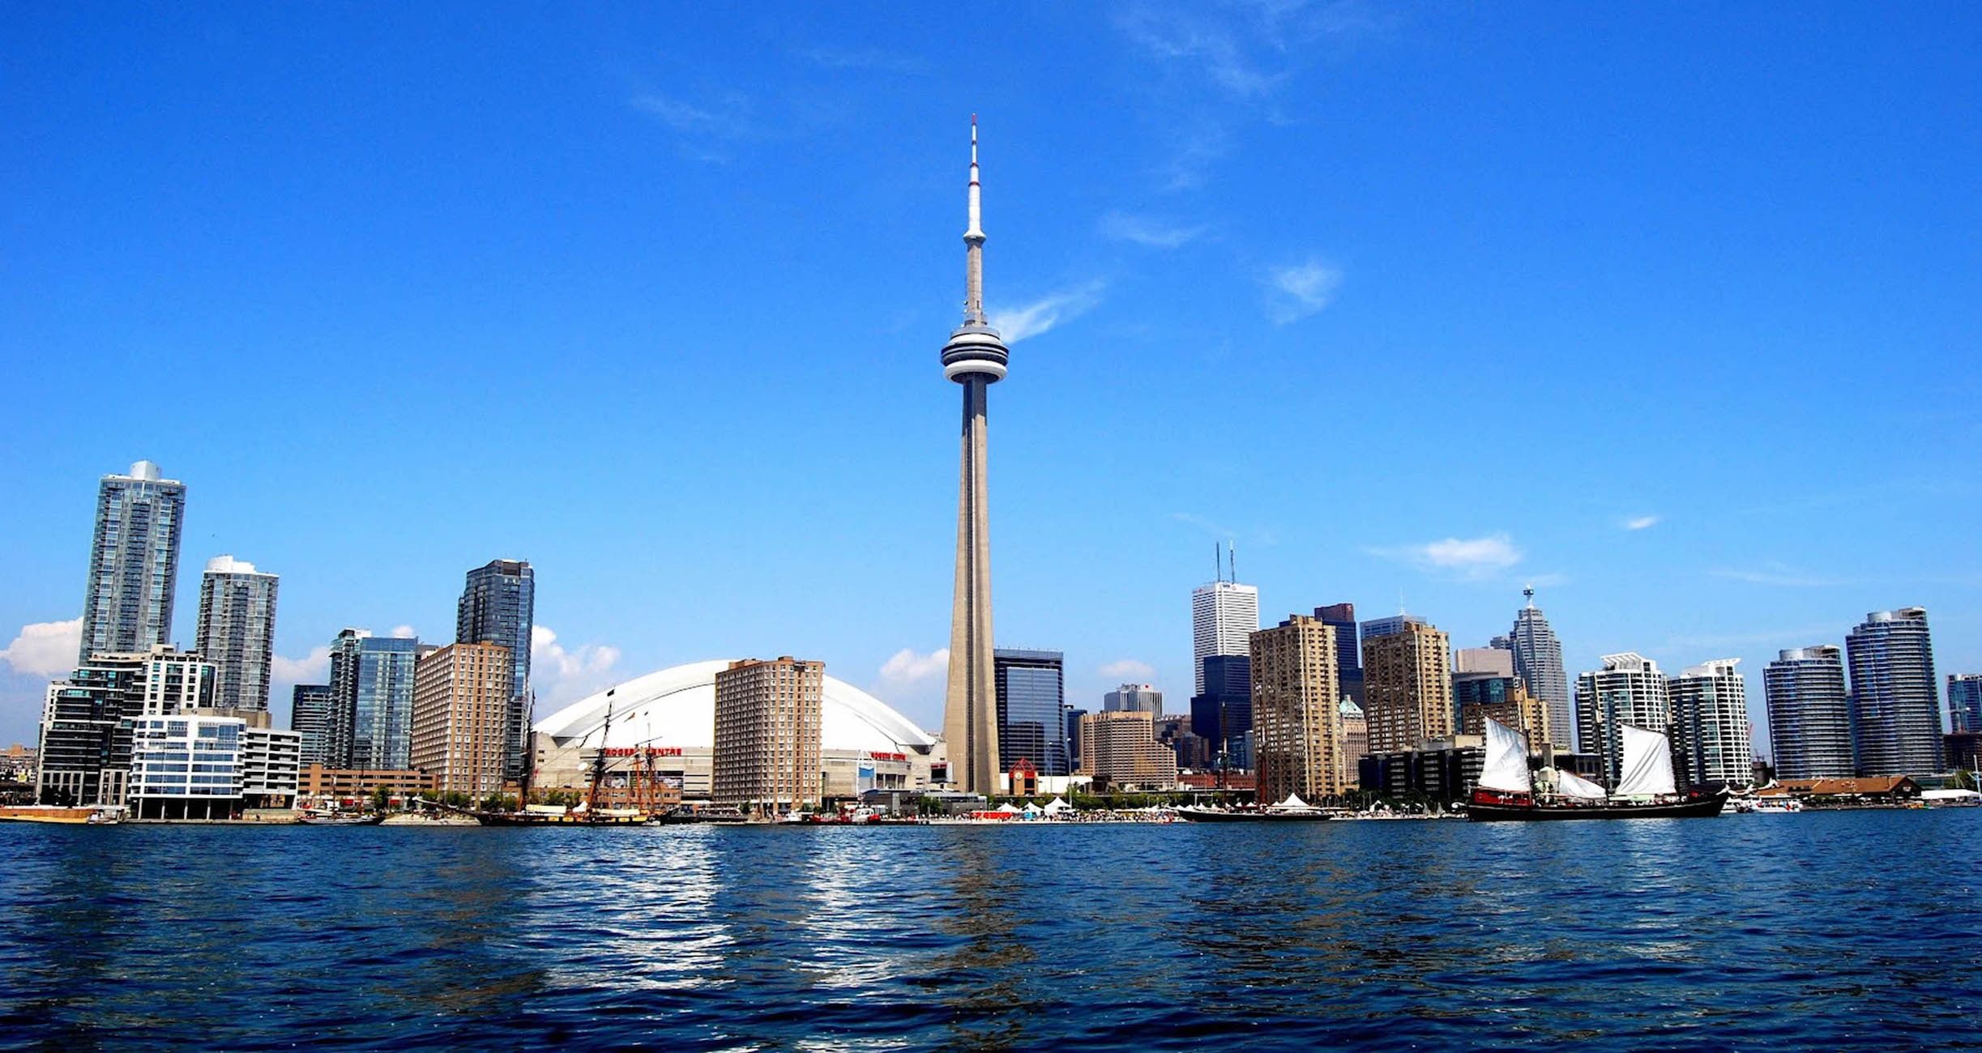
Canada

Slide 2
Index:
Information of Canada.
Flag and coin.
Language and religions.
Important monuments.
Tipycal Food.
Tipycal Sports.
Tipycal Music.

Slide 3
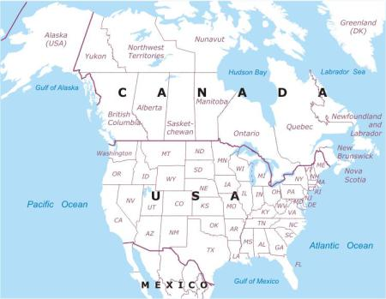
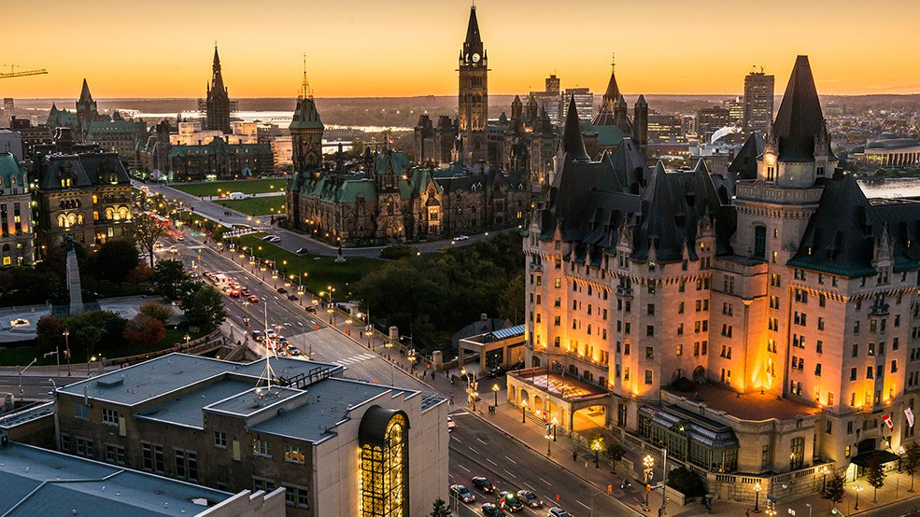
Information:
Canada Is situated to the north of America.
In Canada there are 36.155.487 inhabitants.
The capital of Canada is Ottawa.

Slide 4
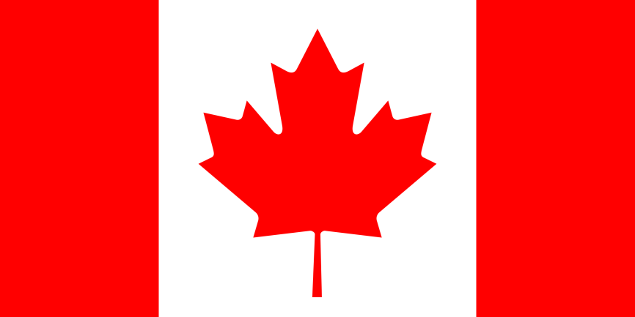
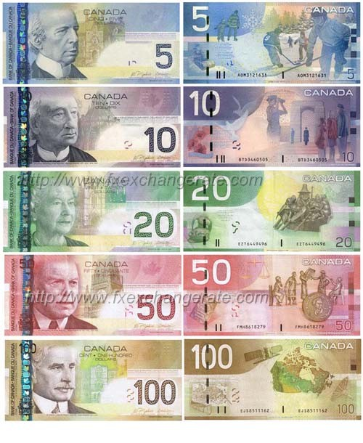
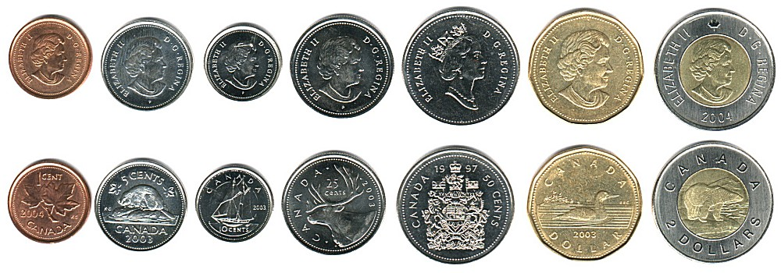
Flag:
Symbolize the belonging of the country, and his loyalty to the crown.
Coin:
These are the coins and the billets that use in Canada.

Slide 5
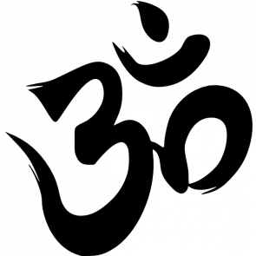
Language:
The language that speaks in Canada is the French and English.
Religions:
The religions that practise are:
Christianity Islamisme Hinduism

Slide 6
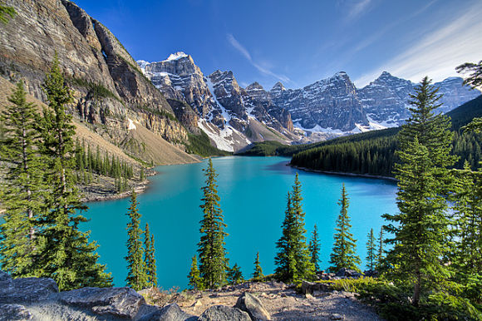
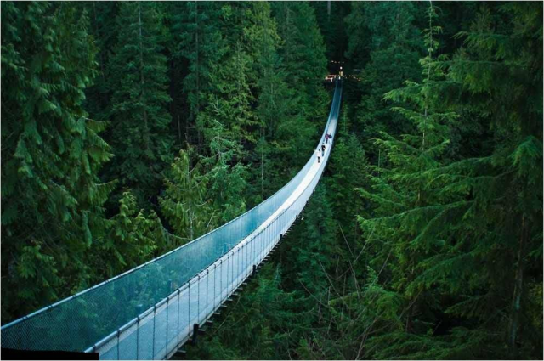
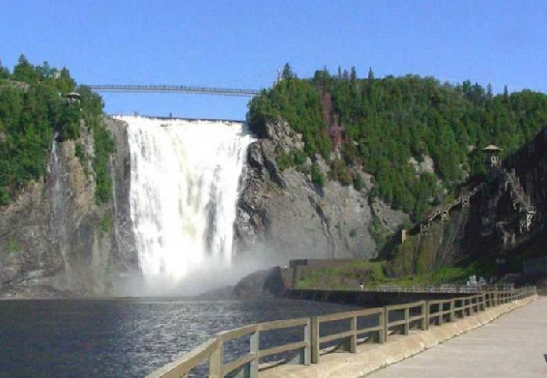
Importants monuments:
National park Banff
Bridge hanging of Capilano
It is the national park more ancient of Canada. Has 6.641 kilómetres square.
Waterfalls of Montmorency
It is formed by the river of his same name, and divides the city of Quebec and of the municipalitat of Boischatel.
In the bridge hanging of Capilano crosses the river Capilano in the North district in Vancouver. It has an extension of 140 metres.

Slide 7
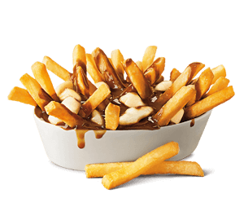
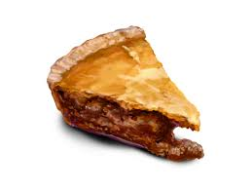
Food:
These are the foods tipics of Canada:
Poutine
Toutière
It is done with chips, cheese and sauce of meat.
It is a cake of meat.

Slide 8
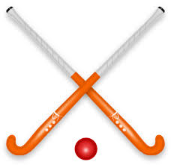
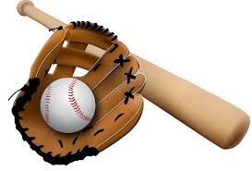
Sports:
The tipics sports of Canada are:
Hockey
Baseball
A sport of two teams that plays on ice.
It plays with two players, one lance and the other has to take the ball.

Slide 9
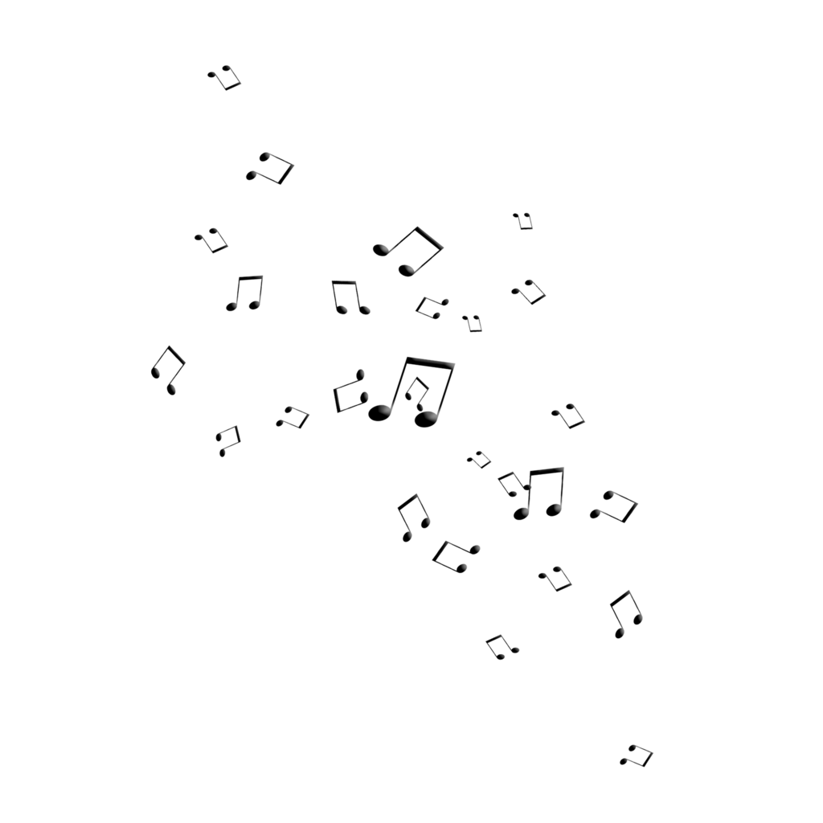
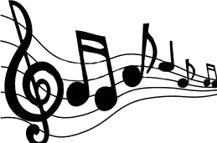
Music:
The music tipyc the Jazz and Country;
Jazz: https://youtu.be/o26qoCYLdS8
Country: https://youtu.be/neroS5wrkpQ

